Slide 1
New Meal Pattern Requirements and Nutrition Standards
USDA’s National School Lunch and School Breakfast Programs

Slide 2
Agenda
Welcome
Training Overview
New Meal Pattern –
  Meal Components
  Dietary Specifications
Timelines for Implementation
Key Issues and Questions
Offer versus Serve
Food Service Management Companies
Program Monitoring
Resources and Sharing Session
USDA Foods
Child Nutrition (CN) Labeling Program
HealthierUS School Challenge (HUSSC)

Slide 3
Activities
Case Study
  Applying some of the main points of today’s training as we go along.
Top 10 list
  What are the top 10 things that must be implemented as of July 1, 2012?
Notes:
In your packets, you have some yellow pages stapled together. This is a case study for a fictitious school district. We’ve provided you with the scenario of a district SFA Director preparing for the new meal pattern changes. As we go through the various presentations throughout the day, we’ll pause at the end of some of them to give you a chance to apply the information you’ve received and then share everyone’s responses with the group.
The other activity that we’ll be conducting throughout the day is a little less formal. Also in your packets, you have one bright yellow page with a blank numbered list for you to list the Top 10 Requirements that must be implemented by July 1, 2012. We have received several questions from states and locals about requirements that do not need to be implemented in the next year. While we are very pleased to hear that you are planning ahead, we also hope to dispel any anxiety you or your schools may be feeling when looking at the big picture of everything that needs to be implemented over the next ten years. There are actually 12 items on the list, but the effect of the two bonus items on your workloads are to either make them easier or not affect them at all.

Slide 4
Overview of Requirements
Notes:
We will start with a brief overview of the requirements for lunch and breakfast, along with the implementation timeframes for each. Much of this information comes from the webinars held when the final rule was released, though it is organized slightly differently than in the webinars. Then we’ll spend most of the rest of the morning on issues and questions that have been raised since then. There will be plenty of time for questions and interaction as we go along.

Slide 5
Age/Grade Groups
Same age/grade groups for NSLP and SBP:
  K-5
  6-8
  9-12
In the SBP, the change takes effect in SY 2013-2014 to ease burden on program operators
Notes:
This rule requires schools to use the same age/grade groups for planning lunches and breakfasts.
The age/grade groups are now narrower to provide age-appropriate meals. However, the rule allows some flexibility to schools that have different grade configurations. This rule permits a school to use one meal pattern for students in grades K through 8 as food quantity requirements for groups K-5 and 6-8 overlap. However, this will require careful planning to ensure requirements are met for both of these two groups.
These age/grade group changes go into effect in SY 2012-13 for lunch. Breakfast has a one year delay in response to operator concerns, and is required beginning SY 2013-14.
Therefore, in SY 2012-13 only, schools have the option to continue the age/grade group K-12 for planning breakfasts.

Slide 6
Menu Planning Approach Changes
Food-Based Menu Planning approach for all age/grade groups
  NSLP operators must use FBMP beginning SY 2012-2013
  SBP operators must use FBMP beginning SY 2013-14
Notes:
A single food-based menu planning approach will be required for both school breakfast and lunch operators.
This approach simplifies menu planning, serves as a teaching tool to help children choose a balanced meal, and ensures that students nationwide have access to key food groups recommended by the Dietary Guidelines.
It also makes it easier for schools to communicate the meal improvements to parents and the community-at-large. Simplifying program management, training and monitoring is expected to result in program savings.
Over 70 percent of program operators currently use food-based menu planning, and training and technical assistance resources will be available to help remaining schools successfully transition to the new meal patterns.
This menu planning approach will be required for lunch operators in SY 2012-2013. However, in response to commenters’ concerns about the estimated cost increase of the breakfast meal, this final rule gives breakfast program operators not currently using food-based menu planning additional time to convert to this planning approach.
Accordingly, breakfast operators may continue with their current menu planning approach until SY 2013-2014.

Slide 7
Lunch Requirements
Notes:
As noted, the age/grade groups apply to both breakfast and lunch, and when breakfast is fully implemented all schools will be using a single food-based menu planning approach for all meals.
Now let’s spend a few minutes reviewing all of the meal pattern requirements for the lunch program.

Slide 8
Lunch Meal Components
Fruits
Vegetables
Grains
Meat/Meat Alternate
Milk
Notes:
I want to start by mentioning that there are now 5 meal components for lunch --- fruits, vegetables, grains, meat/meat alternate and milk. As you know, fruits and vegetables are now separate components.

Slide 9
Lunch Meal Pattern
 | Lunch Meal Pattern
 | Grades K-5 | Grades 6-8 | Grades 9-12
Meal Pattern | Amount of Foodª Per Week (Minimum Per Day)
Fruits (cups)^{b} | 2.5 (0.5) | 2.5 (0.5) | 5 (1)
Vegetables (cups)^{b} | 3.75 (0.75) | 3.75 (0.75) | 5 (1)
Dark green^{c} | 0.5 | 0.5 | 0.5
Red/Orange^{c} | 0.75 | 0.75 | 1.25
Beans and peas (legumes)^{c} | 0.5 | 0.5 | 0.5
Starchy^{c} | 0.5 | 0.5 | 0.5
Other^{c,d} | 0.5 | 0.5 | 0.75
Additional Veg to Reach Total^{e} | 1 | 1 | 1.5
Grains (oz eq) ^{f} | 8-9 (1) | 8-10 (1) | 10-12 (2)
Meats/Meat Alternates (oz eq) | 8-10 (1) | 9-10 (1) | 10-12 (2)
Fluid milk (cups) ^{g} | 5 (1) | 5 (1) | 5 (1)
Other Specifications: Daily Amount Based on the Average for a 5-Day Week
Min-max calories (kcal)^{h} | 550-650 | 600-700 | 750-850
Saturated fat (% of total calories)^{h} | < 10 | < 10 | < 10
Sodium (mg)^{h,i} | < 640 | < 710 | < 740
Trans fat^{h} | Nutrition label or manufacturer specifications must indicate zero grams of trans fat per serving.
Notes:
This is the new meal pattern for lunch.
There is a copy of the full meal pattern chart in your packets which you can refer to throughout the day
Now let’s review the requirements for each of the components

Slide 10
Fruits (Lunch)
Lunch Meal Pattern
 | Grades K-5 | Grades 6-8 | Grades 9-12
Meal Pattern | Amount of Food^{b} Per Week (Minimum Per Day)
Fruits (cups) | 2.5 (0.5) | 2.5 (0.5) | 5 (1)
Notes:
This slide shows the fruits component for lunch, excerpted from the meal pattern chart. You can see that there is a requirement for 2.5 to 5 cups of fruit at lunch, per week, depending on the age/grade group being served. The numbers in parentheses refer to the minimum amount to be served daily.
You can see that the minimum weekly requirement at lunch for fruit is 2.5 cups for Grades K-5 as well as Grades 6-8, and a minimum of 5 cups per week for Grades 9-12. Grades K-5 and Grades 6-8 have minimum daily requirements of ½ cup (as shown again in parentheses) and Grades 9-12 must be offered a minimum of 1 cup of fruit per day.

Slide 11
Fruits (Lunch)
Fruits/vegetables separated into two components
A daily serving at lunch
May select from fresh, frozen without added sugar, canned in juice/light syrup, or dried fruit options
  No more than half of fruit offerings may be in the form of juice
  100% juice only
  ¼ cup of dried fruit = ½ cup of fruit
  Refer to Food Buying Guide for crediting
Notes:
Additionally, this rule separates fruits and vegetables into two different food components.
A daily serving of fruit must be offered at lunch.
If students select fruit, they must select at least a ½ cup serving of fruit to count toward a reimbursable meal, under offer vs serve (otherwise, must take full required offering).
Fruit may be offered in several different forms. These forms include: fresh, frozen without added sugar, canned in juice or light syrup, and dried. However, no more than half of fruit offerings may be in the form of juice, and only 100%, full strength, juice can be served. For crediting purposes, dried fruit is credited as twice the volume as served. Therefore, ¼ of a cup of dried fruit is creditable as ½ of a cup of fruit.
Menu planners must continue to use the Food Buying Guide for Child Nutrition Programs to determine how to credit whole fruit. USDA will update the Food Buying Guide as soon as possible, and will also develop other technical assistance resources as needed.

Slide 12
Vegetables (Lunch)
 | Lunch Meal Pattern
 | Grades K-5 | Grades 6-8 | Grades 9-12
Meal Pattern | Amount of Food Per Week (Minimum Per Day)
Vegetables (cups) | 3.75 (0.75) | 3.75 (0.75) | 5 (1)
Dark green | 0.5 | 0.5 | 0.5
Red/Orange | 0.75 | 0.75 | 1.25
Beans/Peas (Legumes) | 0.5 | 0.5 | 0.5
Starchy | 0.5 | 0.5 | 0.5
Other | 0.5 | 0.5 | 0.75
Additional Veg to Reach Total | 1 | 1 | 1.5
Notes:
This rule seeks to give children access to a variety of vegetables, and requires weekly minimums of all vegetable subgroups.
For lunch, the new meal pattern requires a daily serving of vegetables. There are also weekly minimums for the vegetable subgroups- this means that over the course of the week, the required amount of each subgroup must be met, but that on any given day there are no specific subgroup requirements.
The subgroups required each week consist of: dark green, red/orange, beans/peas (legumes), starchy, and other.
The “other” vegetable subgroup is a distinct grouping of food items, as classified by the 2010 Dietary Guidelines (handout included in folders). Schools can substitute vegetables from the dark green, red/orange, or beans/peas for “other” vegetables if they desire, but they may NOT substitute starchy vegetables for “other” vegetables.
Additionally, there is a catch-all category added for additional vegetables that can come from any subgroup to meet the weekly total.

Slide 13
Vegetables (Lunch)
A daily serving that reflects variety over the week
Vegetable subgroup weekly requirements for:
    Dark Green (e.g., broccoli, collard greens, spinach)
    Red/Orange (e.g., carrots, sweet potatoes, tomatoes)
    Beans/Peas (Legumes) (e.g., kidney beans, lentils, chickpeas)
    Starchy (e.g., corn, green peas, white potatoes)
    Other (e.g., onions, green beans, cucumbers)
    Additional vegetables to meet 5 cup weekly total
Notes:
On this slide, you will see a few examples of vegetables from each of the subgroups - dark green, red/orange, beans/peas (legumes), starchy, and other.
Again, there is a catch-all category added for additional vegetables that can come from any subgroup to meet the weekly total.

Slide 14
Vegetables (Lunch)
Variety of preparation methods available
  Fresh, frozen, and canned products
  USDA Foods offers a variety of no salt added or lower sodium products
Changes in crediting of leafy greens
Foods from the beans/peas (legumes) subgroup may be credited as a vegetable OR a meat alternate
Notes:
Schools may select from a variety of vegetable preparation methods to meet these new requirements. Fresh, frozen and canned products are all allowable.
Schools have access to many nutritious vegetable choices through USDA Foods. For instance, schools can select reduced sodium canned vegetables with no more than 140 mg of sodium per half-cup serving, which is in line with the 2010 Dietary Guidelines. Schools can also order frozen vegetables with no added salt, such green beans, carrots, corn, and peas.
As is currently practiced, 1/8 of a cup of vegetables is the minimum creditable amount. In this final rule, however, the crediting of leafy greens is changed. Uncooked, leafy greens will credit as half of volume as served. Therefore, one cup of romaine lettuce is creditable as one half of a cup of vegetables.
Additionally, local menu planners can decide how to incorporate beans and peas (legumes) into the school meal. These foods may count toward either the requirement for vegetables or the meat/meat alternate component. However, schools may not offer one serving of beans and peas and count it toward both food components during the same meal.

Slide 15
Grains (Lunch)
Lunch Meal Pattern
 | GradesK-5 | Grades6-8 | Grades9-12
Meal Pattern | Amount of Food^{b} Per Week (Minimum Per Day)
Grains (oz eq) | 8-9 (1) | 8-10 (1) | 10-12 (2)
Notes:
The next meal component I will discuss is grains. The biggest change from current practice is a new requirement for whole grain-rich food items.
The whole grain provisions shown here are unchanged from the proposed rule.
However, many program operators expressed concern about the increased quantity of food offered to children. Therefore, the weekly grain quantities required at lunch are reduced to 8-9 ounce equivalents for grades K-5, 8-10 ounce equivalents for grades 6-8, and 10-12 ounce equivalents for grades 9-12.

Slide 16
Grains (Lunch)
Schools must offer the daily and weekly serving ranges of grains
  Maximums and minimums
Initially, at least ½ of grains offered during the week must be whole grain-rich
Beginning in SY 2014-15, all grains offered must be whole grain-rich
  “Whole grain-rich” foods must contain at least 50 percent whole grains
Notes:
Now, I will talk about the grains requirement for lunch. Please note that there are both weekly minimums and weekly maximums.
The whole grain-rich requirements will be phased in gradually. Beginning SY 2012-2013, at least half of the grains offered at lunch must be whole grain-rich. Beginning SY 2014-15, all grains offered at lunch must be whole-grain rich.

Slide 17
Grains (Lunch)
Grain-Based Desserts
  Only two creditable grain-based desserts allowed at lunch per school week
  These items are a major source of solid fats and added sugars per DGA 2010
Notes:
Due to the contribution of grain-based desserts toward intake of solid fats and added sugars, USDA has reduced the number of allowable grain-based desserts at lunch to a maximum of 2 per week.

Slide 18
Criteria for Whole Grain-Rich Foods
Meet the serving size requirements in the Grains/Breads Instruction, and
Meet at least one of the following:
      Whole grains per serving must be ≥ 8 grams
      Product includes FDA’s whole grain health claim on its packaging
      Product ingredient listing lists whole grain first (HUSSC criteria)
Notes:
Until the FDA addresses labeling for the whole grain content of food products, schools will follow USDA guidance on whole grain-rich foods. Our guidance incorporates the temporary criteria for whole grain-rich foods provided in the IOM report.
That criteria is based on what is currently possible given the limited information on product packaging regarding the whole grain content of food products.
First, a product must meet the grains/breads instruction serving size requirements- which are currently being updated.
Second, a product must also meet one of the following:
Whole grains per serving must be greater than or equal to 8 grams
The product includes FDA’s whole grain health claim on its packaging, OR
The product ingredient listing lists whole grain first
.At this time, the product ingredient listing is the only certain way to tell because manufacturers aren’t required to provide information about the grams of whole grains in their products, and the FDA whole grain health claim is not mandatory.
USDA’s Healthier US School Challenge initiative has already developed whole grains guidance, and we will provide more technical assistance as needed.

Slide 19
Meats/Meat Alternates (Lunch)
Lunch Meal Pattern
 | Grades K-5 | Grades 6-8 | Grades 9-12
Meal Pattern | Amount of Food Per Week (Minimum Per Day)
Meats/Meat Alternates (oz eq) | 8-10 (1) | 9-10 (1) | 10-12 (2)
Notes:
This shows the daily minimums for the different age/grade groups in parentheses, as well as the weekly ranges for the different groups (8-10 oz. eq. for K-5; 9-10 oz. eq. for 6-8; and 10-12 oz. eq. for 9-12). Please note that these weekly ranges are minimums and maximums; K-8 should not get more than 10 oz. eq. per week, and 9-12 should not get more than 12 oz. eq. per week.
These requirements go into effect in Lunch in SY 2012-13

Slide 20
Meats/Meat Alternates (Lunch)
Daily and weekly requirements for lunch only
  2 oz eq. daily for students in grades 9-12
  1 oz eq. daily for younger students
A variety of meat/meat alternates is encouraged
Tofu and soy yogurt will be allowable as meat alternate
See memo SP-16-2012, Crediting Tofu and Soy Yogurt Products
Notes:
Offering a meat/meat alternate daily as part of the school lunch supplies protein, B vitamins, vitamin E, iron, zinc, and magnesium to the diet of children, and also teaches them to recognize the components of a balanced meal.
Students in grades 9-12 must be offered at least 2 ounce equivalents daily, and younger students must be offered at least one ounce equivalent daily. Meal planners have flexibility to determine how to reach the required weekly ranges.
USDA encourages schools to offer a variety of protein foods such as lean or extra lean meats, seafood, and poultry; beans and peas; fat-free and low-fat milk products such as cheese and yogurt; and unsalted nuts and seeds, to meet the meat/meat alternate requirement. However, there is no requirement to offer the protein subgroups as described in the 2010 Dietary Guidelines.
Additionally, both tofu and soy yogurt will be creditable as meat alternates. This allows schools to diversify the sources of protein available to students and better meet the dietary needs of vegetarians and culturally diverse groups in schools. We’ll talk about this crediting later today.

Slide 21
Milk (Lunch)
Lunch Meal Pattern
 | Grades K-5 | Grades 6-8 | Grades 9-12
Meal Pattern | Amount of Food Per Week (Minimum Per Day)
Fluid milk (cups) ^{l} | 5 (1) | 5 (1) | 5 (1)
Notes:
The last meal component I will discuss is the fluid milk requirement. At least 1-cup of milk must be offered each day for lunch regardless of age/grade group. This is a minimum requirement.
These requirements are effective in lunch in school year 2012-13.

Slide 22
Milk (Lunch)
Allowable milk options:
  Fat-free (unflavored or flavored)
  Low-fat (unflavored only)
  Fat-free or low-fat (lactose-reduced or lactose-free)
Must offer at least two choices
Does not alter nutrition standards for milk substitutes (e.g., soy beverages)
Milk provisions also apply to children ages 3-4
Notes:
Schools must offer at least two choices within the types of milk listed - fat-free (unflavored or flavored) and unflavored low-fat milk.
Schools may offer a variety of milk options such as - fat-free (unflavored or flavored), low-fat (unflavored only), and fat-free or low-fat (lactose reduced or lactose-free). Note that if flavored lactose reduced or lactose-free milk is offered, it also must be fat-free. Schools are not allowed to offer 2% or whole milk.
There is no change to the requirements for the nutritional content of optional non-dairy beverages offered to students with special dietary needs in place of milk at the request of parents.
Lastly, the milk fat and flavor restrictions established by this final rule also apply to meals for children in the 3-4 year-old age group. USDA notified program operators of this requirement for all school meals through implementation memorandum SP-29-2011.

Slide 23
Breakfast Requirements
Notes:
Now let’s spend a few minutes reviewing all of the meal pattern requirements for breakfast.

Slide 24
Breakfast Meal Components
Fruits
Grains
Milk
Notes:
There are 3 components for breakfast, once fully implemented: Fruits, Grains and Milk.
In the School Breakfast Program meat/meat alternate is not a required component for a reimbursable meal but may be offered under certain circumstances which we’ll discuss in a minute.

Slide 25
Breakfast Meal Pattern
 | Breakfast Meal Pattern
 | Grades K-5 | Grades 6-8 | Grades 9-12
Meal Pattern | Amount of Foodª Per Week (Minimum Per Day)
Fruits (cups)^{b} | 5 (1) ^{e} | 5 (1) ^{e} | 5 (1) ^{e}
Vegetables (cups)^{b} | 0 | 0 | 0
Dark green^{c} | 0 | 0 | 0
Red/Orange^{c} | 0 | 0 | 0
Beans and peas (legumes)^{c} | 0 | 0 | 0
Starchy^{c} | 0 | 0 | 0
Other^{c,d} | 0 | 0 | 0
Additional Veg to Reach Total^{e} | 0 | 0 | 0
Grains (oz eq) ^{f} | 7-10 (1) ^{j} | 8-10 (1) ^{j} | 9-10 (1) ^{j}
Meats/Meat Alternates (oz eq) | 0 ^{k} | 0 ^{k} | 0 ^{k}
Fluid milk (cups) ^{g} | 5 (1) | 5 (1) | 5 (1)
Other Specifications: Daily Amount Based on the Average for a 5-Day Week
Min-max calories (kcal)^{h} | 350-500 | 400-550 | 450-600
Saturated fat (% of total calories)^{h} | < 10 | < 10 | < 10
Sodium (mg)^{h,i} | < 430 | < 470 | < 500
Trans fat^{h} | Nutrition label or manufacturer specifications must indicate zero grams of trans fat per serving.
Notes:
Here is the breakfast meal pattern. You’ve got a copy in your handouts, as part of the overall meal pattern handout.
Let’s review the requirements for each of the components. As we move through this part, I will be emphasizing when requirements go into effect since breakfast is phased in gradually over three school years.

Slide 26
Fruits (Breakfast)
Breakfast Meal Pattern
 | Grades K-5 | Grades 6-8 | Grades 9-12
Meal Pattern | Amount of Food Per Week (Minimum Per Day)
Fruits (cups) | 5 (1) | 5 (1) | 5 (1)
Notes:
This is the Fruit portion of the new meal pattern chart. There is a minimum daily requirement and a total weekly requirement. Important to note: The new fruit requirements for breakfast don’t go into effect until SY 2014-15 (HINT: Top 10 list of things to be done by July 1, 2012 – Lunch only!).
The requirements for fruit at breakfast have changed significantly, and that’s why we have allowed an additional two years for implementation. Students at all age/grade levels must be offered 5 cups of fruit per week at breakfast, with a daily minimum of 1 cup.

Slide 27
Fruits (Breakfast)
Fruits is a single component
A daily serving must be offered at breakfast
  At breakfast only, vegetables may be offered in place of fruits
Notes:
Again, this rule separates fruits and vegetables into two different food components.
A daily serving of fruit must be offered at breakfast.
To enhance menu planning flexibility, this rule also gives schools the option to offer vegetables in place of all or part of the required fruit component at breakfast. This can also be a potential cost control measure. However, the first two cups per week of any such substitution must be from the dark green, red/orange, beans and peas (legumes) or the “other” vegetable subgroup.
Starchy vegetables may also be offered in substitution of fruits, once the first two cups offered have been from non-starchy vegetable subgroups.
Fruit may be offered in several different forms. These forms include: fresh, frozen without added sugar, canned in juice or light syrup, and dried. However, no more than half of fruit offerings may be in the form of juice, and only 100% juice can be served. For crediting purposes, dried fruit is credited as twice the volume as served. Therefore, ¼ of a cup of dried fruit is creditable as ½ of a cup of fruit. This is no different than the requirements for lunch.
Menu planners must continue to use the Food Buying Guide for Child Nutrition Programs to determine how to credit whole fruit. USDA will update the Food Buying Guide as soon as possible, and will also develop other technical assistance resources as needed.
Students must select at least a ½ cup of fruit to count toward a reimbursable meal under OVS, but we have time this afternoon devoted solely to OVS and will talk more about that then. (maybe just leave this out for now and wait for the OVS portion of the training?)

Slide 28
Grains (Breakfast)
 | Breakfast Meal Pattern
 | Grades K-5 | Grades 6-8 | Grades 9-12
Meal Pattern | Amount of Food Per Week (Minimum Per Day)
Grains (oz eq) | 7-10 (1) | 8-10 (1) | 9-10 (1)
Notes:
Here you will find the grain requirement for the breakfast program. Again, lets keep in mind implementation of the WG requirement at breakfast does not have to be implemented until SY 2013. In the chart, you will see that there are overlaps in the weekly amounts across all levels (grades k-12). This will be helpful for schools where students’ age/grade groups extend beyond those set in the new meal pattern.

Slide 29
Grains (Breakfast)
Offer the daily and weekly serving ranges of grains at breakfast
  Phased-in implementation of whole grain-rich
Schools may substitute meat/meat alternate for grains once daily grains minimum is met
Notes:
Schools must offer daily and weekly servings of grains at breakfast.
However, the whole grain-rich requirements will be phased in gradually. Beginning SY 2013-2014, at least half of the grains offered must be whole grain-rich in breakfast.
Beginning SY 2014-15, all grains offered at breakfast must be whole-grain rich, the same year as lunch.
We have not adopted the proposed requirement for a daily meat/meat alternate at breakfast. However, once schools meet the daily minimum grain quantity required (1 ounce equivalent for all age-grade groups) for breakfast, they are allowed to offer a meat/meat alternate in place of grains.
In that case, the meat/meat alternate would count toward the weekly grains requirement, where a 1 ounce equivalent of a meat/meat alternate credits as a 1 ounce equivalent of grains.

Slide 30
Milk (Breakfast)
Breakfast Meal Pattern
 | Grades K-5 | Grades 6-8 | Grades 9-12
Meal Pattern | Amount of Food Per Week (Minimum Per Day)
Fluid milk (cups) | 5 (1) | 5 (1) | 5 (1)
Notes:
The breakfast milk requirements are the same as lunch and, like lunch, go into effect in SY 2012-2013.

Slide 31
Fluid Milk (Breakfast)
Allowable milk options include:
  fat-free (unflavored or flavored)
  low-fat (unflavored only)
  fat-free or low-fat (lactose-reduced or lactose-free)
Must offer at least two choices
Does not alter nutrition standards for milk substitutes (e.g., soy beverages)
Students may decline milk component under OVS
Notes:
Schools may offer a variety of milk options. These include: fat-free (unflavored or flavored), low-fat (unflavored only), and fat-free or low-fat (lactose reduced or lactose-free). Note that if flavored lactose reduced or lactose-free milk is offered, it also must be fat-free. Schools are not allowed to offer 2% or whole milk.
Schools must offer at least two choices within the types of milk listed.
This final rule does not change the nutrition standards for optional non-dairy drinks offered to students with special dietary needs in place of milk at the request from parents.
Students are able to decline the milk component of a meal in accordance with offer versus serve.
Lastly, the milk fat and flavor restrictions established by this final rule also apply to meals for children in the 3-4 year-old age group. USDA notified program operators of this requirement for all school meals through implementation memorandum SP-29-2011.

Slide 32
Meal Pattern Activity

Slide 33
Four Dietary Specifications
(Lunch and Breakfast)
Notes:
We’re now going to turn to the four dietary specifications required in the new meal pattern, more commonly known as nutrients. We’ll discuss these for both lunch and breakfast, and again provide information on implementation timeframes.

Slide 34
Four Dietary Specifications
Weekly average requirements
  Calories
  Sodium
  Saturated fat
Daily requirement
  Trans fat
Notes:
In addition to complying with the meal pattern components, lunches and breakfasts must also meet a few dietary specifications. This is intended to improve consistency with the Dietary Guidelines and the Dietary Reference Intakes.
These specifications are calories, sodium, saturated fat, and trans fat.
The standards for calories, sodium, and saturated fat are to be met on average over the school week. This means that the levels of any of these in any ONE MEAL COULD EXCEED THE STANDARD AS LONG AS THE AVERAGE NUMBER FOR THE WEEK MEETS THE STANDARD.
However, with regard to trans fat, food products and ingredients used daily will have to contain zero grams of trans fat per serving.

Slide 35
Calorie Ranges
Minimum and maximum calorie (kcal) levels
  Average over course of the week
Effective SY 2013-14 for SBP
Effective SY 2012-13 for NSLP
Grade Level:
6-8 (Ages 11-13)
Calorie Ranges: Breakfast: 400-500 Lunch: 600-700
Grade Level: 9-12 ( Ages 14-18)
Calorie Ranges: Breakfast: 450-600 Lunch: 750-850
Grade Level:
K-5 (ages 5-10)
Calorie Ranges: Breakfast: 350-500
Lunch: 550-650
Notes:
The first dietary specification is calorie ranges. These calorie ranges are to be met ON AVERAGE over the school week.
These requirements are effective SY 2013-14 for breakfast, and SY 2012-13 for lunch. The modification to the breakfast timeline from the proposed rule is intended to give program operators additional time to implement the new meal requirements in breakfast.
The calorie ranges displayed here are based on evidence about children’s intakes at meals and snacks.
The intent is not to reduce the amount of food but to avoid excessive calories. The meal patterns provide more fruits, vegetables and whole grains than current school meals and should result in nutrient-dense meals. The required maximum calorie levels are expected to drive menu planners to select nutrient dense foods and ingredients to prepare meals, and avoid products that are high in fats and added sugars.

Slide 36
Sodium
Sodium Limits and Timeline
Target 1: SY 2014-15 Lunch ≤1230mg (K-5) ≤1360mg (6-8) ≤1420mg (9-12) Breakfast ≤540mg ( K-5) ≤600mg (6-8) ≤640mg (9-12 | Target 2: SY 2017-18 Lunch ≤935mg (K-5) ≤1035mg (6-8) ≤1080mg (9-12) Breakfast ≤485mg ( K-5) ≤535mg (6-8) ≤570mg (9-12 | Final target: SY 2022-23 Lunch ≤640mg (K-5) ≤710mg (6-8) ≤740mg (9-12) Breakfast ≤430mg ( K-5) ≤470mg (6-8) ≤500mg (9-12)
Notes:
The final rule requires schools to make a gradual reduction in the sodium content of the meals, as recommended by the IOM. USDA recognizes that it is difficult to achieve substantial reductions in sodium immediately.
Therefore, schools are required to meet two intermediate sodium limits, as well as a final limit.
Target 1 will be required beginning SY 2014-2015 for both breakfast and lunch. This reflects sodium reductions that menu planners can achieve through menu changes and recipe modifications.
Target 2 will be required beginning SY 2017-2018 for both breakfast and lunch. . This is based on sodium reductions that can be feasibly achieved with product reformulations by food industry, using currently available technology.
And finally, the Final Target will be required beginning SY 2022-2023 for both breakfast and lunch. Meeting the Final Target will require new technology and/or food products and, therefore, we are allowing a 10-year period to meet the new requirement.
Prior to the implementation of Target 2 and the Final sodium targets contained in this rule, USDA will evaluate relevant data on sodium intake and human health, as required by Section 743 of the Consolidated and Further Continuing Appropriations Act of 2012.
(Handout: DGA Fact Sheets (Note: reading labels for low sodium, considering serving size, and seasoning without salt.)
Although, sodium requirements do not take effect until 2014, it is a good ideal to start looking at your menus now to see what you can change. As you will hear later in this training, USDA Foods may be able to help you with ways to reduced sodium in your food offerings. You may also wish to start working with your manufacturers on ways to obtain products with a lower sodium content. Another way for schools to reduced their sodium will be to look at their recipes and see how it may be tweaked to reduce sodium as well.

Slide 37
Sodium Reduction Efforts
Procurement specifications and recipes will have to be modified
Technical assistance and training resources will be available
USDA Foods reducing sodium in foods available to schools
  Already reduced for products such as most cheeses
Notes:
We understand that reducing sodium in school meals is a formidable challenge. Procurement specifications and recipes will have to be modified.
Therefore, FNS has developed resources to help plan meals with lower sodium content. Team Nutrition and the National Food Service Management Institute both provide guidance for reducing sodium.
In addition, USDA Foods continues to make low-sodium food products available to schools and has targeted specific commodities to be made available at lower sodium levels. We will talk more about this later in today’s presentation.

Slide 38
Saturated Fat
Limit saturated fat
  Less than 10 percent of total calories
  Same as current regulatory standard
No total fat standard
Notes:
The next dietary specification is saturated fat.
This rule continues to emphasize saturated fat reduction, and the standard – less than 10% of calories -- is the same as the one we have in the current regulations.
Offering fat-free and low-fat milk will help schools reduce the saturated fat content of the meals.
Note that this rule does not require schools to meet a total fat standard, a change from existing requirements.

Slide 39
Trans Fat
New trans fat restriction
Nutrition label or manufacturer’s specifications must specify zero grams of trans fat per serving (less than 0.5 gram per serving)
  Begins SY 2013-2014 for SBP
  Begins SY 2012-2013 for NSLP
Naturally-occurring trans fat excluded
    e.g. beef, lamb, dairy products
Notes:
The fourth and final dietary specification is trans fat.
Current regulations do not include a limit on trans fat. This rule establishes a practical approach to keeping the amount of trans fat in the meals as low as possible.
Beginning in SY 2013-14 for breakfast and SY 2012-13 for lunch, schools will have to make sure that the nutrition label or manufacturer specifications for food products, or ingredients used to prepare meals, indicate zero grams of trans fat per serving.
It will be important for menu planners to develop food procurement specifications and recipes to meet the trans fat specification.
However, naturally occurring trans fat found in products such as beef and lamb is excluded from the requirement.

Slide 40
Timeline of Changes:
An Overview

Slide 41
Implementation Timeline
NEW REQUIREMENTS | Implementation (School Year) for NSLP (L) and SBP (B)
 | 2012/13 | 2013/14 | 2014/15 | 2015/16 | 2016/17 | 2017/18 | 2022/23
Fruits Component
Offer fruit daily | L
Fruit quantity increase to 5 cups/week (minimum 1 cup/day) |  |  | B
Vegetables Component
Offer vegetables subgroups weekly | L
Grains Component
Half of grains must be whole grain-rich | L | B
All grains must be whole-grain rich |  |  | L, B
Offer weekly grains ranges | L | B
Meats/Meat Alternates Component
Offer weekly meats/meat alternates ranges (daily min.) | L
Milk Component
Offer only fat-free (unflavored or flavored) and low-fat (unflavored) milk | L, B
Dietary Specifications (to be met on average over a week)
Calorie ranges | L | B
Saturated fat limit (no change) | L, B
Sodium Targets ^{l}-Target 1Target 2Final target |  |  | L, B |  |  | L, B | L, B
Zero grams of trans fat per portion | L | B
Menu Planning
A single FBMP approach | L | B
Age-Grade Groups
Establish age/grade groups: K-5, 6-8, and 9-12 | L | B
Offer vs. Serve
Reimbursable meals must contain a fruit or vegetable (1/2 cup minimum) | L |  | B
Monitoring
3-year adm. review cycle |  | L, B
Conduct weighted nutrient analysis on 1 week of menus | L | B
Notes:
Now I’d like to take a few minutes to recap the timeline for implementation of the requirements. You should all be familiar with this chart by now- this is a graphic depiction of when each requirement will be phased in for both breakfast and lunch over the next 10 years—it’s the same chart we used it the webinars and is also posted on our website. I understand that this screen shot is not easy to read, but it is just a reminder of what handout you should be referencing.

Slide 42
Lunch Program Changes
All changes to lunch go into effect July 1st, 2012 with the following exceptions:
  3-year administrative review cycle (July 1st, 2013)
  All grains must be whole grain-rich (July 1st, 2014)
  First target (#1) for average weekly sodium limit (July 1st, 2014)
    Target 2 goes into effect for SY 2017-2018
    Final Target goes into effect for SY 2022-2023
Notes:
All changes to the lunch program go into effect beginning July 1st, 2012 in (SY 2012-2013). There are only a handful of exceptions to this date. These are:
The new 3-year administrative review cycle begins on July 1st, 2013 (SY 2013-14),
All grains must be whole grain-rich beginning July 1st, 2014 (SY 2014-2015), and
Target 1 for the average weekly sodium limit also goes into effect for SY 2014-15.
Additionally, Target 2 goes into effect for SY 2017-2018. Likewise, the Final Target goes into effect for SY 2022-2023.
Other than these exceptions, everything else is happening this coming school year for lunch!

Slide 43
Breakfast Program Changes SY 2012-13
No changes to breakfast effective July 1st, 2012
Schools continue with current meal pattern/menu approaches
Exceptions:
  Milk requirement, which is already in effect (fat & flavor)
  Formulated grain-fruit products not creditable
Notes:
On the other hand, there are only minimal changes to the breakfast program as of July 1st, 2012 (this coming school year).
Therefore, schools should plan to continue with the existing meal pattern and menu approaches they have already been using.
The only changes of note to breakfast this year are the lowfat/fat-free milk requirement, and the discontinuation of formulated grain-fruit products.
While the saturated fat requirement applies, it is not a change from existing practices.

Slide 44
Breakfast Program Changes SY 2013-14
New meal pattern goes into effect, with the following exceptions:
  Fruit/vegetable component with current (existing) required quantities remains this year
  No sodium limit yet
Notes:
Beginning July 1st, 2013, the new meal pattern applies to breakfast.
Therefore, schools must begin following the new requirements.
The only exceptions this are that the fruit/vegetable component with current (existing) required quantities remains this year only
Additionally, there is no sodium limit yet- however, schools should be making efforts to reduce sodium in breakfast in preparation for Target 1 the following year.

Slide 45
Breakfast Program Changes SY 2014-15
Schools continue to follow the new meal pattern
  All grains whole grain-rich
  Fruit/vegetable component becomes a Fruit component only, quantities increase
  New OVS requirements for breakfast apply
  First target (#1) for average weekly sodium limit (July 1st, 2014)
    Target 2 goes into effect for SY 2017-2018
    Final Target goes into effect for SY 2022-2023
Notes:
In SY 2014-15, schools will continue to follow the new meal pattern, with a move to all grains being whole grain-rich.
At this time, the fruit/vegetable component becomes the fruits component, and required quantities increase. Vegetable substitution is allowable, but there is no vegetable requirement at breakfast.
Additionally, with the new Fruits component in place, the new procedures for OVS at breakfast apply.
Finally, the first of three sodium targets takes effect. As for lunch, Target 2 is effective in SY 2017-18, and the Final Target is effective SY 2022-23.

Slide 46
Key Issues and Questions
(Meal Pattern)
Notes:
Now that we have covered the meal components and dietary specifications, I would like to take a few minutes to cover some of the “Key Issues” that have arisen with the new meal patterns.
These are questions we have heard repeatedly from folks in the past month about some unique challenges we must work through.
I will note that the information I present today should not necessarily be considered complete, or final- this is the information we have available at this time, and we will continue to update you as needed.

Slide 47
Key Issues and Questions
Identification of reimbursable meal
Early adoption of breakfast requirements
Existing Inventory (frozen fruit)
Fruit and vegetable serving sizes
Vegetables in the SBP
Grains- whole grain-rich criteria
Formulated grain-fruit products
Tofu and soy products
Milk
Sodium
  Sodium reduction techniques
Trans fat
Notes:
Here are some of the key issues and questions we will be discussing today:
Identification of reimbursable meal
Early adoption of breakfast requirements
Existing Inventory (frozen fruit)
Fruit and vegetable serving sizes
Vegetables in the SBP
Grains- whole grain-rich criteria
Formulated grain-fruit products
Tofu and soy products
Milk
Sodium, including sodium reduction techniques
Trans fat

Slide 48
Identification of reimbursable meal
Identify content of reimbursable lunch and breakfast near or at the beginning of the serving line(s)
Assures students do not unintentionally purchase a la carte items, minimize issues at point of sale
Schools have discretion how to identify these foods
  Discretion depends on set up, age of children, etc
Notes:
-In this final rule, schools are required to identify the foods that are part of the reimbursable meal near or at the beginning of the serving line.
This seeks to ensure that students understand the components of the reimbursable meal and do not make unintentional purchases of a la carte foods.
Schools have discretion as to how to identify the foods that are part of the reimbursable meal, as approaches may vary depending on set up of the serving area, ages of children, etc. We would like to take a minute and hear if you have any ideas as to how schools are thinking about implementing this requirement.
Seek audience input. If none, state…for instance, we have heard some folks discussing the idea of color coding the components, so children know when they are selecting a grain, meat, etc. Another proposal was having a poster of MyPlate at the beginning of the line and highlighting where each part of the daily meal fits within the plate.

Slide 49
Early adoption of breakfast requirements
Breakfast requirements are being phased in over several years
  Designed to reduce operator burden
However, some SFAs may prefer to adopt changes to NSLP and SBP concurrently
  SFAs must seek permission by States to implement new standards earlier than required
    Serves as additional checkpoint to maintain nutritional integrity
Notes:
We have also received questions on early adoption of breakfast meal requirements.
Some of the new meal requirements are being phased in over several years, which is designed to reduce operator burden.
However, some School Food Authorities may prefer to adopt changes to breakfast and lunch concurrently. In this case, School Food Authorities must seek permission by States to implement new standards earlier than required.
This is to ensure that the nutritional integrity of the meal is not compromised. We note that one of the only clear ways an SFA would compromise the nutritional integrity would be if SFAs adopt the new calorie requirements (with a lower minimum than existing requirements) without making other improvements to the meal, such as increased whole grains or fruit.
We do not anticipate this being a major concern in most cases, but the State review will serve as a check point in the event of unusual circumstances. If there are ever questions at the State level regarding whether an SFA’s early adoption proposal could be problematic, we encourage you to contact your Regional Office.

Slide 50
Existing Inventory (Frozen Fruit)
Relatively few items cannot be used in SY 2012-13
  Careful menu planning
  Use in other programs (SFSP, Snack Program)
Frozen fruit without added sugar
  Exemption for SY 2012-13 only
  Applies to USDA Foods and commercially purchased products
  SP 20-2012, issued Feb 24th
Notes:
The next topic I will discuss is how schools can utilize existing inventory that will not meet the new meal requirements this coming school year.
First, I would like to note that there are relatively few products that absolutely cannot be used. Some requirements, such as sodium limits, do not take effect immediately. In other cases, careful menu planning can incorporate items such as foods high in calories and saturated fat if balanced with foods lower in calories and saturated fat within the same week.
There may be some cases, however, where existing inventory is not compliant- some examples might be products with trans fat, or canned fruit in heavy syrup.
One solution is to utilize these products before the new requirements take effect on July 1st. Another is to use them in programs not held to the new requirements, such as the Summer Food Service Program.
However, I would also like to remind you that for the frozen fruit without added sugar requirement, there is a one-time exemption for School Year 2012-13 only.
This applies to products acquired through USDA Foods as well as those purchased commercially and is for SY 2012-13 only. Beginning July 1, 2013, all frozen fruit served in the NSLP must contain no added sugars.
There was a memo, SP 20-2012, that was issued on February 24th, that describes this exemption.

Slide 51
Fruits/Vegetables – Serving Sizes
Serving Size – What needs to be provided?
  ⅛ cup?
  ¼ cup?
  ½ cup?
  More?
Any of the above can work if you have enough of each option
Notes:
-Many of you have been asking about serving sizes for both fruits and vegetables. The menu planner determines the serving sizes and the number of servings needed to meet the meal pattern requirement (e.g. ¾ cup of veggies daily for Grades K-5).
With that said, you do have options on how to make this requirement work for you and your students.
Recall that 1/8 cup is minimum creditable amount, which is not a change.
So therefore, you may wish to serve smaller portions of vegetables, such as ½ cup of corn, in addition to ¼ cup of salsa with an entrée, to meet the ¾ cup vegetable requirement. It does not have to be ¾ cup of just one vegetable, it can be a combination of various vegetables offered. So the number of veggies offered is really yours to determine, keeping in mind that the smallest creditable amount is ⅛ cup. The same applies for fruits.
BUT, and this has been a source of confusion – ⅛ cup of vegetables, alone with no other accompanying vegetables, is not enough to meet the vegetables component of the reimbursable meal. You must serve additional vegetables in another way to meet the full ¾ cup offering.

Slide 52
Vegetables in SBP
1 cup daily fruit requirement effective July 1, 2014
Vegetables may be substituted for fruit
Starchy vegetables may be served if two cups of vegetables from the dark green, red/orange, legumes, and/or other subgroup have also been offered
Notes:
Let’s talk a minute about vegetables in Breakfast.
Remember, for the first two years, there is no change in the Fruit/Vegetable component for breakfast.
Beginning School year 2014-2015, there is a 1 cup daily Fruit requirement, but vegetables may be substituted for fruit in whole or in part.
Again, in order to encourage variety, we’ve required that dark green, red/orange, beans/peas (legumes) and “other” (meaning the “other” subgroup) must first be substituted for fruit, before starchy vegetables are offered.
And we’ve received a lot of questions about whether we really meant they had to be offered first, chronologically during the week. And that is not what we intended.
Keep in mind that we see the menu as a whole over the course of the week. So our intent isn’t about timing, but instead, planning. When menu planners are substituting vegetables for fruit, they need to plan two cups of dark green, red/orange beans/peas (legumes) and other as substitutions over the course of any week if they wish to include starchy vegetables. So yes, they can serve hash browns on Monday, as long as over the course of the week, they also serve two cups of dark green, red/orange red/orange beans/peas (legumes) or other at breakfast.
Let’s think about why and how they might do that. There are several reasons to include vegetables at breakfast; they may be a customary or culturally preferred food, they are typically less expensive than fruit, and they can add flavor, color and variety to a menu. So if a menu planner wants to substitute vegetables for fruit they need to think beyond hash browns. And since there is a 5 cup minimum requirement over the course of the week, they will need to make sure their weekly menu has two cups worth of dark green, red/orange red/orange, beans/peas (legumes) and/or other in that minimum when they add starchy vegetables to the menu.
Now I imagine many of you will be asked “What vegetables would we serve at breakfast besides potatoes?” Well, sweet potato home fries are delicious. Tossing some tomatoes and red peppers into an omelet is not unusual, or how about breakfast bean burritos? What other creative ways have you seen schools incorporate vegetables into breakfast? (wait for examples from audience)

Slide 53
Grains: Whole Grain-Rich
Whole-Grain Rich = at least 50% whole grains
Dietary Guidelines update
  If the first ingredient is water, a whole grain may be listed as the second ingredient and still meet our whole grain-rich criteria
Notes:
Moving on the grains component, another question that we’ve received from numerous sources is “What exactly is the requirement? 50 percent or 51 percent.
To be considered whole grain-rich, a food product must contain at least 50 percent whole grains and the remaining grains in the product must be enriched.
If the food item is a grain-based product (bread, cereal, etc), it must contain at least 50 percent or more whole grains by weight or have a whole grain listed as the first ingredient on the ingredient label. If the food item is a mixed dish product (lasagna, stir fry, etc), a whole grain must be the primary grain ingredient by weight.
We know that we listed 51 percent inadvertently in the rule, and we will make a technical correction in another rulemaking soon, but we want to confirm with you, as we have elsewhere, that the requirement is at least 50 percent.
Additionally, we wanted to share with you that the Dietary Guidelines now also makes the following allowance: If the first ingredient of a grain product is water, a whole grain may be listed as the second ingredient and still meet our whole grain-rich criteria. We are also allowing this clarification.

Slide 54
Whole Grain-Rich Activity

Slide 55
Grains: Formulated grain-fruit
What is a formulated grain-fruit product?
  A grain product
  Highly fortified
  Creditable as both a grain and fruit serving
  Required specific FNS approval
This change does not prohibit:
  Energy, granola, cereal, or breakfast bars (with or without fruit pieces or spread)
  Fortified cereal or cereals with fruit pieces
Notes:
Formulated grain-fruit products were specifically defined in the school breakfast regulations (appendix A to 7 CFR 220). The final rule removes from the regulations the portion of appendix A that deals with formulated grain-fruit products.
These products are highly fortified and have a specific nutrient profile. To credit them in the school breakfast program, they required approval from FNS and a statement on the label saying they met a grain and fruit serving.
These are specific types of products that were served and most often recognized as a grain product (roll or doughnut) but fortified to be credited as both a fruit and grain. There may not have been any fruit at all in these products.
The removal of formulated grain-fruit products does not prohibit the use of energy bars, granola bars, cereal bars, breakfast bars, fortified cereals, or cereals with fruit to be credited toward the meal pattern. These products may be credited as a grain if they meet the new requirements.

Slide 56
Tofu and Soy Products
Crediting Tofu
  Must be commercially prepared
  Must meet definition est. in 7 CFR 210.2
2.2 ounces (1/4 cup) of commercially prepared tofu, containing at least 5 grams of protein, is creditable as 1.0 oz. eq. meat alternate.
½ cup (4 fluid oz) is creditable as 1.o oz. eq. meat alternate
Memo SP 16 – 2012, “Crediting Tofu and Soy Yogurt Products,” dated Feb. 22, 2012
Notes:
The information on this slide comes directly from Memo SP 16 – 2012, “Crediting Tofu and Soy Yogurt Products,” dated Feb. 22, 2012 on PartnerWeb, noted at the bottom of the slide for your reference.
Tofu must be commercially prepared and meet the following definition, established in 7 CFR 210.2, which states that it is “a soybean-derived food…basic ingredients [in tofu] are whole soybeans, one or more food-grade coagulants (typically a salt or an acid), and water.”
2.2 ounces (1/4 cup) of commercially prepared tofu, containing at least 5 grams of protein, is creditable as 1.0 ounce equivalent meat alternate.
½ cup (4.0 fluid ounces) of soy yogurt is creditable as 1.0 ounce equivalent meat alternate. This is consistent with the crediting of dairy yogurt while allowing schools to provide a non-dairy alternative.
Tofu is also being used to produce other meat substitute products such as links and sausages made from tofu, which are easily recognizable as meat substitutes and can be credited as such. Products designed to “hide” the tofu/meat alternate (as noodles, blended into soups, etc) are not creditable.
See Memo SP 16 – 2012, “Crediting Tofu and Soy Yogurt Products,” dated Feb. 22, 2012

Slide 57
Sodium
  Naturally occurring sodium (i.e. milk) and nutrient analysis
Notes:
A quick point on sodium: I would like to clarify that all foods and beverages offered as part of the reimbursable meal are included in the weighted nutrient analysis during the one week review period. Therefore, all sources of sodium- including naturally occurring sources such as milk, must be taken into account.

Slide 58
Sodium Reduction Techniques
Increase in-house preparation, scratch cooking
USDA foods
Menu planning
Procurement specifications
Nutrition labels
Condiments
  Alternate seasoning choices
  Salt shakers/packets on the tables
Notes:
Although the first sodium target does not take effect until SY 2014-15, it is important that schools make serious efforts to reduce sodium in school meals during that time frame in order to better prepare for that requirement.
The first target requires only modest changes, and we have provided some suggestions for SFAs here- this is certainly not anything close to an exhaustive list, but we encourage you to work with schools to think creatively about other sodium reduction strategies.
One suggestion is to increase the focus on in-house preparation, since the vast majority of sodium in foods is added during processing. Preparing items in-house allows schools to start with relatively low-sodium staple ingredients and control how much sodium is added during production.
We also suggest using USDA Foods, as many products are currently low-sodium- and many more are being modified to lower sodium levels even further.
Careful menu planning is important, too- since sodium is analyzed based on one week’s worth of menus, it is more sensible to not put several high sodium items on the menu within the same week.
Schools can modify procurement specifications to request lower sodium products, and begin reading nutrition labels (if not already doing so!) on products to become familiar with which items are the greatest contributors of sodium to the meals.
Schools should consider alternate seasoning choices, such as lemon, vinegar, pepper, herbs and spices, in place of salt.
Finally, schools should be aware of their condiment offerings- particularly since these are included in nutrient analyses and are often high in sodium. One easy fix is to take salt shakers or packets off tables or off of self-serve condiment bars.

Slide 59
Trans Fat- Mixed Dishes
Products containing naturally-occurring trans fat and possibly added trans fat
  Schools must request this information from vendors
  Vendors already moving away from use of trans fats in products
Notes:
In regards to the new trans fat requirement, we have received questions about how to determine if a product is in compliance if it is a mixed dish containing beef, lamb, or other naturally-occurring sources of trans fat- since naturally-occurring trans fat is exempt from the requirement.
One popular example is a beef burrito- the nutrition label shows there is trans fat, but is that coming from the beef or possibly added trans fat in other ingredients in the burrito (such as the tortilla)?
In this case, the only clear way to determine if the product is in compliance is for schools to request this information from suppliers on how much of the trans fat is naturally occurring versus if any of the other ingredients contain trans fat.
We realize this is a challenge but do not anticipate this being a widespread issue, particularly as vendors have already been moving away from using trans fats in recent years- and will continue to move in this direction.

Slide 60
More Key Issues and Questions (Menu Planning)

Slide 61
Key Issues (Menu Planning Considerations)
Age/Grade groups
Pre-K/CACFP/Snack programs
Short and long weeks
Whole-grain rich offerings
Multiple offerings and serving lines
  Salad bars
  Daily minimums
  Vegetable subgroups
  Weekly ranges (min/max)
Notes:
There are several issues that I will be covering today, all related to various challenges in menu planning to meet the new meal pattern requirements.
They include:
Age-grade groups- when there is overlap, when there is not overlap and how to work through this
Pre-K/CACFP/Snack programs- what impact, if any, the new rule has on other programs
Short and long weeks- what to do on 4-, 6- and 7-day weeks
Whole-grain rich offerings- a brief clarification on semantics
And lastly, Sara will discuss with you the topic of multiple offerings and serving lines. This last section will cover a lot of ground, including: serving lines and salad bars, daily minimums, vegetable subgroups, and weekly ranges (where there is a minimum and maximum weekly requirement)

Slide 62
Age/Grade Groups
Overlap in K-5 and 6-8 meal patterns
  A single menu can meet both patterns
  Must meet following:
    8-9 oz eq grains/week
    9-10 oz eq meats/meat alternates/week
    Average daily calorie range 600-650
    Average daily sodium limit ≤640 mg*
*Note this is final sodium target; no sodium requirement until SY 2014-15
Notes:
We have received many questions related to the new, narrower age/grade groups. Many of you have been asking how to accommodate schools that do not fit neatly into the K-5, 6-8, and 9-12 grade groupings.
First, please note that the meal requirements for the K-5 and 6-8 age/grade groups do overlap, therefore a single menu can be used to meet the needs of children in grades K-8. The daily minimum requirements for food components are identical.
However, in order to accommodate the average daily nutrient limits and weekly minimums/maximums for both grains and meat/meat alternates, menu planners must work with the following parameters:
8-9 oz eq grains/week
9-10 oz eq meats/meat alternates/week
Average daily calorie range 600-650
Average daily sodium limit ≤640 mg (although recall that this does not apply at all for the first two years, and the 640mg value is the final target for SY 2022-23). A reminder that since sodium is an upper limit, schools must always follow the lower age group requirement when dealing with multiple grade groups (in this case, the K-5 requirement)

Slide 63
Age/Grade Groups (cont’d)
No overlap in grades 6-8 and 9-12 meal patterns
  Schools that consist of both grade-groups must develop menus accordingly to meet needs of these two separate groups
    Previously, schools allowed a one grade level deviation
    No allowance for this in new meal pattern
Notes:
However, menu planners must adapt in order to offer menus that work for grades 6-8 and 9-12 in a single school, since one single menu with the same amounts of food will not work.
Schools that consist of both grade-groups must develop menus accordingly to meet needs of these two separate groups.
Additionally, the new meal pattern does not allow for schools with a grade configuration with one grade above or below the grade grouping to follow the predominant grade group requirements (as was previously allowable).
However, note that modest adaptations can be made to menus to accommodate both grade groups in a single school.

Slide 64
Example of Age/Grade Group Differences
Grade Level: 6-8 (Ages 11-13)
Calorie Ranges: Breakfast: 400-500 Lunch: 600-700
Grade Level: 9-12 ( Ages 14-18)
Calorie Ranges: Breakfast: 450-600 Lunch: 750-850
Grade Level: K-5 (ages 5-10)
Calorie Ranges: Breakfast: 350-500 Lunch: 550-650
Overlaps
B: 400-500
L: 600-650
Overlaps
B: 450-500
L: ---
Notes:
As a quick refresher, here is a nice graphic showing the calorie ranges for the 3 different grade groups- and you can also see that there is overlap for calories between grades K-5 and 6-8, but no overlap at lunch for grades 6-8 and 9-12.
So, what to do for a school that consists of both students from grades 9-12 and another grade group?

Slide 65
Menu Planning for Grades 6-8 and 9-12
Modest adaptations to menus to accommodate needs of older children:
  Offer ½ cup more fruit daily
  Offer ¼ cup more vegetables daily
    Need ½ cup more red/orange, ¼ cup other, ½ cup additional (any subgroup) some time during the week
  These changes alone may meet calorie needs for the 9-12 group
    Consider an additional oz eq of grain and/or M/MA for the older kids
Notes:
One way to ease menu planning for a school with both 6-8 and 9-12 grade groups within one school is to start with a menu that is appropriate for grades 6-8, then add in a few additional foods to serve to the older grade group.
For the older children (grades 9-12), the fruit and vegetable minimums must be met. Therefore, on top of the requirements for the 6-8 group, schools must make available to the older children:
Offer ½ cup more fruit daily
Offer ¼ cup more vegetables daily
Need ½ cup more red/orange, ¼ cup other, ½ cup additional (any subgroup) some time during the week
An alternate suggestion is to make the full 1 cup fruit and vegetables required for grades 9-12 available to both grade-groups (same menu plan for these 2 food components), if such offerings do not exceed the calorie limit for the 6-8 grade group
To meet the additional calorie needs of the 9-12 grade group, consider an additional ounce equivalent of grain or meat/meat alternate served to the older children (i.e. additional bread option, larger entrée serving size)

Slide 66
Menu Planning Activity:
Grade Groups

Slide 67
  Pre-K/CACFP/Snack Programs
New school meal patterns not required
  Schools encouraged to make healthier changes provided in new rule
  Proposed CACFP rule may make changes to these groups
  Milk fat restriction (1% or less) does apply to these programs (but not SFSP)
Notes:
Many of you have also had questions related to how the new regulation affects other Child Nutrition programs.
For pre-K students in schools, the new meal patterns are not required. However, schools are encouraged to adopt aspects of the meal pattern, as feasible, to promote optimal nutrition for these children- such as providing whole grain-rich foods, more fruits and vegetables, etc.
Likewise, the new meal pattern does not apply to the Snack Program- schools should continue to follow existing patterns (no changes). Again, schools are encouraged to adopt aspects of the new meal pattern- such as increasing whole grains- but there is no requirement to do so.
Please keep in mind that the proposed rule for CACFP meal patterns is coming soon, so these programs may be affected by that rule- stay tuned.
Additionally, the milk fat restriction (1% or less) does apply to all children in schools, including the pre-K children. It also applies to the Snack Program and the Special Milk Program. The milk fat restriction does not apply to the Summer Food Service Program.
The variety of milk options, however, is only required for the lunch and breakfast programs.

Slide 68
  Short and Long Weeks
General approach is to increase or decrease required weekly quantities by 20% for each day variation from a standard 5-day week
  Weeks with 1 or 2 days may be combined with either the previous or following week
  Daily requirements apply regardless of week length
Notes:
As a reminder, when a school week operates on a shorter or longer cycle (i.e. 4-day week, or 6- and 7-day weeks), menu planners should plan to increase or decrease weekly requirements by 20% for each day that deviates from the 5 day standard week.
Further, weeks with 1 or 2 days may be combined with either the previous or following week
Daily requirements are unaffected by a longer or shorter week.

Slide 69
  Short and Long Weeks- Examples
  Based on Lunch Meal Pattern for K-5
    Selected components/dietary specifications
 | K-5 Lunch Meal Pattern
Meal Pattern | 5-day week | 4-day week | 7-day week
Fruits (cups) | 2.5 (0.5) | 2.0 (0.5) | 3.5 (0.5)
Grains (oz eq) | 8-9 (1) | 6.5-7.5 (1) | 11-12.5 (1)
Min-max Calories (kcal) | 550-650 | 550-650 | 550-650
Notes:
As this example shows, using the lunch meal pattern for the K-5 grade group, shows, the daily requirement (shown in parentheses) is unchanged regardless of the length of the school week.
Additionally, because the dietary specifications are daily averages, the requirements also do not change- there will simply be either fewer or greater days to average together in order to meet the target (in this case, calories).
However, you will note that for grains, while the daily requirement remains unchanged, the 20% principle has been applied to the weekly range. This calculation does not produce nice, even numbers, so the 20% adjustments for the weekly grains requirement were rounded to the nearest half ounce.
We recognize that for the weekly requirements for the vegetable subgroups, the amounts are quite small to begin with (often as little as ½ cup) so the 20% adjustment poses some additional challenges. We are in the process of developing more detailed guidance on how schools should adapt the weekly vegetable subgroup requirement for short and long weeks and will be providing that soon.

Slide 70
Whole Grain-Rich
From the preamble of the rule:
  For lunch in 2012-14 and breakfast in 2013-14, “…schools must offer the weekly grain ranges and half of the grains as whole grain-rich”
Semantics
  Half of the required ounce equivalents must be whole grain-rich
Notes:
Now a quick clarification on whole grain-rich offerings. The rule states that “schools must offer the weekly grain ranges and half of the grains as whole grain-rich” for SY 2012-13 and 2013-14 for lunch and 2013-14 for breakfast. There have been some questions on whether this refers to ½ of all grain items (rolls, crackers, etc) or ½ of the weekly ounce equivalent requirement.
The technical answer is that we are looking for half of the weekly ounce equivalents to be whole grain-rich.
So, if a school serves 10 ounce equivalents of grain weekly for grades 9-12, for example, at least 5 ounce equivalents need to be whole grain-rich. This way, a 2 oz roll that is whole grain-rich counts as 2 ounce equivalents toward the needed 5.

Slide 71
Whole Grain-Rich
Operational considerations
  Option 1: Schools show they are offering half of the total ounce equivalents for the week are whole grain-rich
  Option 2: Schools show they are EITHER offering half of their items as whole grain-rich OR half of the total ounce equivalents for the week are whole grain-rich
Notes:
Operationally, however, we realize that it can become complicated to differentiate between items offered and ounce equivalents. Therefore, we are considering that if schools are able to show that they are EITHER offering half of their items as whole grain-rich OR half of the total ounce equivalents for the week are whole grain-rich, that is sufficient.
We are looking for your feedback on this approach- and please keep in mind that this is only a consideration for the next 2 years. After that point, all grains must be whole grain-rich. To audience: We will be discussing this point, as well as couple of other monitoring approaches, at the end of this section of the presentation- so start developing your responses and hold onto them for a few more minutes.

Slide 72
Whole Grain-Rich Questions
Question #1
  Do all grain items have to be whole grain-rich?
Notes:
To help make this clearer, here are a few questions for you to consider.
First, do all grain items have to be whole grain-rich? Wait for audience to volunteer, when ready to show answer, click to next slide.

Slide 73
Whole Grain-Rich Questions
Question #1
  Do all grain items have to be whole grain-rich?
    NO. Half of the grains must be whole grain-rich, and the other half may be enriched (not whole grain-rich)- until SY 2014-15
Notes:
(NO. Half of the grains must be whole grain-rich, and the other half may be enriched/not whole grain-rich- until SY 2014-15).

Slide 74
Whole Grain-Rich Questions
Question #2
  Do schools have to offer a daily whole grain-rich item?
Notes:
Second, do schools have to offer a daily whole grain-rich item? Wait for audience to volunteer, when ready to show answer, click to next slide.

Slide 75
Whole Grain-Rich Questions
Question #2
  Do schools have to offer a daily whole grain-rich item?
    NO. This is a weekly requirement.
Notes:
NO. This is a weekly requirement. So for grades K-5 for example, the range is 8-10 ounce equivalents per week- and 4-5 of them must be whole grain-rich. Therefore, schools could offer those 4 or 5 ounce equivalents on any number of days.
However, keep in mind that schools should aim to incentivize students to take the whole grain-rich items, as this will be the only option in 2 years- so offering these items on many days of the week is encouraged to promote familiarity and acceptance).

Slide 76
Multiple Offerings and Serving Lines
Regulatory Requirement
Salad Bars
Daily minimums
  Discussion
Vegetable subgroup weekly minimums
Weekly ranges (max/min)
  Discussion
Notes:
The last section I will discuss today deals with multiple offerings and serving lines. There are many aspects to this, including salad bars, daily minimums, vegetable subgroups, and weekly ranges (where there is a minimum and maximum weekly requirement).
We will also take some time to solicit your feedback on some proposed ideas we have for monitoring (yes, I said the forbidden word!) with some of these aspects of menu planning.

Slide 77
Multiple Offerings and Serving Lines (cont’d)
Regulatory Requirement
  “Schools that offer a variety of lunches or multiple serving lines must make all required food components available to all students, on every lunch line, in at least the minimum required amounts”
    210.10(k)(2) on page 4147 in Federal Register
  More detailed guidance to come (definitions of distinct serving lines, etc.)
Notes:
It is important to start the discussion on multiple offerings and multiple serving lines with a quick reference back to the regulatory text regarding this requirement.
In section 210.10(k)(2), it states “Schools that offer a variety of lunches or multiple serving lines must make all required food components available to all students, on every lunch line, in at least the minimum required amounts.”
Therefore, one can think of each serving line as its own entity- and the daily and weekly requirements must be in place for each line.
However, we understand there are many outstanding questions on this issue, and more detailed guidance will be forthcoming on this. For instance, we will provide information on what the definition of a separate serving line would actually look like operationally.

Slide 78
Salad Bars
Excellent way to offer variety of vegetables
If a separate serving line, must offer all components of a reimbursable meal
  All daily and weekly requirements must be met
    For vegetable subgroups, schools must offer, but child does not have to take subgroups
    Variety within subgroups encouraged but not required
Suggestions for using salad bars
    http://teamnutrition.usda.gov/Resources/tricks_trade.pdf
        Know the planned portion sizes
        Pre-portion some foods
        Use portion-controlled serving utensils
Notes:
A topic of interest for many of you is salad bars. We continue to encourage schools to offer salad bars to provide students with a wide variety of fresh produce. At the same time, we have been hearing from many of you that the new requirements present some new challenges. Many of the questions we have been hearing are not related to the new meal pattern, but confusion over existing practices related to salad bars.
There is more guidance to come on this topic, but today we would like to remind you that if the salad bar is a separate line, it must offer all components of a reimbursable meal. This relates back to the slide I just presented to you with the regulatory text for separate serving lines. However, there have been some concerns raised about how to ensure that the child selects vegetable subgroup offerings from salad bars- we would like to remind you that the requirement is for schools to make those subgroups available. The child is not required to take any specific subgroups under OVS.
Additionally, while we certainly encourage a variety of options within the vegetable subgroups, there is no requirement for this. Therefore, operators do not necessarily have to change their offerings each day on the salad bar.
We would like to remind you of some resources that continue to be available on utilizing salad bars (or garden bars, or fruit/veggie bars), such as reference materials already available through Team Nutrition.
We recognize that some aspects of the document (the link is posted on the slide; it is also referenced for you in your packets of reference materials) may have to be updated, but there is some great material in there to work with already. And again, many of the concerns we are hearing are related to salad bars in general, not the new meal pattern- and general information on operating salad bars already exists.

Slide 79
Multiple Offerings and Serving Lines (cont’d)
Daily minimum requirements
  Students must select the minimum daily requirement to meet any single meal component
All offerings must meet the minimum requirement
Notes:
The next aspect of multiple offerings relates to the daily minimum requirements. This applies to fruits, vegetables, grains, meat/meat alternates, and milk (all 5 components) at lunch, and fruits, grains, and milk (all 3 components) at breakfast.
Students must select the minimum daily requirement to meet any single meal component.
I see you all getting ready to protest- for fruits and vegetables ONLY, there is an option to take less than the required offering under OVS- but that will be discussed later in this presentation so I will not cover it now.
For menu planning purposes, we expect that all offerings must meet the minimum requirement (be equal to or above that amount).
For example, in grades 9-12 the minimum daily grain requirement is 2 ounce equivalents. So if a student is offered a choice between a pizza with 2 ounce equivalents of grain OR a stir fry with a 1 ounce equivalent of grains, only 1 of those offerings meets the 2 ounce minimum.
The student would need to have another ounce equivalent offered with the stir fry, such as a side item, in order to meet the daily grains minimum.

Slide 80
Multiple Offerings and Serving Lines (cont’d)
Compliance Approach Discussion
  Average of all daily offerings are in compliance
      OR
  All offerings of the food groups be equal to or above the daily minimum requirements
Notes:
However, in consideration of how to assess that schools are meeting the daily minimum requirements, we are aiming to weigh a rigorous application of the requirement with flexibility and practicality.
As stated previously, implementation of the new meal pattern is going to be a work in progress. Therefore I would like to take a moment to solicit your feedback on our proposed compliance approach.
We are considering compliance with the daily minimums be assessed by averaging the daily offerings, and that average value must be equal to or above the daily minimum.
For example, if a school serving 9-12 grade (so a minimum daily requirement of 2 ounce equivalents of grain) offered a salad with 1.5 ounce equivalents of grain, or a pizza with 2.5 ounce equivalents of grain, the average offering would be 2 ounce equivalents and the school would be in compliance for that day.
If compliance is assessed by examining if all offerings of the food groups be equal to or above the daily minimum requirements, that same school- as stated on the previous slide- would not meet requirements, since one of the offerings, the salad with 1.5 ounce equivalents of grain, is below the daily minimum requirement of 2 ounce equivalents.
We welcome your thoughts on these two approaches and at the end of this section, we will open up the floor for your comments on this- so keep this in the back of your mind for now…

Slide 81
Multiple Offerings and Serving Lines (cont’d)
Vegetable subgroup weekly requirements
  No daily subgroup requirement
    What if a school only serves two of the weekly subgroups on one day (the same day) and the student may choose only one of these?
      Need to make the affected subgroups available for student selection on an additional day
    Lots of training and technical assistance needed to prevent/correct this
Notes:
There are also some questions about how to plan menus that meet the vegetable subgroup weekly requirements.
Since there is no daily subgroup requirement, schools may choose what combinations of vegetable subgroups to offer each day
Question: what if a school plans a menu that serves two of the weekly subgroups on the same day and the student may choose only one of these?
This is an issue, because the school needs to make each of the subgroups available to all children during the week- the child should not have to choose 1 subgroup over another on a single day, and lose out on any remaining opportunity to select from the other subgroup
Therefore, schools need to make the subgroups where there is a conflict available for student selection on an additional day
Lots of training and technical assistance is needed to prevent/correct this from happening when SFAs are planning their menus!

Slide 82
Multiple Offerings and Serving Lines (cont’d)
Food Item | Portion size | Vegetable Subgroup Contribution
Chili con carne with beans | 1 cup | 1/2 cup legumes
Chicken Caesar entree salad | 1 salad (2 cups romaine lettuce, 3 oz grilled chicken) | 1 cup dark green vegetables
Soft taco with chicken | 1 taco (2.5 oz pita, 2 oz grilled chicken, iceberg lettuce topping) | N/A
Food Item | Portion size/ Vegetable Subgroup
Broccoli | 1/2 cup dark green vegetables
Pinto beans | 1/2 cup legumes
Notes:
So in a practical sense, what might that look like on a menu? Here are two examples of menu planning where there is a vegetable subgroup conflict.
As you can see in example 1, students must choose an entrée that contains EITHER the legumes OR the dark green vegetables. This gets a bit confusing knowing that beans can used as either a vegetable or a meat/meat alternate at any given meal (schools determine which component), but bear with me here and let’s proceed with the understanding that the school has elected to serve beans today as a vegetable.
If this is the only day legumes are offered as a vegetable, and the student choose the Caesar salad, the student has no opportunity that week to consume the legume subgroup. (Note: if the school chose to count the beans as a meat/meat alternate, and served beans another day as a vegetable, there would no longer be a conflict).
Similarly, in example two, there are two vegetable side dishes on the menu, but the student is directed to choose one of the two. If the students are encouraged to take both choices, there is no longer a conflict. Or, dark green veggies and/or legumes should be offered at another point during the week.

Slide 83
Vegetable Subgroup Decision Tree
Does daily menu include
two vegetable subgroups?
Yes
No
Is either subgroup
No Conflict
offered another day?
Yes
No
No Conflict
How are the vegetables offered?
Both as part of
Both as
One as part of entrée, one as
entrée
vegetable
vegetable choice
choice
In different entrees?
Can select only one?
No Conflict
Yes
No
Yes
No
Conflict
No Conflict
Conflict
No Conflict
Notes:
This chart may be a useful way for schools (and States assisting schools) to plan their menus appropriately in order to minimize the issue of vegetable subgroup conflicts and ensure all students are able to select from all of the subgroups in a given week.

Slide 84
Multiple Offerings and Serving Lines (cont’d)
Weekly range (min/max) requirements
  Grains and meat/meat alternates
    Sum of daily minimums must meet the weekly minimum requirement
    Sum of daily maximums must not exceed the weekly maximum requirement
Notes:
The last issue related to multiple offerings has to do with weekly range requirements. This applies to both the grain and meat/meat alternate components.
For menu planning purposes, SFAs should strive to offer a menu such that the total of all daily minimum offerings meets at least the weekly minimum requirement. For grades 9-12, since the daily minimum for both grains and meat/meat alternates is 2 oz eq, adding these daily minimums across the week would result in a total of 10 oz eq offered per week- so that certainly works.
For grades K-5 and 6-8, it is a slightly greater challenge since the daily grains minimum is only 1 oz eq and the weekly grains minimum is 8 oz eq. Offering a minimum of only 1 oz eq daily would only total 5 oz eq across the week. So on some days, schools would have to offer at a minimum more than 1 oz eq of grains.
The same logic for weekly minimums applies to the meat/meat alternate component.
The second half of the menu planning approach is not exceeding weekly maximums. SFAs should plan their menus so that the sum of the daily maximum offerings for grains and meat/meat alternates is equal to or less than the weekly maximum limit. This is likely more challenging for schools, particularly those that offer a wide variety of items that vary in size.
For instance, at the extreme, if every day a grade 9-12 school offered an item with 3 oz eq of grain (even if other items with lower weights were also options), this would add to a total of a possible 15 oz eq offered over the week, if the child selected that 3oz grain item every day.
Since the maximum weekly grain offering for grades 9-12 is 12 oz eq, the school’s planned menu that week would not meet the meal pattern requirements. In this case, the menu planner would have to revise the offerings for the week.

Slide 85
Multiple Offerings and Serving Lines (cont’d)
Compliance Approach Discussion
  Sum of daily minimums must meet the weekly minimum requirement AND sum of daily maximums must meet the weekly maximum requirement
        OR
  Sum of daily averages to be compliant with the weekly min and max
Notes:
However, similar to the discussion we had earlier on how to assess menus to make sure they are meeting requirements, we would like to also consider flexibility and practicality. Therefore, we are currently considering the following approaches to assessing compliance with the weekly range requirements:
Sum of daily minimums must meet the weekly minimum requirement AND sum of daily maximums must meet the weekly maximum requirement
OR
Sum of daily averages to be compliant with the weekly min and max
The second approach would be consistent with the proposed approach to assess daily minimums by using an average calculation.
Again, we want to hear from you: What are the trade-offs of these approaches? Can you think of examples where one approach might either be too restrictive, or when an approach might not do a good enough job making sure the school is following the meal pattern requirements?

Slide 86
Discussion
Whole Grain-Rich offerings
  Consider: half items OR half ounce equivalents each week are WGR
Daily minimums
  All offerings be equal to or above daily minimum requirement, OR average of offerings are at or above minimum
Weekly ranges (min/max)
Other Key Issues discussed here
  Others?
Notes:
This section of today’s training covered a lot of ground, and I know there are still a lot of questions on these topics. We do plan to continue to provide you with additional information in the coming months.
I would like to take some time to revisit three topics that we asked you to consider during this portion of the presentation.
The first is whole grain-rich, where we noted we are considering that if schools are able to show that they are EITHER offering half of their items as whole grain-rich OR half of the total ounce equivalents for the week are whole grain-rich, that is sufficient. I’d like to hear your thoughts on this consideration. Open up for audience discussion.
The next consideration is for daily minimums, where we could asses compliance by checking whether all offerings are equal to or above the daily minimum requirement, or compliance with the daily minimums could be assessed by averaging the daily offerings, and that average value must be equal to or above the daily minimum. I’d like to hear your thoughts on this consideration. Open up for audience discussion.
The third consideration is related to assessing weekly ranges, which have both a minimum and maximum. One option is that the sum of daily minimums must meet the weekly minimum requirement AND the sum of daily maximums must meet the weekly maximum requirement…OR the sum of the daily averages must be compliant with the weekly min and max (it falls somewhere in between). I’d like to hear your thoughts on this consideration. Open up for audience discussion.
What questions do you have on any of the other Key Issues we discussed in this section?
How about other topics/key issues that we have not yet addressed?

Slide 87

Parking Lot – Level A

Slide 88
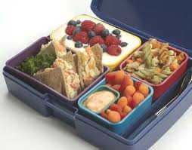
Lunch (on your own)

Slide 89
Offer versus Serve
Notes:
(Rosemary)

Slide 90
OVS - What Didn’t Change
Only required for senior high schools for the NLSP
Optional for lower grades for the NSLP
Optional for the SBP at all grade levels
Notes:
The statutory requirement that OVS is only required for senior high schools in the NSLP did not change.
Nor did the optional OVS in the NSLP for grades below senior high school.
And OVS remains an option for all grade levels for the SBP.

Slide 91
OVS - What Didn’t Change
Student’s option to decline item(s)
Same price if child declines item(s)
Full amount of each component must be available to choose
Notes:
The option to decline items remains with the child although must take at least ½ cup of fruit or vegetable which we’ll discuss later.
Meal is still priced as a unit and the price is the same whether the child takes the full reimbursable or declines one or two items.
Full amount of each component must be made available to choose. For example, if the fruit component requirement of one cup for 9-12 is offered in two half cup servings, the student must be able to take both ½ servings if s/he wants the full serving of fruit.
And students are always encouraged to not only take the full planned serving for the fruit and vegetable components but for all components as only the full meal provides the nutritional benefits needed for each grade grouping of students.
We were asked if the student has to be offered the full amount - how does that save money and waste? Once the school knows what is typically taken, it may not need to produce the full amount for every child. For example, if a school has determined that when peaches, blackberries, and strawberries were offered in ¼ cup portions, the strawberries are taken 75% of the time and the other choices are only taken 5% of the time. The school would not need to produce enough for 100% of servings of all 3 fruit choices; rather, they would prepare more servings of the more popular items. (They should have some fruit ready in case they do run out.)

Slide 92
Definitions
Food component—
  One of five food groups for reimbursable meals
Food item—
  A specific food offered within the five food components.
Notes:
Before we get into the new OVS requirements, let’s review what food component and food item are under the new regulations. We’ll discuss in terms of the lunch requirements, but the same definitions apply to the SBP.
There are five components with the separation of fruits and vegetables at lunch.
For NLSP, food items are what’s offered for each of the five different components.
For SBP, food items are what is offered for the fruit component; grain component; and milk component.
We understand that in practice, people may think of an item as the what’s offered in the meal (a turkey sandwich, a slice of pizza or a chef’s salad) but this presentation, we’re thinking in terms of what meets these definitions. The turkey sandwich then becomes a two component (m/ma and grains) item, the pizza becomes a three component (m/ma; grains; and vegetable) item and the chef salad becomes a 2 component item ( vegetable and m/ma).
Definitions from 7 CFR 210.2
Food component means one of the five food groups which comprise reimbursable meals. The five food components to be offered to students in
grades K–5 are: Meats/meat alternates, grains, vegetables, fruits, and fluid milk. Meals offered to preschoolers must consist of four food components: Meats/
meat alternates, grains, vegetables/fruits, and fluid milk.
Food item means a specific food offered within the five food components: Meats/meat alternates, grains, vegetables, fruits, and fluid milk.

Slide 93
What must be offered in NSLP
5 components
  Meat/meat alternate
  Grains
  Fruits
  Vegetables
  Milk
Notes:
While we’ve heard lots about the meal pattern, this shows it again for the NSLP because, of course, it is the basis for determining reimbursable meals under OVS.
This shows that SFAs must have menus that provide the meat/meat alternate, grains and milk components and separate fruit and vegetable components.
For OVS, a student may refuse up to two food components.

Slide 94
Lunch Example
The lunch offered: turkey, mashed potatoes, peaches, roll and milk
OVS—current
  Turkey, roll and milk = reimbursable lunch
OVS-under new regulations
  Turkey, roll and milk ≠ reimbursable lunch
  To be reimbursable, must add mashed potatoes or peaches
Notes:
A real simple example of OVS currently and OVS under the new regulations:
Turkey, mashed potatoes, peaches, roll and milk.
The child may take turkey, roll and milk under current OVS requirement.
Under the new requirements, this meal isn’t reimbursable even though it has 3 components. The child would be required to take either the mashed potatoes or peaches in addition or choose one of these instead of one of their other choices. There must always be at least ½ cup serving of a fruit or a vegetable for reimbursable meal under OVS.
We’ll be doing an exercise at the end of this presentation with a sample menu and determining if various choices provide reimbursable lunches.

Slide 95
OVS for NSLP--What must be taken
Must take at least 3 of 5 components
Must take at least ½ cup serving of the fruit or vegetable component
Student may take two ¼ cup servings of the same item fruit or vegetable to meet the requirement
Notes:
A student can decline a maximum of two items – this means they must take at least 3 of the 5 offered components including a fruit or a vegetable.
If the school offers a combination item – one containing more than one component (say a cheeseburger (grain and meat) ): if a student chooses to decline this item, they could not decline another if there are no other way to choose these components. This has not changed; 3 components are still necessary.
In order for the fruit or vegetable component to be credited under OVS, the student must take at least ½ cup serving of the fruit or vegetable component. This smaller portion size is only credited under OVS as meeting the fruit or vegetable component. Otherwise, to be credited, the full component must be selected. And even under OVS, the full components of the m/ma, grains and milk must be selected to be credited as a component for a reimbursable lunch.
The child can now take two of same items to meet the fruit or vegetable component for lunch. For example, if the school offers ¼ cup servings of applesauce, peaches and grapes for the fruit component, the child may select 2 servings of peaches or 2 servings of grapes to meet the requirement. This is not currently allowed in order to ensure some variety in a student’s choices since fruits and vegetables are one component. However, because fruits and vegetables, under the new requirements. are separate components, variety is promoted that separation.

Slide 96
Different Choices
Can mix different fruits to reach minimum required serving
Can mix different vegetables to reach minimum required serving
Notes:
Can mix different fruits to reach minimum required serving. For example, a student can choose ¼ cup of peaches and ¼ cup of apples to arrive at the ½ cup.
Can mix different vegetables to reach minimum required serving. For example, the student could choose a pizza with 1/8th cup vegetable and a 3/8th cup of broccoli.
However, student can’t take ¼ cup of fruit and ¼ cup of vegetables to meet the requirement because these are now two separate components and can’t be combined.
We’ve been asked about crediting combination items containing both the fruit and vegetable components for OVS. These would items like a salad with orange slices or carrot raisin slaw. We would like to hear more from you about this issue so please bring up any concerns or suggestions on this issue during the question period or place them on the parking lot.

Slide 97
OVS for SBP
Phasing-in changes in the SBP
For SY 2012-2013, no changes to SBP other than milk requirement
For SY 2012-2013, may continue to use current menu planning approach and requisite OVS requirements
Notes:
We are phasing-in changes in the SBP as you have already heard.
For SY 2012-2013, there are no changes to SBP other than the milk requirement, which was already implemented through memo for this year and saturated fat limit applies since this has not changed.
SY 2013-2014, single food-based approach implemented with the requirement to use a food based approach and new components.

Slide 98
SBP for SY 2013-2014
Must offer 3 components without OVS
  Grains (optional meat/meat alternate after daily grain met)
  Fruit/Vegetable/Juice (current quantities)
  Milk
Must offer 4 food items if using OVS
  Grains
  Fruit/Vegetable/Juice
  Milk
  Additional item
Notes:
SY 2013-2014 will require implementation of the 3 components for non-OVS and 4 food items for OVS.
Also implemented in this SY that will affect OVS:
the grade groups must be followed which effects the number of servings for grains; and
the daily grain requirement with an optional meat/meat alternate once at least one grain
Not implemented are any changes to the fruit/vegetable/juice component for—
for grade groups which would affect the required serving sizes; and
the requirement to select at least ½ cup of fruit must be selected for a reimbursable meal under OVS.
So under OVS this school year, the 4 food items would be:
A Grain
A fruit or a vegetable or juice
Milk and
An additional item, e.g., a serving of grain or a serving of meat/meat alternate

Slide 99
SBP for SY 2014-2015
Fruit component only
Quantity of fruit required increases
Vegetables may be substituted to provide all or part of the fruit requirement
For OVS, must take at least--
  ½ cup of fruit OR
  ½ cup of vegetable, if offered
Notes:
For OVS, must take at least--
½ cup of fruit OR
½ cup of vegetable, if offered
This is the same as in NSLP, but does not take effect until SY 2014-2015 because that is when the additional fruit is added to the SBP

Slide 100
What must be offered for SBP
3 components
  Grains (optional meat/meat alternate substitution)
  Fruits (optional vegetable substitution)
  Milk
OVS must offer four food items
  Milk
  Fruit (or optional vegetable)
  Grains
  One additional item
Notes:
Once all of the changes are phased-in, this is what SBP must offer
Non OVS, must offer at least three components
OVS, must offer at least 4 food items
In 2014-2015, must offer fruit in quantities specified and child must take at least ½ cup of fruit
In 2014-2015, can substitute vegetables
An old reimbursable breakfast: Slice of toast, scrambled eggs, fruit cup and milk. Under OVS, can take any 3.
Under new SBP OVS: 4 offered and eggs may be offered because the grain requirement is met. Student must take 3 items, one of which must be the fruit cup.
There are a couple of issues that we’d like to provide input on relating to OVS in the SBP. One is how the new OVS requirements could work for breakfast in the classroom and whether, given the weekly grains requirements and the difference in the number of required components for non-OVS and OVS, whether schools would not necessarily have OVS everyday. Again, please discuss during the question session or put your thoughts on this issue on the parking lot.

Slide 101
OVS for SBP-What must be taken
Students may decline one item except they must take at least
  ½ cup of fruit OR
  ½ cup of vegetable, if offered
Notes:
This is to show what must be taken when all of the various changes to the SBP meal pattern requirements are in effect.
Can’t have OVS with only 3 food items
Consistent with these Guidelines and IOM’s recommendations, this final rule requires that the reimbursable lunch selected by a student includes a fruit or a vegetable. At breakfast, this requirement is effective in SY 2014-2015, when the required fruit quantities for breakfast increase.
Questions?
Now we like to have a group activity and discussion using a lunch menu and the new NSLP OVS requirements.

Slide 102
Is it reimbursable?
An OVS Challenge

Slide 103
Monitoring

Slide 104
Monitoring Requirements
Interim Rule – 6 Cent Certification
Final Meal Pattern Rule
  3 year State agency review cycle
    Begins School Year 2013-14 (July 1, 2013)
    Admin review includes breakfast beginning SY 2013-14
  SMI reviews eliminated
  Modified Performance Standard 2 (CRE) Nutrition Provisions
Notes:
The interim rule on 6 cent certification will be published very soon. That rule will address, in part, administrative review requirements in SY 2012-13.
Let’s start with an overview of the monitoring provisions in the final meal pattern rule. These provisions are based in part on the requirements of section 207 of HHFKA, which requires that USDA establish a “unified accountability system” for monitoring compliance in the NSLP and SBP, and that reviews be conducted on a 3-year cycle.
The final meal pattern rule establishes a framework for State agency administrative reviews in the coming years.
The rule includes a 3-year State agency review cycle, beginning School Year 2013-14. In addition, the State administrative review now includes breakfast as well as lunch, beginning the same year.
Finally, the rule eliminated the School Meal Initiative Reviews effective July 1, 2012, and made modifications to CRE’s Performance Standard 2.

Slide 105
Monitoring Requirements (cont.)
Performance Standard 2 requirements
  Lunch and breakfast
  Food components and quantities
  State agency weighted nutrient analysis on meals offered to determine compliance with calories, sodium, saturated fat
  State review of nutrition labels and/or manufacturer specs for trans fat
Notes:
Let’s look a little closer at the new Performance Standard 2 (Nutrition) requirements under the final rule.
First, as I mentioned, Performance Standard 2 now requires that reimbursable lunches meet the requirements of Section 210.10 of the regulations, based on the age/grade group being reviewed, and that reimbursable breakfasts meet the requirements of 220.8 and 220.23 as applicable, based on the age/grade group being reviewed.
As part of the administrative review, State agencies are required to determine whether required food components and quantities are provided, based on observation of serving lines and at the point of sale, and review of menu and production records.
In addition, State agencies are required to conduct a nutrient analysis of one week of menus for breakfast and lunch, to determine compliance with 3 nutrient requirements in offered meals over the course of the week: calories, sodium, and saturated fat.
For trans fat, State agencies must review nutrition labels and/or manufacturer specifications for products or ingredients used to prepare the meals to verify they contain zero grams of trans fat per serving.

Slide 106
Technical Assistance and Corrective Action
Actions required for Performance Standard 2 Violations
Missing Menu Items/Food Items | Milk Type, and Vegetable Subgroup | Whole Grain Rich, Food Quantities, and Dietary Specifications
Immediate fiscal action required (as currently done) | Fiscal action required for unresolved, repeat violations (after technical assistance and corrective action have taken place) | State Agencies have discretion to take fiscal action for unresolved, repeated violations (after technical assistance and corrective action have taken place)
Notes:
As is currently required, State agencies must apply immediate fiscal action if the meals offered are completely missing one of the required food components.
The State agency is required to take fiscal action for repeated violations of the vegetable subgroup and milk type requirements- for example, when a State agency finds the same violation of offering 2% milk after technical assistance and corrective action have taken place.
In addition, State agencies have discretion to take fiscal action for repeated violations of the food quantity and whole grain-rich requirements, and for repeated violations of the dietary specifications (calories, saturated fat, sodium and trans fats) because they require specific knowledge or tools from the school food service staff or a careful assessment from a State reviewer.

Slide 107
Monitoring Workgroup
Administrative Review Reinvention Team will consider administrative review process and procedures
Not bound by what’s currently in place---will look at program requirements and make recommendations for how best to achieve program oversight
Develop new tools to accomplish review activity
Notes:
As I mentioned, the monitoring provisions in the final rule provide a framework for State agency administrative reviews in the coming years. We recognize that just changing the regulations is not enough. We need to work together to develop a State agency oversight process that appropriately reflects the new requirements for school meals, as well as the numerous other significant changes made to the programs since the creation of CRE and SMI, including those from the final meal pattern rule and the Healthy, Hunger-Free Kids Act.
We will be working over the year, with State agency input, to revamp the State agency administrative review process, so that you are prepared to implement the 3-year review cycle beginning July 1, 2013.
The team will develop and implement an updated, effective and efficient State oversight process for the school meals program. This will include:
Reducing the ongoing State agency review cycle from 5 years to 3 years
Combining the CRE and SMI reviews into one streamlined review process. The combined process must provide effective oversight of increasingly complex school meals programs while also recognizing the resource constraints facing States in their oversight of approximately 16,000 SFAs
Updating the nutrition review component of the process to reflect new and increasingly complex meal pattern requirements
Incorporating breakfast into the review process
They will examine program requirements and make recommendations for how best to achieve program oversight. They will also develop new tools to accomplish review activity.

Slide 108
Monitoring/Oversight Timeline
Spring 2012
  Interim rule: certification for 6 cent reimbursement
  Additional information on SY 2012-13 administrative reviews
  Begin reinvention of administrative reviews
SY 2012-2013
  New meal patterns implemented for lunch (July 1, 2012)
  Certification for 6 cents (funds available 10/1/12)
  Final year of current 5-year review cycle for CRE
  No SMIs
SY 2013-2014
  3-year cycle for administrative reviews begins
Notes:
Before we finish our discussion of monitoring, let’s take a minute to recap the timing of several key provisions related to State agency monitoring and oversight in the next couple of years.
In Spring 2012 (hopefully very soon), we expect to publish an interim rule on the six cent reimbursement rate increase. The rule will set forth the certification process for State agencies to determine school food authority compliance with the new meal patterns for receipt of the additional 6 cents, and also include information on the interaction of certification activities with State agency administrative review responsibilities in School Year 2012-2013.
We are also forming the FNS/State agency workgroup this Spring
As of July 1, 2012, the new meal patterns go into effect, and we expect the State agency certification process will begin at that time as well.
In accordance with the Healthy, Hunger-Free Kids Act, the additional reimbursement becomes available as of October 1, 2012, for certified school food authorities.
School Year 2012-13 concludes the final year of the current 5-year review cycle for CRE. Please note that there are no more SMIs as of July 1, 2012.
In SY 2013-14, the new 3-year review cycle requirement will take effect.

Slide 109
State Funding Assistance
Funding from HHFKA for the first two years of the new meal requirements
  To assist SAs with implementing new requirements
Expected increases in State Administrative Expense funding in two years
  Based on increased reimbursement with additional 6 cents
Notes:
I would also like to note some funding assistance opportunities for the States. The HHFKA provides USDA with $3 million and the States with $47 million for each of the first two years of the new meal requirements.
This funding will be used for assisting State agencies in implementing the new requirements, in the amounts noted in a recent memo provided to the States.
These funds, combined with expected increases in State Administrative Expense funding in two years (based on increased reimbursement with additional 6 cents), should assist States and local operators in improving the quality of school meals provided to children.

Slide 110
Meal Pattern Changes and Food Service Management Contracts
Contracting with Food Service Management Companies

Slide 111
Policy memo issued by FNS
SP 17-2012 issued on February 23, 2012
Title: “Procurement Questions and Answers to Assist in the Implementation of the final rule titled Nutrition Standards in the National School Lunch and School Breakfast Programs”

Slide 112
Impact of final rule on SFA-FSMC contracts?
We anticipate that some current contracts between SFAs and FSMCs will not be inconsistent with the new nutrition standards of the final rule; therefore, those contacts would require only nonmaterial changes to ensure consistency with the final rule
  This means that some SFAs may have anticipated the new nutrition standards and their current contracts will require nonmaterial changes to ensure consistency with the final rule.

Slide 113
How do SFAs determine if the implementation of the final rule will create a material change to current SFA-FSMC contracts?
SAs and SFAs must review existing contracts to determine if implementation of the final rule (i.e., new meal pattern requirements) will result in material changes to current contracts
A blanket answer is not acceptable as the determination depends on the initial solicitation and resulting contract (unique for each SFA-FSMC contract)

Slide 114
Questions to ask to help determine material change
If there would be an increase or decrease to the cost of the contract, would the increase or decrease in cost have caused bidders to bid differently if the prospective change had existed at the time of bidding?
Would the prospective change materially affect the scope of services, types of food products, volume of food products, etc., in both the solicitation document and resulting contract?
  For example, the final rule requires schools to serve whole-grain rich products, and specific varieties of vegetables, which already may be included in current contracts

Slide 115
Note: renewals are not automatic
Per regulations, contracts between SFAs and FSMCs must be no longer than one year in duration with four optional annual renewals
Every SFA should annually reviewing its FSMC contract with no expectation by either party to renew the contract
SA and SFA must review the current contract and determine if any prospective changes would result in a material change

Slide 116
What options are available if SFA’s implementation of final rule creates a material change to contract with FSMC?
Option 1: SFA can conduct a separate procurement to obtain the desired deliverable that created the material change
  For example, the current contract doesn’t address whole-grain rich foods. SFA would issue a solicitation to procure additional whole-grain rich foods, consistent with the current contract between SFA and FSMC

Slide 117
What options are available if SFA’s implementation of final rule creates a material change to contract with FSMC? contd.
Option 2: SFA can conduct a new procurement (i.e., rebid) and ensure that the new solicitation associated with the rebid contains the appropriate specifications and provision to ensure conformance to the final rule
  For example, if the SFA’s initial solicitation and resulting contract did not address whole-grain rich foods, the SFA would ensure that rebid specifications would procure such foods.

Slide 118
What happens if rebid can’t be completed prior to 2013-14 SY?
If a rebid is deemed necessary based on the implementation of the final rule, the SFA may in the interim amend its current contract in order to ensure full implementation of the final rule until the rebid could occur
All rebids must occur prior to the 2013-14 SY
Both the SFA and FSMC would need to agree to the terms of the amendment
Notes:
Make it clear that this is a band aid

Slide 119
What if FSMC doesn’t agree to amending current contract?
The SFA would need to take immediate action. For example, immediate action may include:
  Termination of the current contract between the SFA and the FSMC in accordance with the termination provisions and issuance of a new solicitation;
  Issuance of a separate solicitation to procure the necessary foods in order to ensure compliance with the final rule, consistent with the current contract between the parties
Notes:
The principles and time frames outlined should apply to all contracts between an SFA and contractor.

Slide 120
Timeline for new procurement
(i.e., rebid)?
An SFA may conduct a procurement at the next feasible juncture if needed;
However, SAs and SFAs must ensure that a new procurement is completed for the 2013-14 school year (SY)
This means that a new procurement (i.e., rebid) must be completed for the 2013-14 SY.

Slide 121
What about other contracts (i.e., SFA contracts with distributor)?
The same principles and timeframes should apply to all SFA contracts

Slide 122
Additional guidance
Will continue to review your questions and concerns
Additional guidance as well as modifications to existing guidance, as needed, will be forthcoming

Slide 123
Menu Planning and Technical Assistance Resources
Menu Planning Resources for the New Meal Pattern
Notes:
Good afternoon!
The focus of this presentation will be menu planning resources for the new meal pattern and technical assistance to meet the requirements. Many resources are currently available and many are in the process of being updated.
Let’s get started!

Slide 124
Menu Planning Resources for the
New Meal Pattern
Objective: Upon completion of this session the listener will be able to:
Identify resources to provide technical assistance to School Food Authorities on menu planning for the New Meal Pattern and the Dietary Guidelines.
Notes:
Read slide.
Objective: Upon completion of this session the listener will be able to:
Identify resources to provide technical assistance to School Food Authorities on menu planning for the New Meal Pattern and the Dietary Guidelines.

Slide 125
Menu Planning Resources for the
New Meal Pattern
What resources will be available to assist with Menu Planning for the New Meal Pattern?
Notes:
Read the slide.
What resources will be available to assist with Menu Planning for the New Meal Pattern?

Slide 126
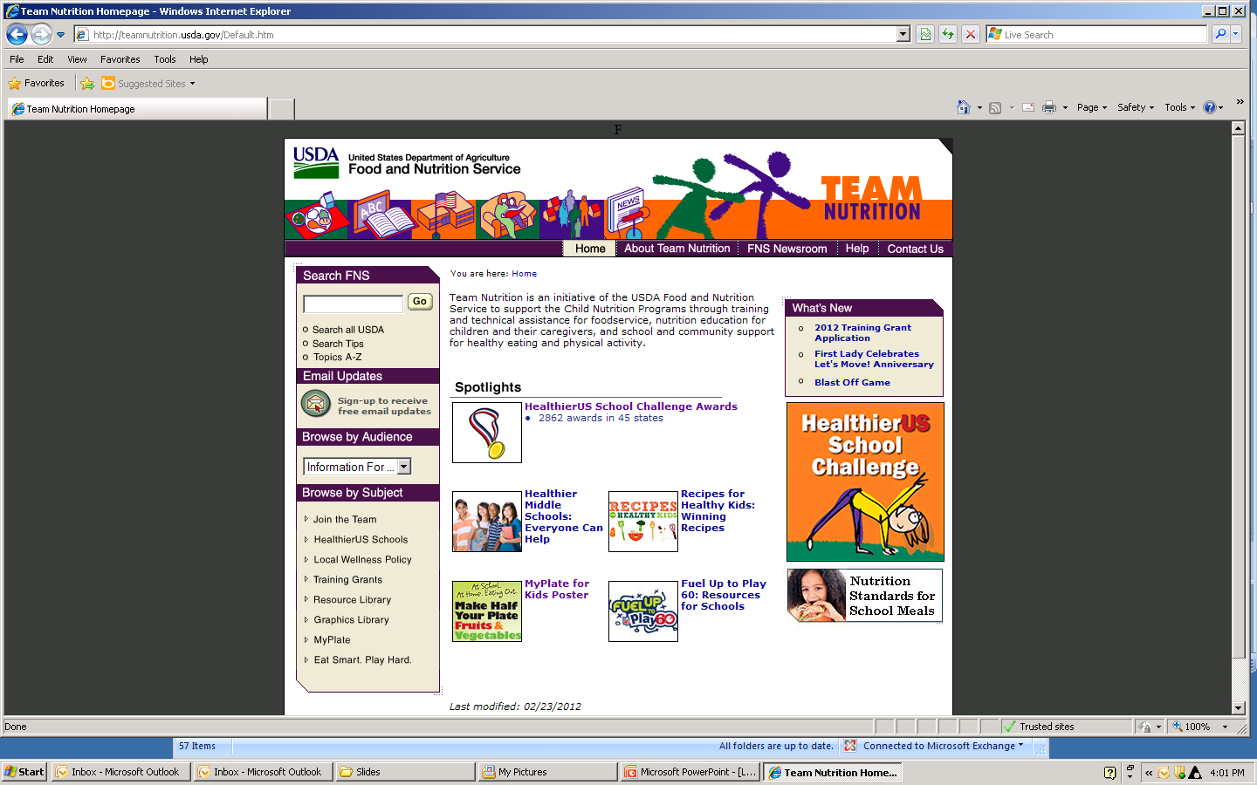
Team Nutrition Resources teamnutrition.usda.gov
Notes:
Let’s begin with the Team Nutrition HOMEPAGE. As new materials are updated they will be placed on this page to be made available to schools.
If you have not done so already, make this website one in your favorites.

Slide 127
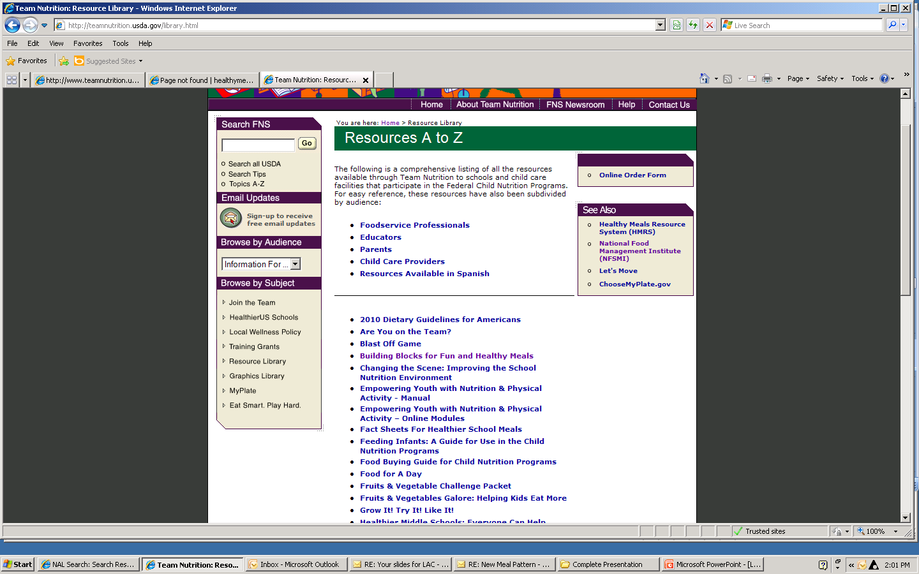
Notes:
This is the page for Resources A to Z from the Team Nutrition website. The arrow directs you to the navigation link to the Resource Library.
The first resource I want to identify is the Food Buying Guide for Child Nutrition Programs.
Next slide.

Slide 128
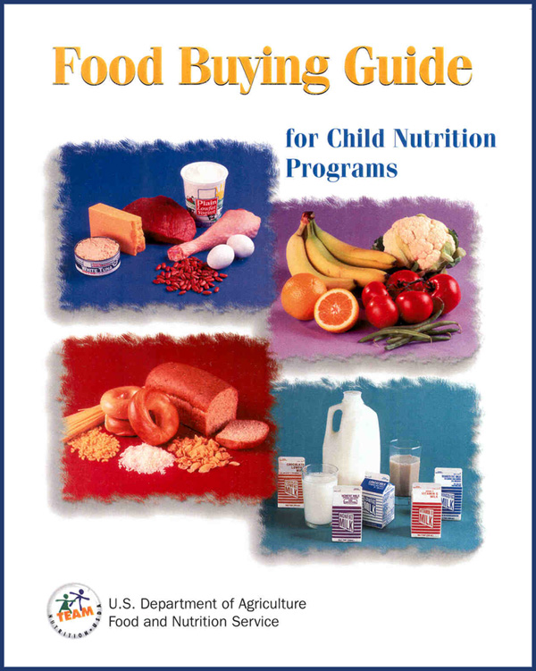
Update the Food Buying Guide
www.fns.usda.gov/tn/Resources/foodbuyingguide.html
Notes:
The Food Buying Guide will be updated in stages.
In Spring, 2012 :
Fruits and vegetables will be separated into these 2 different components and sections of the Food Buying Guide. The vegetable subgroups will be highlighted in their vegetable section to make it easier to plan menus to include the vegetable subgroups.
Edits to include the crediting of dried fruit (i.e. ¼ cup raisins credit as ½ cup) will be made.
Edits to green leafy vegetables will include changing the one-cup quantity credit to a ½ cup vegetable credit.
Edits to the milk section will reflect the new lower fat milk requirements.
New products such as Tofu and soy yogurt will be added to the Meat/Meat Alternate section.
The existing Grains/Bread instruction will be updated to “Grains” and reflect the ounce equivalents and Whole Grain-Rich Food Requirements.
In Winter, 2013 and beyond
The YIELD information for new food items, convenience foods, and Whole-Grain rich items will be updated upon completion of the formal yield testing these products require.
http://www.fns.usda.gov/tn/Resources/foodbuyingguide.html

Slide 129
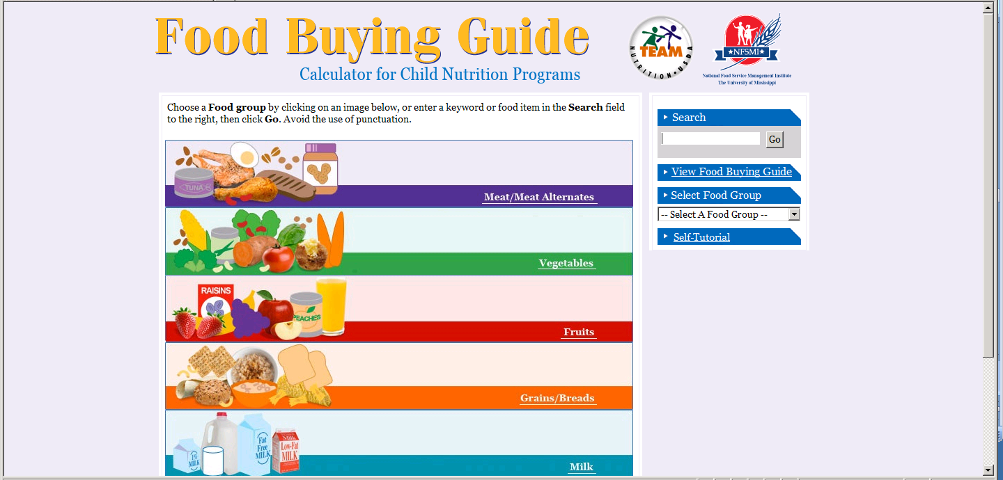
Food Buying Guide Calculator fbg.nfsmi.org
Notes:
The Food Buying Guide calculator is available on both the Team Nutrition and the National Food Service Management Institute websites.
This resource will continue to provide excellent information for schools. This guide is web-based allowing schools to search by component, or type the food in the search function.

Slide 130
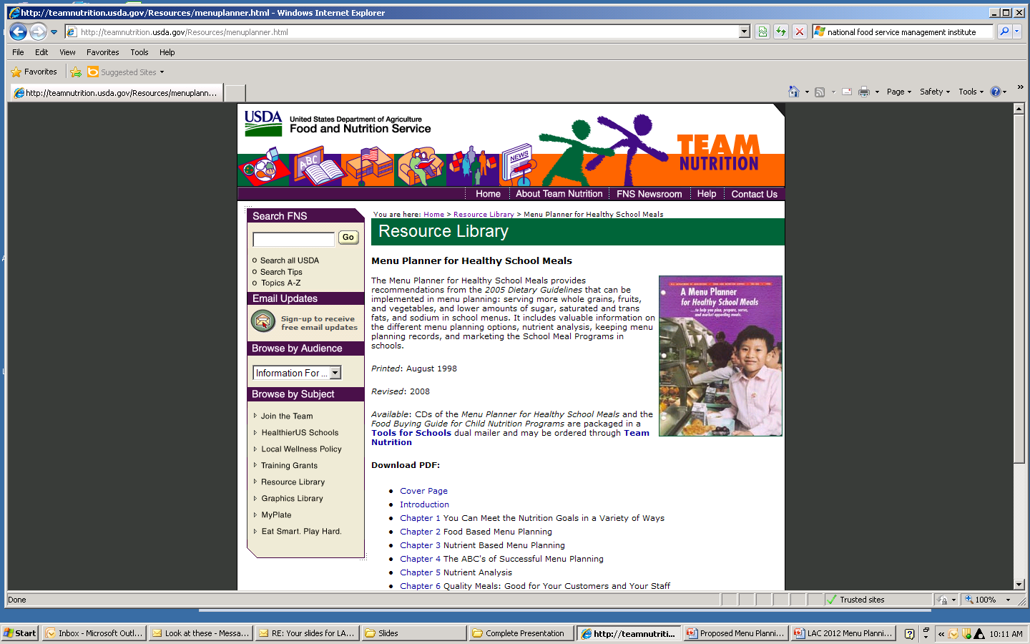
Menu Planner for Healthy School Meals
Notes:
If you select the Team Nutrition Resource Library, you will find the Menu Planner for Healthy School Meals which will be updated by Spring 2013.

Slide 131
Coming Summer 2012…
Updated Fact Sheets
Notes:
The fact sheets for healthier school meals are also being updated. These should be available this Summer 2012. These can be found on the Team Nutrition website as well.

Slide 132


Notes:
These 30 innovative recipes will support the whole grain-rich and vegetable sub-group requirements.
Additionally, crediting information for whole grain-rich and the vegetable sub-groups will be in the recipe books for schools, child-care centers and home.
These recipes will be standardized for 6, 25, 50 and 100 servings. We expect the recipe books to be available on the web in late spring, early summer 2012.
We will then look at all of the USDA recipes and the additional recipes from the Recipes for Healthy Kids Competition to determine which need to be targeted for updating and standardized to meet the new meal pattern requirements.

Slide 133

Available now from
Team Nutrition
Make Half your Plate Fruits & Vegetables Poster
Notes:
To market the programs and to encourage students to consume more fruits and vegetables, this poster is currently available from the Team Nutrition website.
If you have not yet ordered your posters, go to the Team Nutrition site to order them.

Slide 134

Available now from Team Nutrition
Fruits and Vegetables Galore: Helping Kids Eat More
Notes:
Fruits and Vegetables Galore: Helping Kids Eat More is a tool for foodservice professionals packed with tips on planning, purchasing, protecting, preparing, presenting and promoting fruits and vegetables. Use Fruits and Vegetables Galore to help rejuvenate your lunchroom with colorful fruits and vegetables.
Use this resource to get children excited about eating fruits and vegetables. Order your copy today from Team Nutrition or download it from TeamNutrition.usda.gov

Slide 135
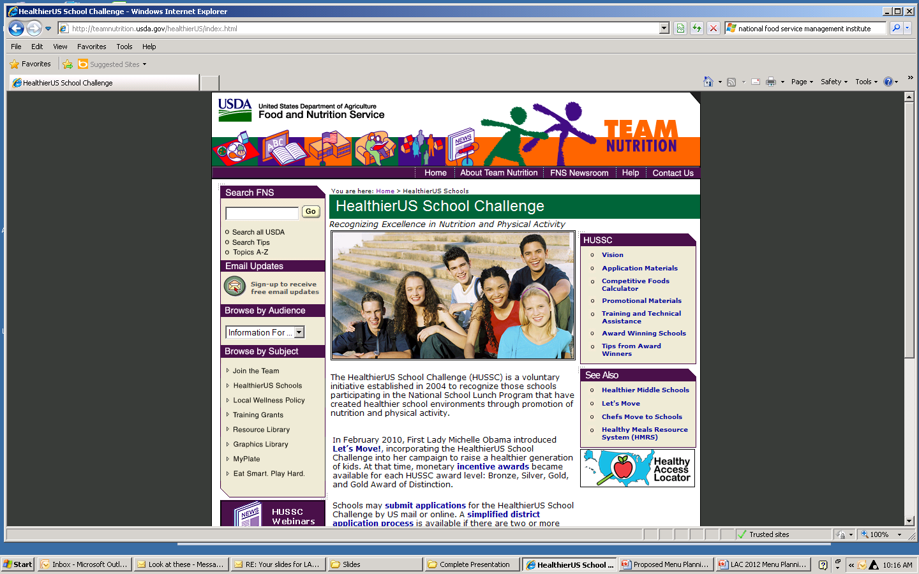
HealthierUS School Challenge Resources
Notes:
The HealthierUS School Challenge Schools have already been serving grains that are whole-grain rich, and a variety of dark green and orange vegetables, and dry beans and peas.
The HealthierUS School Challenge site provides excellent resources for planning School Meals and the new meal pattern.
From this site you will find a link “Application Materials” which provides resources for identifying beans and peas, whole grains and vegetable subgroups.
Resources from this webpage will be also be updated but may be useful currently for determining vegetables in the vegetable sub-groups.

Slide 136
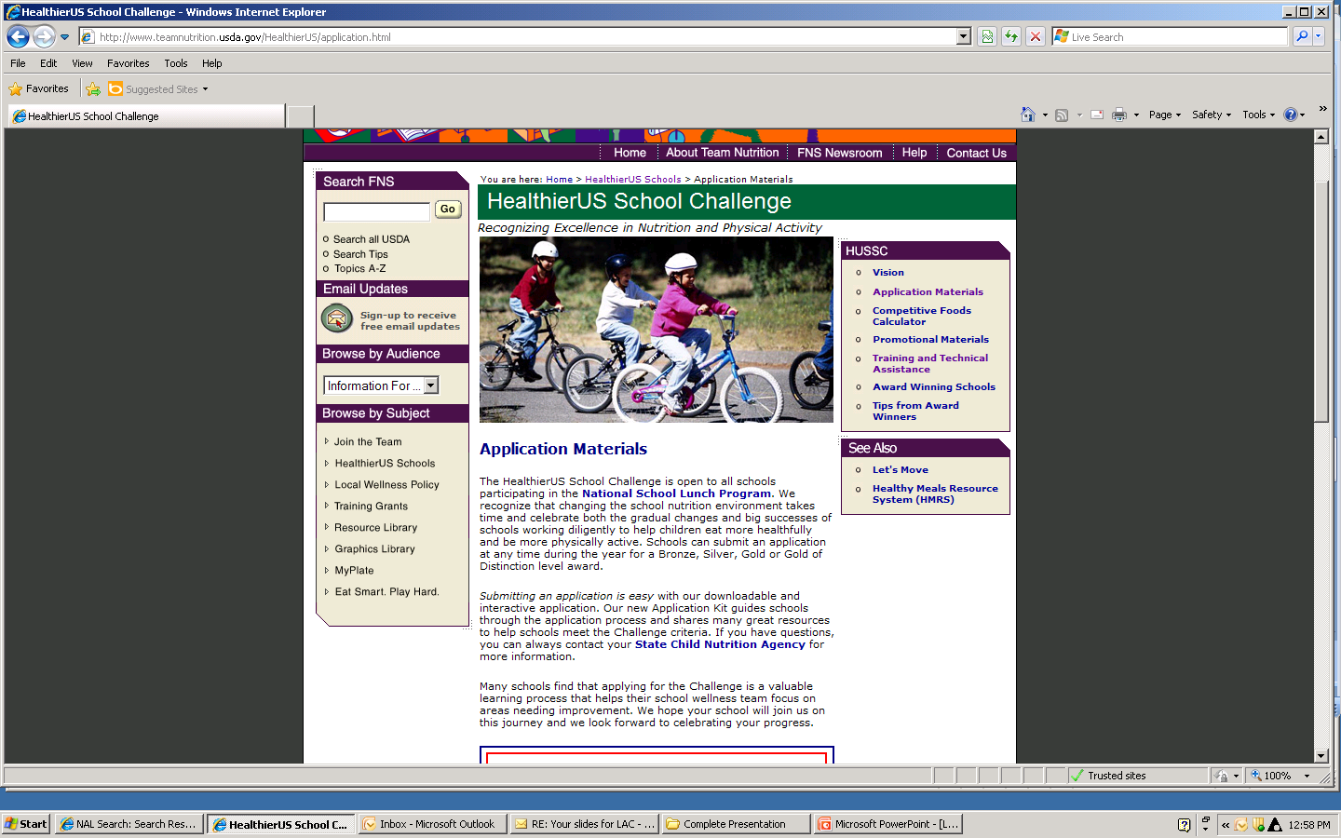
Notes:
This is the “Application Materials” page and if you scroll down – next slide

Slide 137
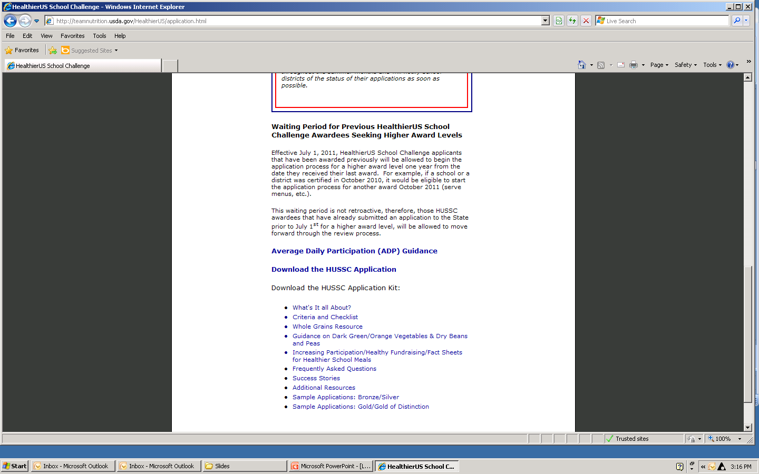
HealthierUS School Challenge Resources
Notes:
If you scroll down you will find the HealthierUS School Challenge Application Kit where the additional resources are located. When you link to the Whole Grain resource you will find this information.
NEXT slide.

Slide 138
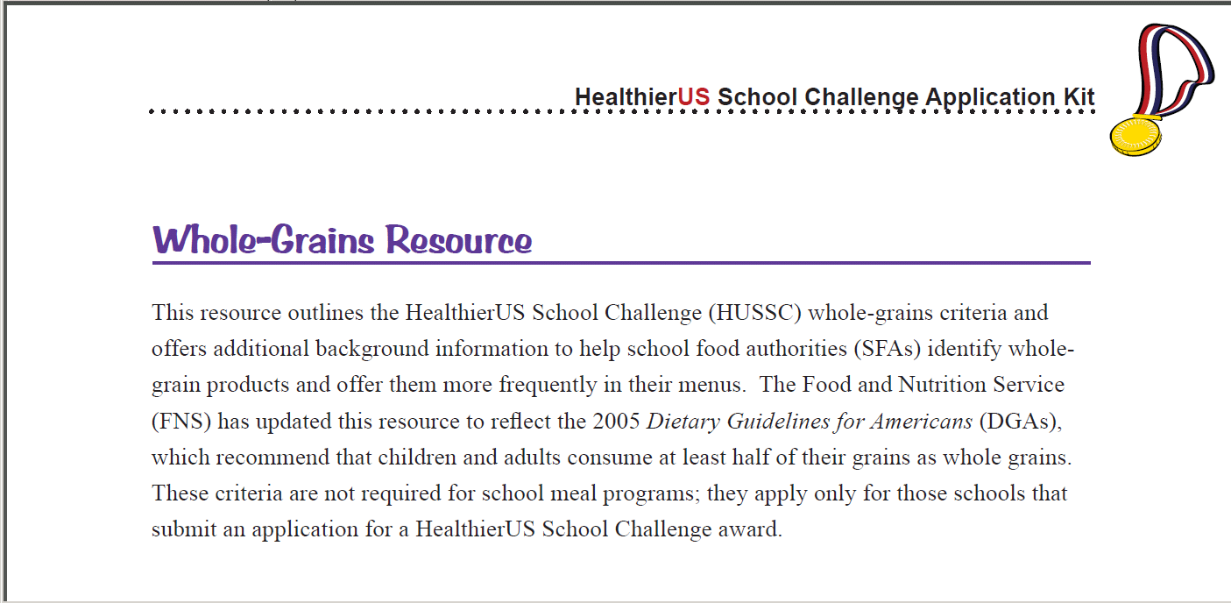
HealthierUS Whole Grain Resource
http://www.teamnutrition.usda.gov/HealthierUS/HUSSCkit_pp25-35.pdf
Notes:
This is the screen shot for the Whole-Grains Resource. The list of whole grains in these materials will provide resources on these products.
Also, you will find tips on how to read the ingredient list for whole-grain ingredients.

Slide 139
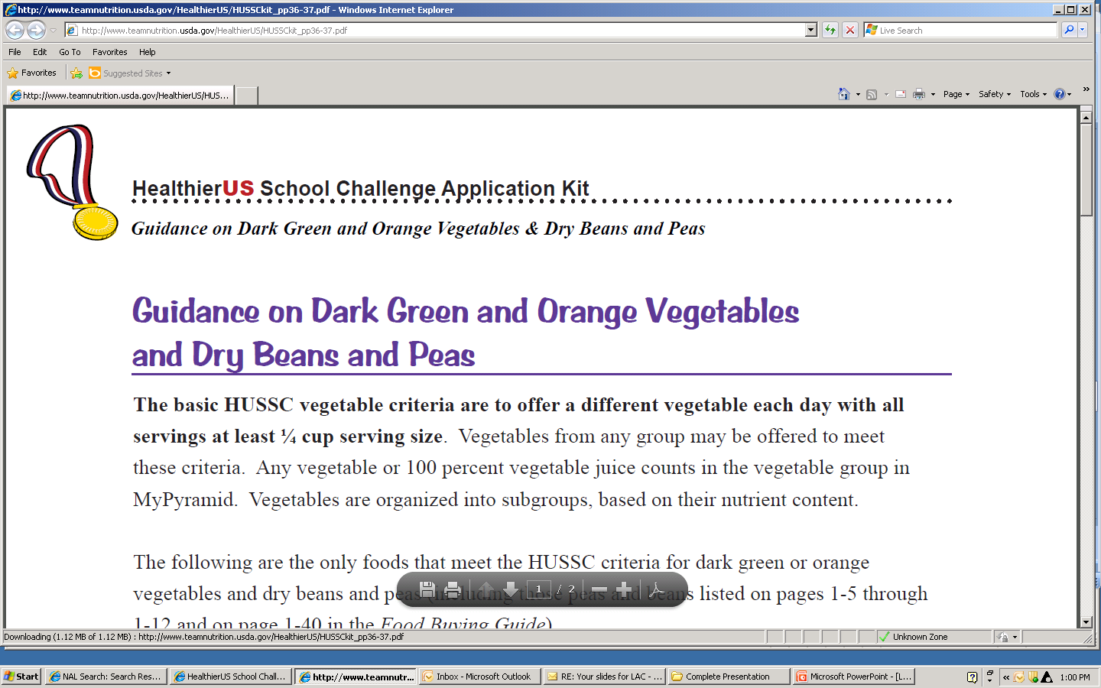
HealthierUS Whole Grain Resource
Notes:
Also available within this link you will find Guidance on Dark Green and Orange Vegetables and Dry Beans and Peas.
The vegetable sub-groups - red and “other” will be updated soon. So, keep this link accessible.

Slide 140
Timeline for Updated Resources
Food Buying Guide in Sections –
  Spring, 2012 - Separating Fruits and Vegetable Subgroups and editing to include tofu, soy yogurt, lower fat milk
  Winter 2013 - Yield studies for new food items and Whole Grain products
Spring 2012 - Recipes for Healthy Kids Cookbooks
Spring 2012 – Update HealthierUS application packet and Resource materials
Summer 2012 – Update Just the Facts nutrition fact sheets
Spring 2013 – Update the Menu Planner for Healthy School Meals
Notes:
The resources from Team Nutrition will be updated using a phase-in approach to provide the key resources first.
Food Buying Guide in Sections –
Spring, 2012 - Separating Fruits and Vegetable Subgroups and editing to include tofu, soy yogurt, lower fat milk
Winter 2013 - Yield studies for new food items and Whole Grain products
Spring 2012 - Recipes for Healthy Kids Cookbooks
Spring 2012 – Update HealthierUS application packet and Resource materials
Summer 2012 – Update Just the Facts nutrition fact sheets
Spring 2013 – Update the Menu Planner for Healthy School Meals
Read the slide.

Slide 141
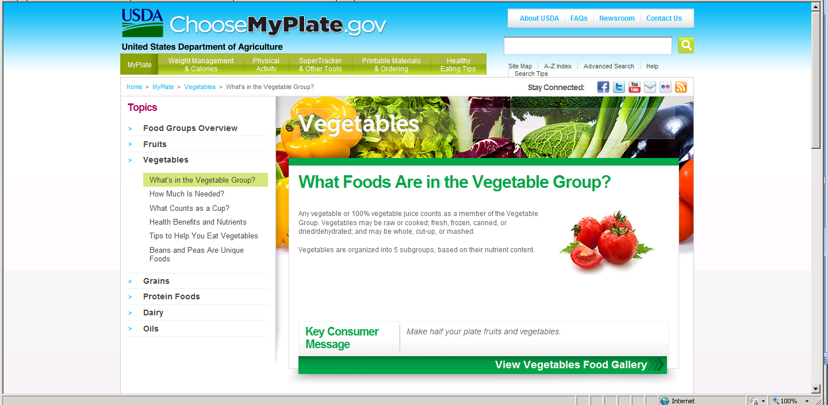
Choose My Plate Resources www.choosemyplate.gov/food-groups/vegetables.html
Notes:
The ChooseMyPlate.gov website provides even more information about components and food items in the fruit and vegetable groups.
Each component provides gallery of photos of food portions common to schools. The vegetable section lists the subgroups and provides pictures of ½ and 1 cup quantities. This link is available NOW!

Slide 142

Available from the National Food Service Management Institute (NFSMI)
Whole
Grains in
Child
Nutrition
Programs
Notes:
The National Food Service Management Institute Whole Grains in Child Nutrition Programs resource provides training materials for recognizing whole grains, whole grain products, writing specifications and marketing whole grains in schools.

Slide 143
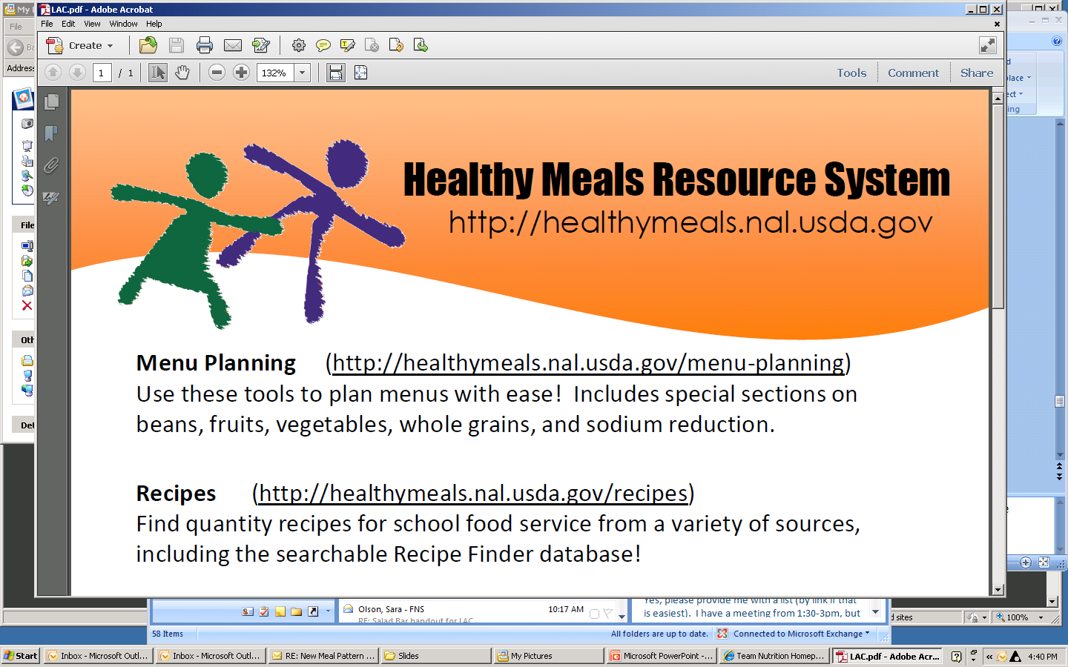
Notes:
The Healthy Meals website information from the National Agricultural Library at the Food and Nutrition Information Center supports FNS through library and electronic collections of nutrition education materials. A handout of the various sites is included in your training packet.

Slide 144
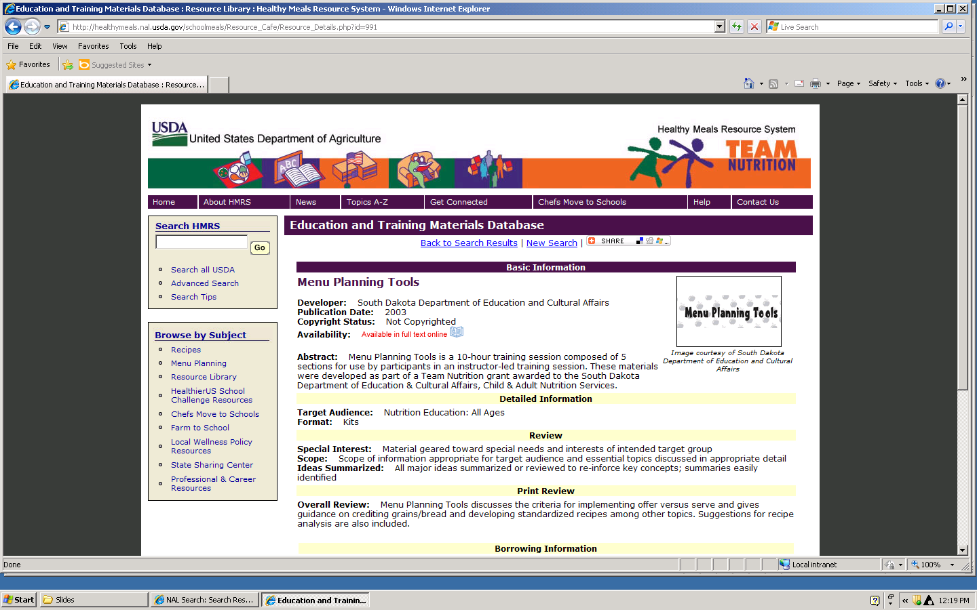
Healthy Meals Resource System at NAL
Notes:
The Healthy Meals Resource System (HMRS) at the National Agricultural Library catalogues and makes available for download materials from State Agencies, Team Nutrition Training Grants, and associations. You can search their educational materials database for resources.

Slide 145
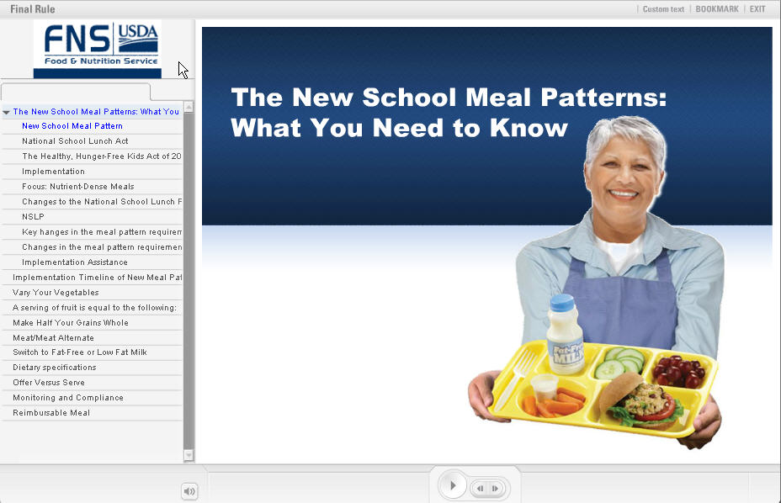
Online training modules http://healthymeals.nal.usda.gov/mealpattern
Notes:
Online training modules for training school staff on the new meal patterns will soon be available on the Healthy School Meals website.
http://healthymeals.nal.usda.gov/mealpattern

Slide 146
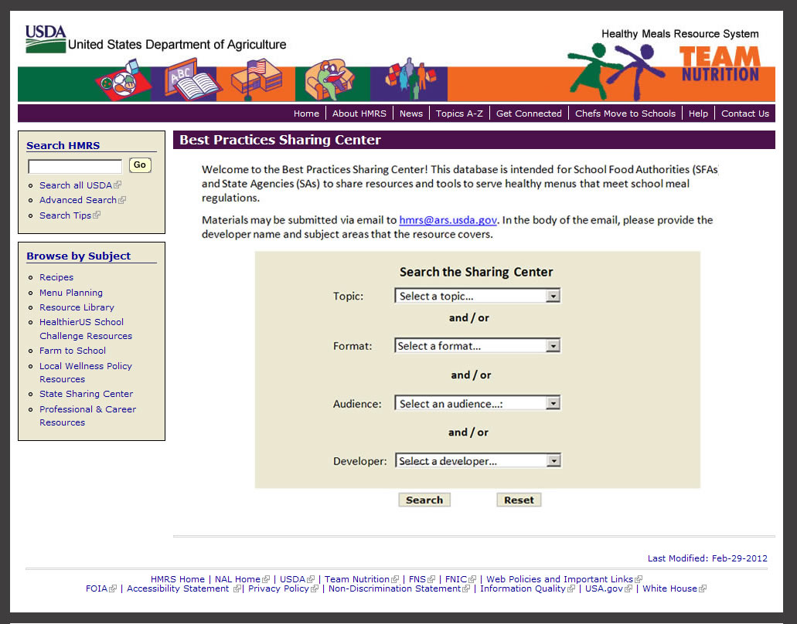
Best Practices Sharing Center at HMRS http://healthymeals.nal.usda.gov/bestpractices
Notes:
http://healthymeals.nal.usda.gov/bestpractices
Healthy Meals Resource System is also developing a Best Practices Sharing Center which will be available early Spring.
This site will collect best practices and resources from schools and State Agencies and catalogue them into a searchable database so that you will be able to find new ideas!

Slide 147
Sharing Session
Resources YOU are working to develop …
Notes:
As you can see, USDA has been working to make an abundance of resources available for use in Menu Planning. But, YOU have probably been working to develop resources, as well.
And, we want to hear what resources you are developing. At this time, please walk to a microphone near you to share what your State is working to develop.
This will allow you to add ideas and the names of states you can contact for more information.
Who will share first?

Slide 148
?
Notes:
This is the conclusion of the information for this session, are there questions?
Thank you for allowing me to share this information with you.

Slide 149
USDA Foods

Slide 150



USDA Foods Update
Laura Walter
Chief, Program Support Branch
Food Distribution Division

Slide 151
New Meal Pattern Challenges:
Serve more fruits and vegetables
Identify and increase whole grains
Reduce sodium
Reduce saturated fat
Eliminate trans fat
Notes:
We know that you will need to serve more fruits and vegetables than ever before. And find creative ways to serve them without added ingredients. You will also need to start expanding your variety to include the new vegetable categories of dark green and orange vegetables. Including USDA Foods in your menu planning can help you meet these challenges.

Slide 152
USDA Foods – Helping Schools Meet New Requirements
Fruits:
  Canned in extra light syrup only
  Frozen– unsweetened strawberries, apples, and blueberries;
    Revising specification for SY 13-14
  Dried- ¼ c. credits as ½ c.

Slide 153
USDA Foods – Helping Schools Meet New Requirements
Vegetables:
  Canned–low sodium or no added salt
  Beans– wide variety offered; canned and dry; coming soon – further processing
  Exploring dark green and orange vegetables
  Fresh Cut Program Expansion – baby carrots, sliced apples

Slide 154
USDA Foods – Helping Schools Meet New Requirements
Whole grains: meet WGR (>50%) requirement
Pastas
Brown Rice – regular or par-boiled 25# bags!!
Rolled oats
Tortillas
Pancakes
Whole kernel corn for further processing
Whole wheat flour
Notes:
Food Distribution knew this was coming and we’ve been aggressively improving our foods the past 5 years. And we’re really glad that schools can have confidence that when they use USDA Foods in their meal programs that these foods now help them meet and exceed the new requirements. We offer a good variety of canned, frozen, fresh and dried fruits that are either packed in extra light syrup or juice or have no sugar added. In addition to the low and no sodium added canned and frozen vegetables offered, we have quite a selection of legumes, of which there is an increased emphasis on as they are naturally fat free, high in fiber and nutrient dense.
We are exploring expanding our Fresh Cut program to include additional value added fruits and vegetables. We are also researching additional vegetables we can add to help you meet the new dark green and orange vegetable categories. We’re confident that we will be able to add frozen broccoli florets soon and we are currently checking on the availability of frozen spinach and squash.

Slide 155
USDA Foods – Helping Schools Meet New Requirements:
Reducing Sodium
  Most meat/poultry 550mg/100g
  Exploring further reductions in cheese and reduced sodium sliced ham
Reducing saturated fats
leaner meats, reduced fat cheeses, oven roasted chicken, Alaska Pollock for processing
Notes:
USDA Foods will help you meet your sodium, saturated fat and transfat targets. Check out our foods available list to see the breath of products we offer.

Slide 156
HHFKA Provision
Improving SFAs’ access to accurate nutrition and ingredient product information for commercial and USDA Foods
Model specifications – helping schools create bids that result in high quality, better pricing
Provide recommendations to Congress
Notes:
Section 242 of HHFKA, Procurement and Processing of Food Service Products and Commodities

Slide 157
Other Resources
USDA Foods Toolkit
Updated Fact Sheets
FDD Website enhancements

Slide 158
CN Labeling and Crediting
Notes:
Now we will Move on to talk about CN Labeling and Crediting

Slide 159
Child Nutrition (CN) Labeling
The CN Labeling Program is a voluntary Federal labeling program for the Child Nutrition Programs.
Who runs the Program?
  The Food and Nutrition Service of USDA in cooperation with the following agencies:
    Food Safety Inspection Service (FSIS)
    Agricultural Marketing Service (AMS)
    National Marine Fisheries Service (NMFS)
Notes:
The Child Nutrition (CN) Labeling Program is a voluntary Federal labeling program for the Child Nutrition Programs.
It is run by FNS in cooperation with the Food Safety Inspection Service (FSIS), Agricultural Marketing Service (AMS) and National Marine Fisheries Service (NMFS).

Slide 160
CN Labeling
What products are eligible:
  Main dish products contributing to meat/meat alternate component (beef patties, cheese or meat pizzas, meat or cheese and bean burritos, and breaded fish portions).
Notes:
Eligible products include main dish items which contribute to the meat/meat alternate component. Examples include beef patties, cheese or meat pizzas, meat or cheese and bean burritos, egg rolls, and breaded fish portions.
Vegetables, grains, and fruits must be combined or pre-plated with meat or meat alternate in order to be eligible for CN Labeling.
Juice drinks and juice drink products with at least 50 percent full-strength juice by volume are also eligible. These products are now ineligible for school lunch and school breakfast, however they may be used for other programs at the present time.
To carry CN labels, eligible products must
Be produced under Federal inspection by USDA or USDC.
Manufacturers are not required to CN-label their products. So if a CN labeled product is desired, this must be clearly stated in the purchasing specifications.

Slide 161
CN Labeling
Label Claims will now Support the Final Rule and Meal Patterns for NSLP and SBP
  Labels will identify Whole Grain-Rich items in crediting statement (WGR Grains).
  Products that include vegetable subgroups will identify those subgroups on the CN label.
Notes:
The CN Labeling Program will fully support the Final Rule and new Meal Patterns for School Lunches and School Breakfasts by modifying crediting statements.
Labels will identify Whole grain-rich items, which will be noted as WGR Grains on the label.
And Products that include Vegetable subgroups will identify these in the CN crediting statement.

Slide 162
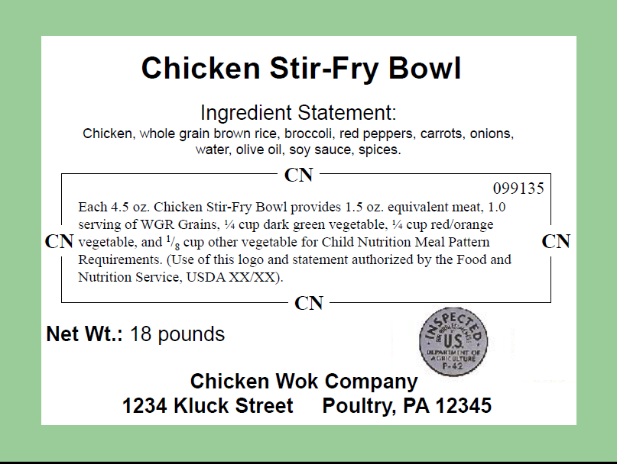
Notes:
Here is an example of an ideal CN Labeled Product that demonstrates the changes to the crediting statements.
First, you would know that a CN Label is valid based on 4 integral components of the label.
1st you can see the product name. This is typically at the top of the label in very large letters.
2nd There is an ingredient statement which lists ingredients in order of predominance.
3rd there is a CN Logo. It should have a 6 digit identification number in the right upper corner. A CN number consisting of all zeros or all x’s should definitely be a red flag. The date should occur in the past, as it reflects the original approval date.
Last, you have the inspection legend. The legend here is distinctly for poultry products. It is a round shield with curved wording at the top. The establishment number is preceded by a “p.”
If one of these components is missing you are not looking at a valid CN label.
This sample product would meet vegetable subgroup criteria and whole grain-rich criteria.
The CN crediting statement reads:
Each 4.5 oz. Chicken Stir-Fry Bowl provides 1.5 oz. equivalent meat, 1.0 serving of WGR Grains, ¼ cup dark green vegetable, ¼ cup red/orange vegetable, and ¹/₈ cup other vegetable for Child Nutrition Meal Pattern Requirements. (Use of this logo and statement authorized by the Food and Nutrition Service, USDA XX/XX).

Slide 163
HealthierUS School Challenge

Slide 164



Take the
HealthierUS
School Challenge
New criteria just released for SY 2012-2013!
Submit applications to SA by June 30 to be considered under current criteria.
Notes:
Now we will move on to the HealthierUS School Challenge, also known as HUSSC.
New criteria have just been released and will become effective on July 1, 2012. Applications must be submitted to State Agencies by June 30, 2012 in order to be considered under the current criteria.
The new criteria reflect changes to the National School Lunch Program (NSLP) and School Breakfast Program (SBP) meal pattern requirements, while continuing to recognize schools that go above and beyond Federal requirements for school meals.

Slide 165
HUSSC Overview
Voluntary certification initiative
Recognizes excellence in nutrition and physical activity in schools
Awards at four levels
Grants certification for 4 years
Notes:
I will start with a brief overview just in case anyone is not familiar with HUSSC.
The HUSSC is a voluntary certification for schools participating in the National School Lunch Program and now also the School breakfast program. It is implemented under USDA’s Team Nutrition.
USDA has established the HUSSC to recognize schools that create healthier school environments by providing nutrition education, nutritious food and beverage choices, physical education and opportunities for physical activity.
The awards recognize schools that have gone above and beyond minimum school meal requirements and have met specific criteria established for Bronze, Silver, or Gold awards—depending on levels of criteria met.
Schools that become certified maintain their certification for four years from the date they receive the Award.
The Food and Nutrition Service of USDA oversees the HealthierUS School Challenge (HUSSC) by establishing award criteria, reviewing applications, promoting the initiative and providing training and technical assistance to Regional Offices and State Agencies.

Slide 166
HUSSC Goals
Notes:
The goal of the HealthierUS School Challenge (HUSSC) is to improve the health of the Nation’s children by promoting healthier school environments. To help meet the goal, the Food and Nutrition Service (FNS) identifies schools that have made changes to:
-improve quality of the foods served,
-provide students with nutrition education, and
-provide students with physical education and opportunities for physical activity.
We currently have 2862 schools certified in 45 states! We have already surpassed our original goal for SY 2011-2012 and are committed to reaching 3250 schools by June of 2013!

Slide 167
What’s New in HUSSC?
“Other Criteria for Excellence”:
  Schools select from 22 options relating to program outreach, physical activity, nutrition education, and school and community involvement in wellness efforts.
    Bronze: 2 options from any sub-category.
    Silver: at least 4 options from any sub-category
    Gold: at least 6 options from any sub-category.
    Gold Award of Distinction: at least 8 options from any sub-category.
Notes:
The handouts you have been given provide the criteria in full detail, however I will discuss a few highlights.
HUSSC now includes a requirement titled “Other Criteria for Excellence.” To meet this requirement, schools may select from 22 options relating to program outreach, physical activity, nutrition education, and school and community involvement in wellness efforts.
Examples of these criteria include:
Innovative practices to increase School breakfast participation, offering 20 minutes of recess daily before lunch, partnering with community groups to promote wellness, display of dark green, red/orange, and/or dry bean/pea vegetable subgroups prominently on the serving line, and partnering with a Chef for the Chefs Move to schools program.
The number of options a school must accomplish varies by award level.
Bronze: Must select at least 2 options from any sub-category.
Silver: Must select at least 4 options.
Gold: Must select at least 6 options from any sub-category.
Gold Award of Distinction: Must select at least 8 criteria for excellence from any sub-category.

Slide 168
What’s New in HUSSC?
ADP Calculation Change
  ADP calculation will be based on attendance rather than enrollment.
New Breakfast Criteria:
  Schools must participate in the SBP
  Upper award levels meet Average Daily Participation (ADP) criteria for breakfast.
  Schools must also meet menu criteria at breakfast.
Notes:
The method for calculating Average Daily Participation has been changed. Based on feedback USDA has received from schools and States, the ADP criteria for school lunch and school breakfast is now based on attendance rather than enrollment. Calculating ADP in this manner is considered to be fairer to schools as it does not include children that do not eat lunch/breakfast in the calculation.
Next, HUSSC has New Breakfast Criteria. Under the 2012 criteria, schools must participate in the School breakfast program and, upper award levels must meet Average Daily Participation (ADP) criteria for breakfast. This is the first time that schools must meet breakfast meal criteria for HUSSC. The addition of these criteria recognizes the importance of a nutritious breakfast to children’s health and academic performance. Today, almost 90% of schools that participate in the NSLP also participate in the SBP.

Slide 169
What’s New in HUSSC?
Updated Lunch Criteria:
  Reflect NSLP meal pattern requirements, while continuing to encourage schools to offer a variety of vegetables, fresh fruit and whole grain-rich grains.
Updated Local School Wellness Policy:
  Consistent with the Healthy Hunger Free Kids Act of 2010, Public Law 111-296.
Notes:
Updated Lunch Criteria. The 2012 HUSSC criteria are updated to reflect NSLP meal pattern requirements, while continuing to encourage schools to offer a variety of vegetables, fruits (including fresh fruit) and whole grain-rich grains.
Updated Local School Wellness Policy Criteria is consistent with the Healthy Hunger Free Kids Act of 2010.
Schools must now report compliance with the district wellness policy;
state how parents, students, PE teachers, and community members participate in the development, implementation, review and update of the Local wellness policy;
and list ways in which the school shares its wellness policy with the public.

Slide 170
What’s New in HUSSC?
The HealthierUS School Challenge (HUSSC), and the Healthy Schools Program (HSP) now offer streamlined application options.
Streamlined HUSSC Application Process for HSP Awardees
    HSP awardees of any level automatically meet the nutrition education, physical education, and physical activity criteria requirements for HUSSC.
Streamlined HSP Application Process for HUSSC Awardees
  HUSSC Awardees at any level automatically meet the bronze school meals requirements for HSP.
Notes:
The HealthierUS School Challenge (HUSSC), and the Healthy Schools Program (HSP), an initiative of the Alliance for a Healthier Generation, both recognize schools that make healthy changes in the school environment. To further align the two initiatives, both now offer streamlined application options when applicants have received either award.
HSP awardees at any level are not required to complete the Nutrition Education Worksheet or the Physical Education/Activity Worksheet of the HealthierUS application. Instead, they can submit a copy of their HSP National Recognition Award for documentation which must be dated within the past year.
HUSSC Awardees of any level automatically meet the bronze level school meals requirements for HSP within one year of receiving their HUSSC award. These schools must be participating in both the National School Lunch Program and the School Breakfast Program and only need to include a copy of their HUSSC award certification with their HSP application for documentation.
Again, the new criteria can be found in detail on your handouts.
Thank you for your time.

Slide 171

Parking Lot – Level B

Slide 172


