Slide 1
TX-UNPS User Guide
Instructions for using TX-UNPS for Procurement Reviews

Slide 2
Getting Started
Before you can begin using TX-UNPS, you must be assigned a user ID and password that provides the required security rights. You must fill out the form FND-100 and submit to TDA. Once this setup is complete, you may use the Internet and your assigned user ID and password to access and log onto the TX-UNPS web site.
https://txunps1.texasagriculture.gov/txunps/Splash.aspx
Tip: Save the link to your favorites list or create a shortcut to your desktop for quicker access.

Slide 3
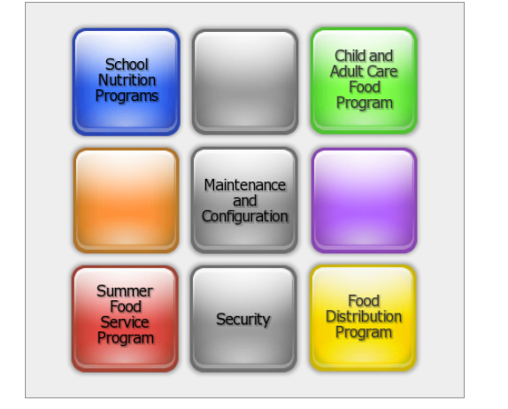
Choose School Nutrition Programs

Slide 4
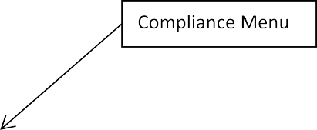
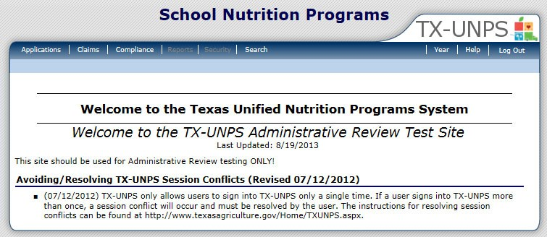
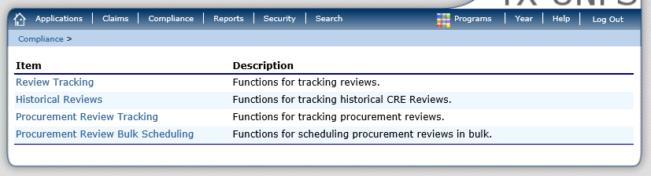
1. Select the Compliance Menu.
2. Select Procurement Review Tracking

Slide 5
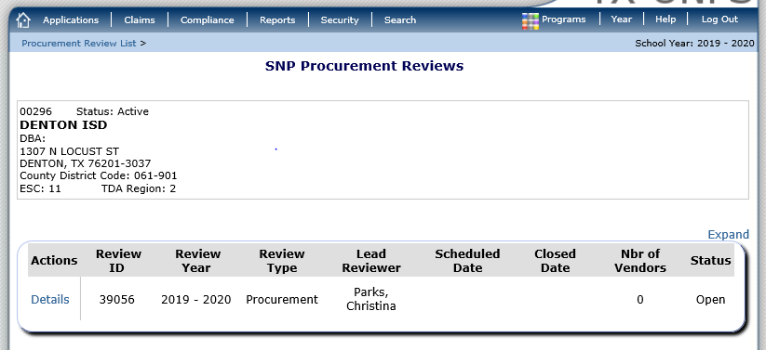
Click Details

Slide 6
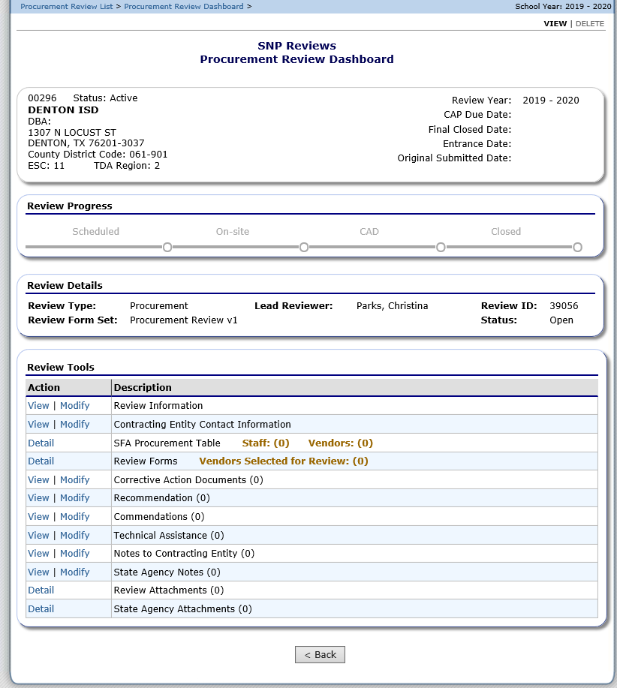

Slide 7
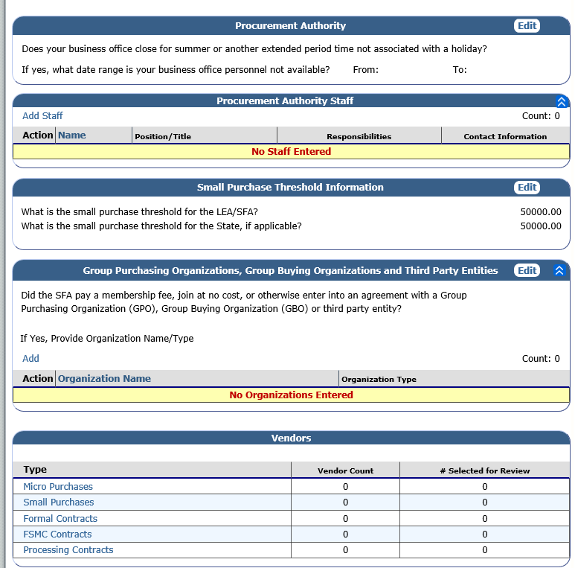
Procurement Table Summary Screen

Slide 8
SFA Procurement Table
Procurement Authority: Allows the CE to enter times that they will be unavailable.
Procurement Authority Staff: CE will enter their staff that handle procurement. This should always at least include the CND and Business Manager/financial person.
  Required sections include:
    Name
    Position/Title
    Responsibilities
    Contact Information
Small Purchase Threshold Information: CE should update the small purchase threshold for the LEA/SFA.
GPO, GBO or third-party entity: CE should respond either yes or no and include the name of the organization and the type.
  Required sections include:
    Organization Name
    Organization Type

Slide 9
Vendors by Type
Micro purchases
Vendors by Type
  Required sections include:
    Vendor name
    Vendor ID (CE can use the same number referenced in accounting documents)
    Goods/services provided
    Total amount paid to vendor
    Goods/services purchased(drop-down)
    How many purchases per vendor and comments if they choose other in the drop-down box.
    CE should not check the box, “selected for review”. Reviewer will be responsible for determining vendors for review.

Slide 10
Micro Purchases

Slide 11
Vendors by Type
Small Purchases
Vendors by Type
  Required sections include:
    Vendor name
    Vendor ID (CE can use the same number referenced in accounting documents)
    Goods/services provided
    Total paid to vendor
    Goods/services purchased (drop down).
    One time or multiple purchases (drop down).
    More than one response?
    Contract obtained through GPO/GBO/non-SFA only coop?
CE should not check the box, “selected for review”. Reviewer will be responsible for determining vendors for review.

Slide 12
Small Purchases

Slide 13
Vendors by Type
Formal Contracts
Vendors by Type
  Required sections include:
    Vendor name
    Vendor ID (CE can use the same number referenced in accounting documents)
    Goods/services provided
    Contract Value
    Solicitation Type
    Contract Type
    Contract duration
    More than one response?
    Contract obtained through GPO/GBO/non-SFA only coop?
    Amendments?
CE should not check the box, “selected for review”. Reviewer will be responsible for determining vendors for review.

Slide 14
Formal Contracts

Slide 15
Vendors by Type
FSMC Contracts
Vendors by Type
  Required sections include:
    Vendor name
    Vendor ID (CE can use the same number referenced in accounting documents)
    Goods/services provided
    Contract Value
    Solicitation Type
    Contract Type
    Contract Year
    More than one response?
    Contract obtained through GPO/GBO/non-SFA only coop?
    Amendments?
CE should not check the box, “selected for review”. Reviewer will be responsible for determining vendors for review.

Slide 16
FSMC Contracts

Slide 17
Vendors by Type
Processing Contracts
Vendors by Type
  Required sections include:
    Vendor name
    Vendor ID (CE can use the same number referenced in accounting documents)
    Goods/services provided
    Contract Value
    Procurement Type (drop down)
    Contract Duration (drop down)
    More than one response?
    Contract obtained through GPO/GBO/non-SFA only coop?
    Amendments?
CE should not check the box, “selected for review”. Reviewer will be responsible for determining vendors for review.

Slide 18
Processing Contracts

Slide 19
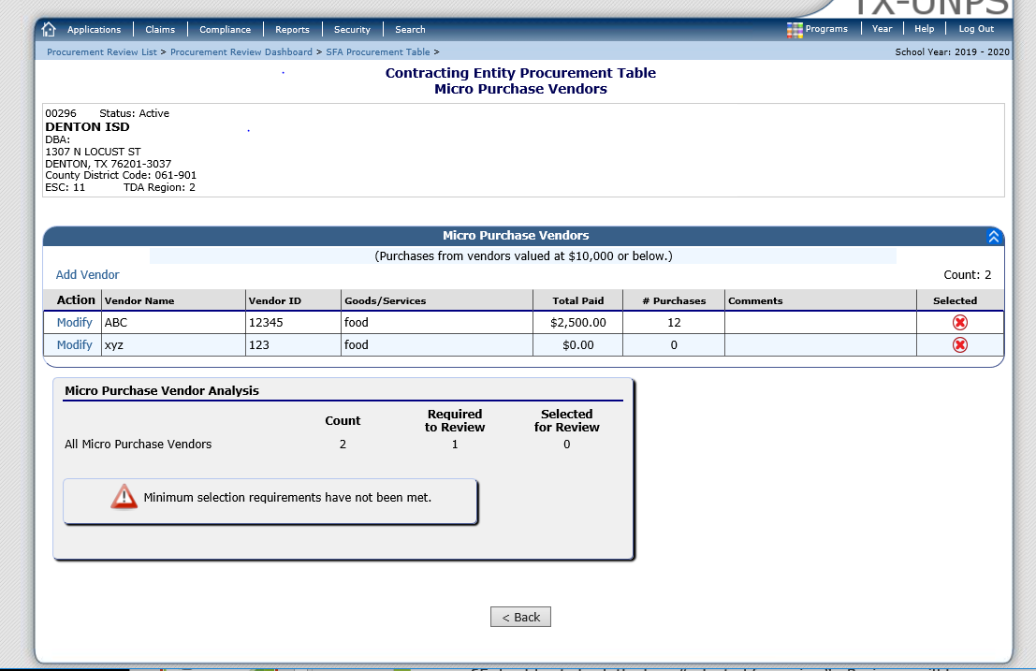
Sample Selection
The required number of vendors to sample is automatically generated in TX-UNPS.
This number is the minimum, so more vendors can be reviewed if necessary.

Slide 20
Documentation Requests
The reviewer should request the following documents from the CE:
  Vendor paid list/summary report of expenditures by vendor.
  Supporting procurement documentation (solicitations, evaluation, and contracts) for each vendor selected for review [2 CFR 200.318(i)].
  The CE's procurement procedures [ CFR 200.318(a) and 7 CFR 210.21(c)].
  Written Code of Conduct [2 CFR 200.318(c) and 7 CFR 210.21(c)].
  Solicitation documentation (copies of quotes and/or sealed bids/competitive proposals issued, and advertisements published, as applicable).
  Responses (quotes for informal procurement procedures and bids/offers for formal procurement procedures).
  Evaluation and scoring results used to select the contractor (for competitive proposals – RFPs)
  Final contract awarded and contract notification documentation.
  Supporting documentation, such as purchase orders and/or receipts/invoices for vendors selected for review (2 CFR 200.318(i)). The State Agency reviewer will examine three receipts from each vendor selected for review. The State has the discretion to request receipts/invoices as follows: three invoices provided in one month from the vendor; one invoice a month for a three-month period; or otherwise as the State Agency chooses.
  Amended contract language, as applicable (The State Agency will need to review amended contracts to determine if a material change was created by an amendment).
  Prior year value of USDA food planned assistance levels for processing contracts for self-operating CEs and for CEs with a FSMC.

Slide 21

Questions??

