Slide 1
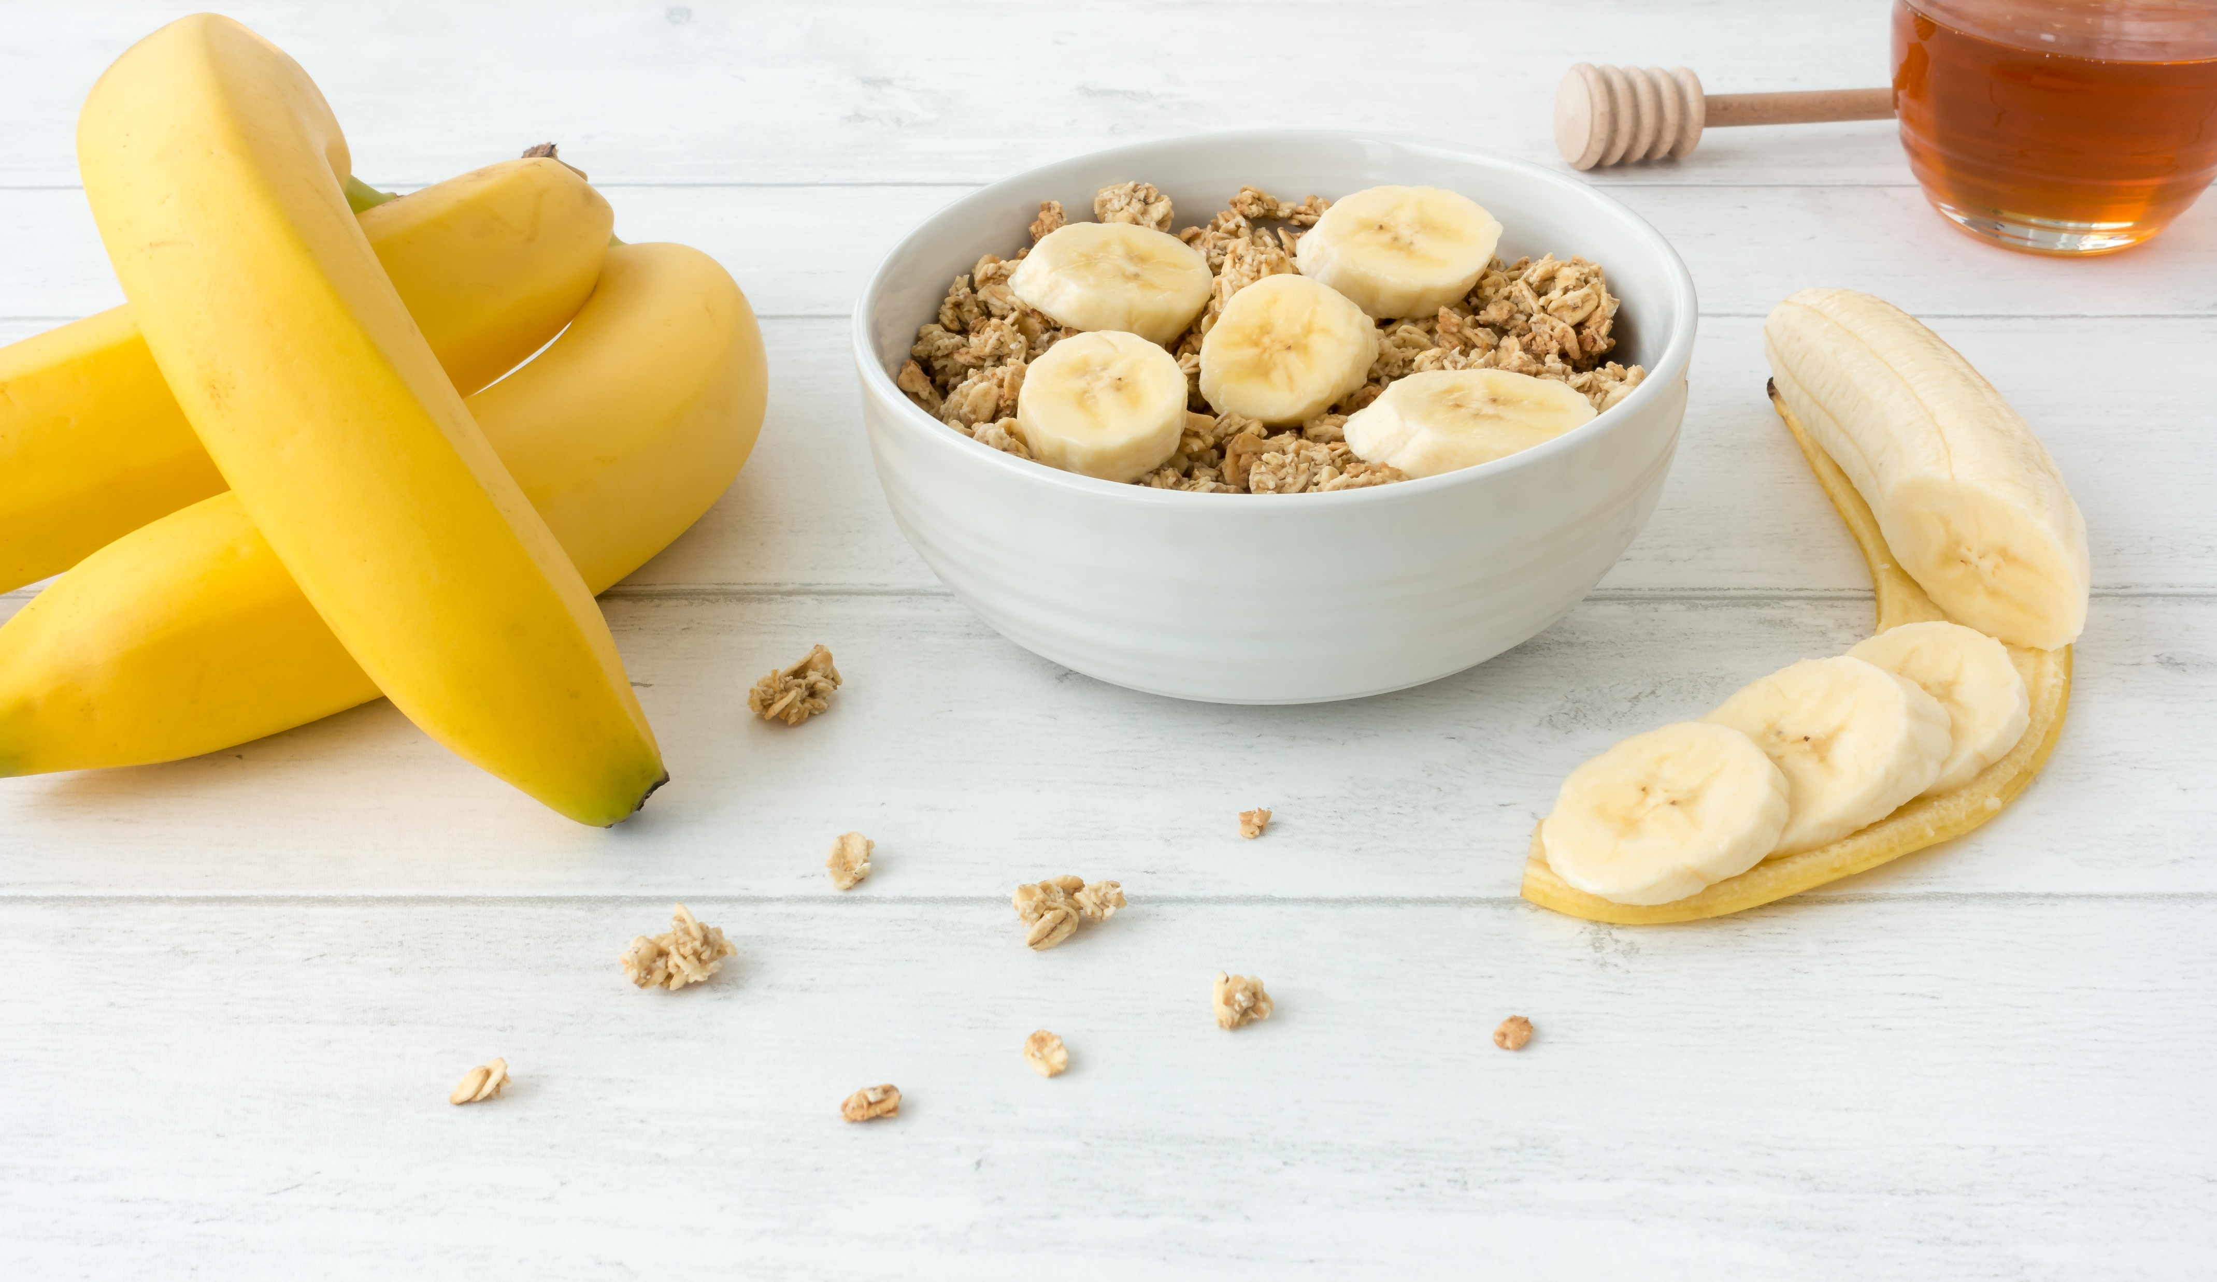
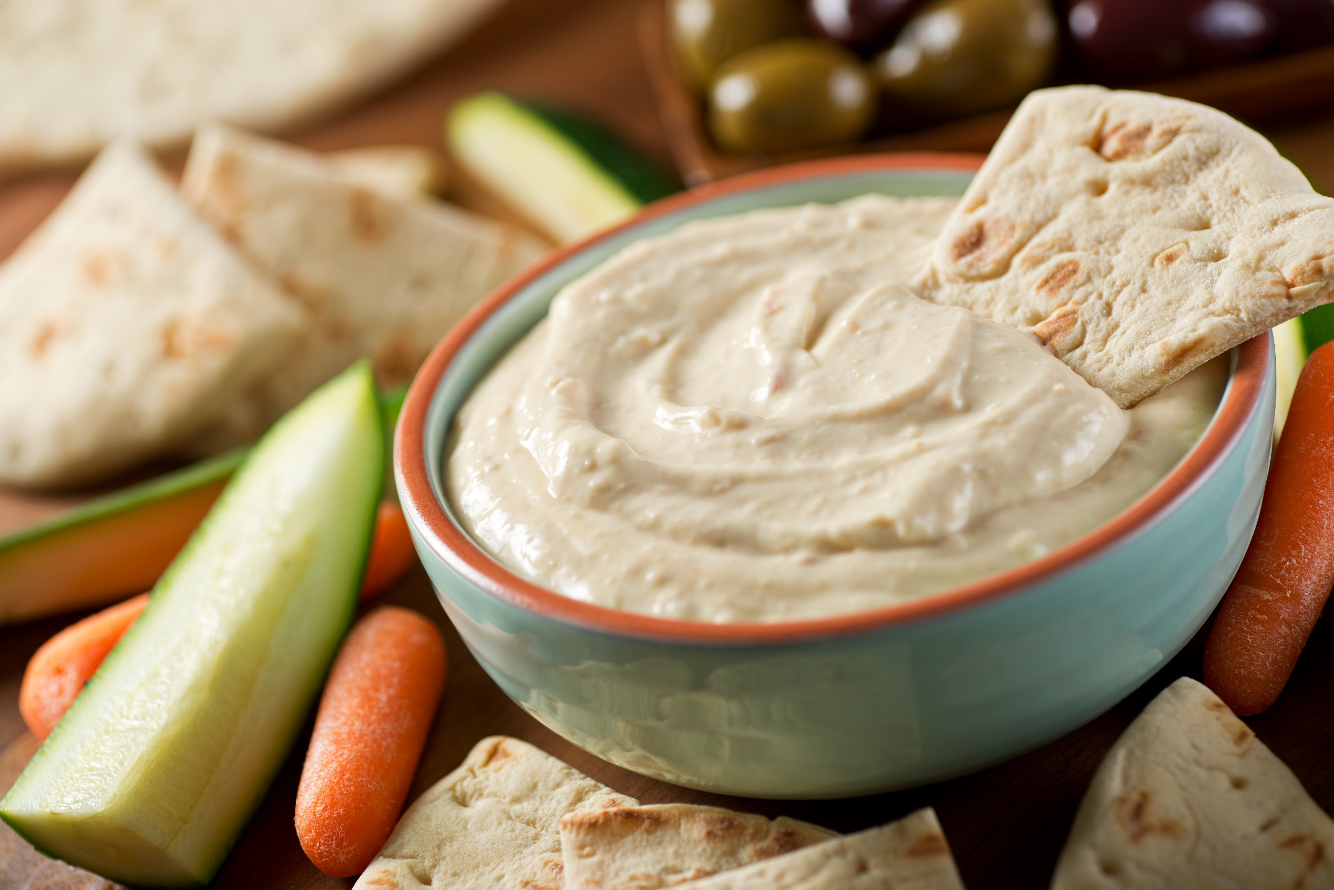
Sample Menu for Adult
 | Monday | Tuesday | Wednesday | Thursday | Friday
Breakfast | Ready to Eat Cereal WG Blueberries Milk | Oatmeal WG Toast Yogurt | Waffles w Syrup Turkey Sausage Banana Milk | WG French Toast Grapes Milk | Quiche Grapefruit Milk
Lunch/ Supper | Spinach and Kale Salad WG Dinner Roll Mandarin Oranges Milk | Baked Chicken Brown Rice Cooked Carrots Green Beans Milk | Minestrone Soup Cheese Cubes Pears French Bread Milk | Beef Chalupa Taco Shells Shredded Lettuce & Died Tomatoes Pineapple Chunks Milk | Tomato Soup WG Grilled Cheese Sandwich Seasonal Fruit Milk
Snack | Hard Boiled Egg Celery Sticks | Cottage Cheese Seasonal Fruit | Rice Cakes Fruit Cocktail | WG crackers Hummus | Vanilla Yogurt Apricots
Adult participants must select 3 food items during breakfast and must have 3 of 5 food components at lunch if the meal is participating in Offer Versus Serve.
Milk is optional at Supper. Yogurt may be substituted for milk once a day when yogurt is not a meat alternate in the same meal.
For complete meal patterns please go to www.SquareMeals.org/
cacfpmealpattern
USDA Standardized Recipes can be found here: https://www.fns.usda.gov/tn/standardized-recipes-cacfp
WG= Whole Grain
TEXAS DEPARTMENT OF AGRICULTURE COMMISSIONER SID MILLER
This product was funded by USDA.
This institution is an equal opportunity provider.
Food and Nutrition Division
Child and Adult Care Food Program
Updated 02/2021
www.SquareMeals.org
Notes:
Sources for menus
Cranberry Orange Muffin
https://www.vernerearlylearning.org/uploads/1/1/4/1/114129345/cranberry-orange-muffin-v4.pdf

Slide 2
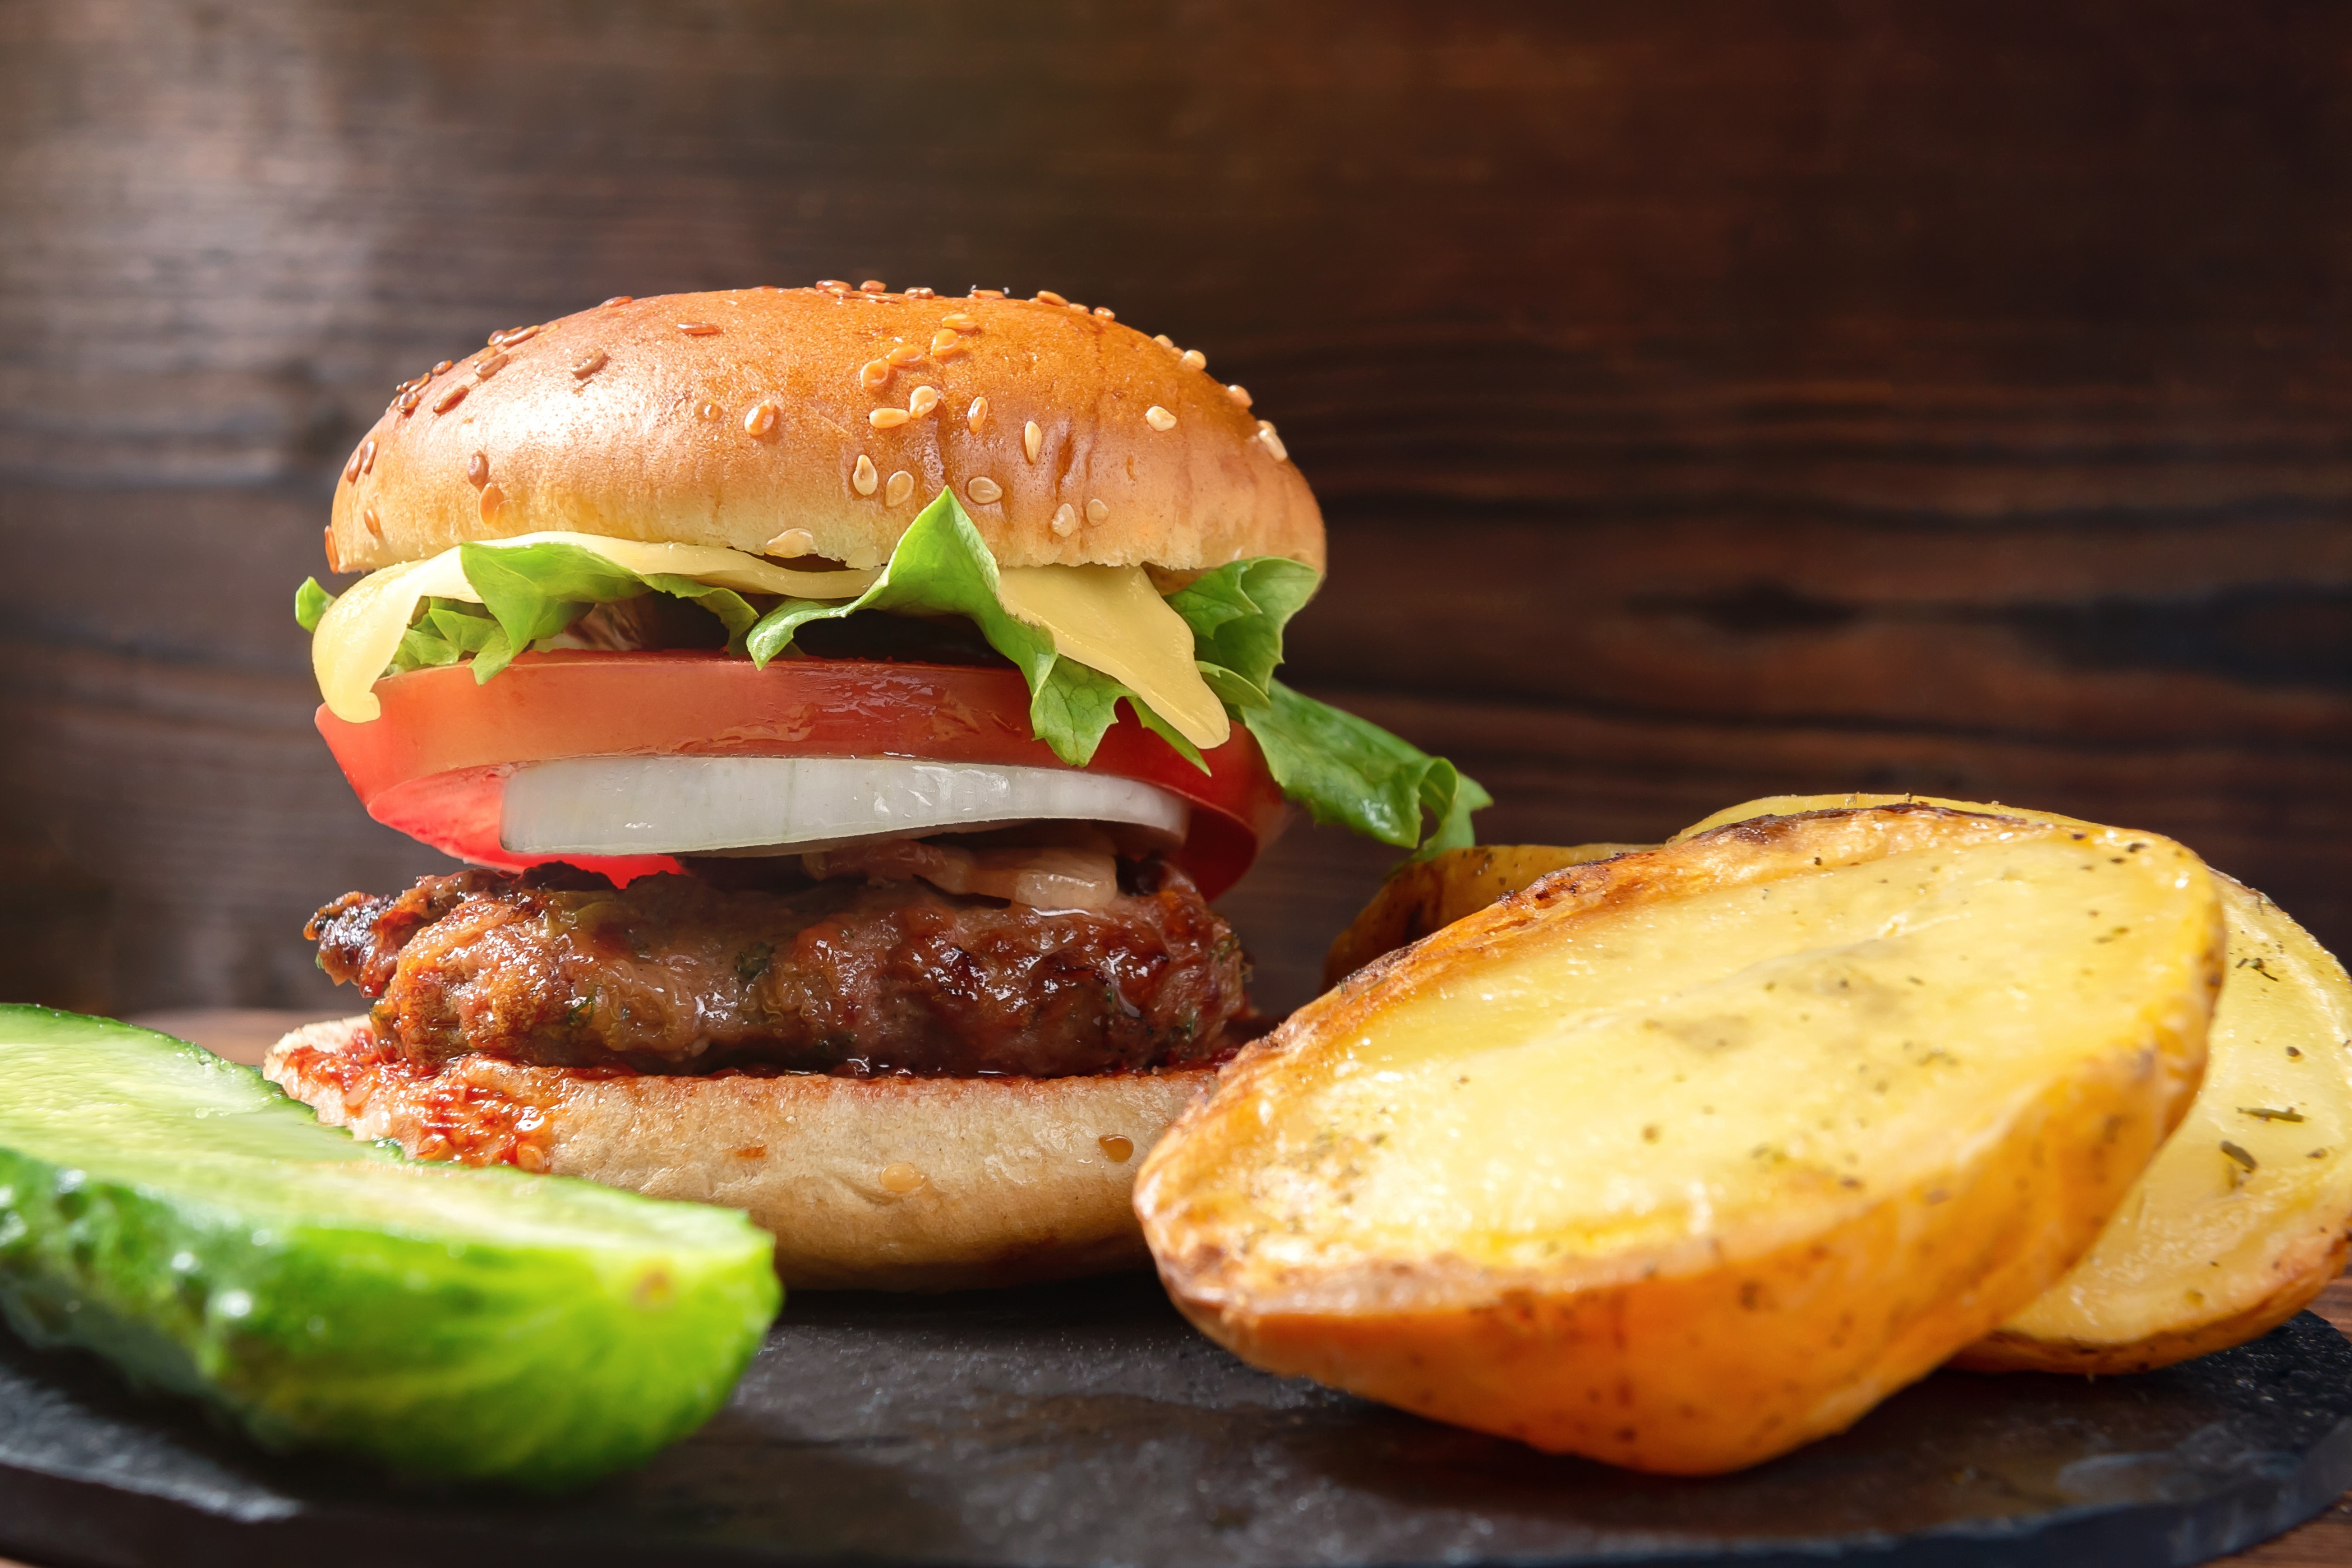
Sample Menu for Adult
 | Monday | Tuesday | Wednesday | Thursday | Friday
Breakfast | WG Bagel w Cream Cheese Orange Wedges Milk | Hot Grits Grapefruit Yogurt | WG Raisin Bread Toast Banana Milk | WG Waffles w/ Maple Syrup Prunes Milk | Toasted WG English Muffin w Jam Apple Slices Milk
Lunch/ Supper | Ham & Cheese Sandwiches (WG) Roasted Potato Salad Cantaloupe Milk | Bean Burrito Bowl * Lettuce, Tomatoes Pear Slices Milk *beans count as Meat Alternate | Baked Fish Filet WG Linguini Pasta Broccoli Bites Seasonal Fruit Milk | Chicken & Rice Soup Saltine Crackers Zucchini Sticks Peach Slices Milk | Hamburger Patty on WG Bun Lettuce, Tomato, Onion Strawberries Milk
Snack | WG Tortilla Chips Pico de Gallo | Apple Slices Pretzels | Graham Crackers Sunbutter Spread | Grapes Cheese Cubes | Baby Carrots Cucumber Dip Pineapple Tidbits
Adult participants must select 3 food items during breakfast and must have 3 of 5 food components at lunch if the meal is participating in Offer Versus Serve.
Milk is optional at Supper. Yogurt may be substituted for milk once a day when yogurt is not a meat alternate in the same meal.
For complete meal patterns please go to www.SquareMeals.org/
cacfpmealpattern
USDA Standardized Recipes can be found here: https://www.fns.usda.gov/tn/standardized-recipes-cacfp
WG= Whole Grain
TEXAS DEPARTMENT OF AGRICULTURE COMMISSIONER SID MILLER
This product was funded by USDA.
This institution is an equal opportunity provider.
Food and Nutrition Division
Child and Adult Care Food Program
Updated 02/2021
www.SquareMeals.org
Notes:
Sources for menus
Cranberry Orange Muffin
https://www.vernerearlylearning.org/uploads/1/1/4/1/114129345/cranberry-orange-muffin-v4.pdf

Slide 3
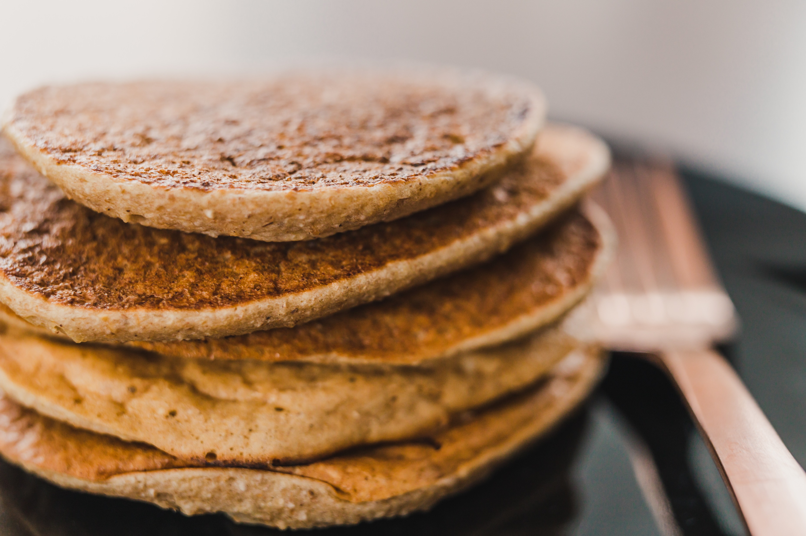
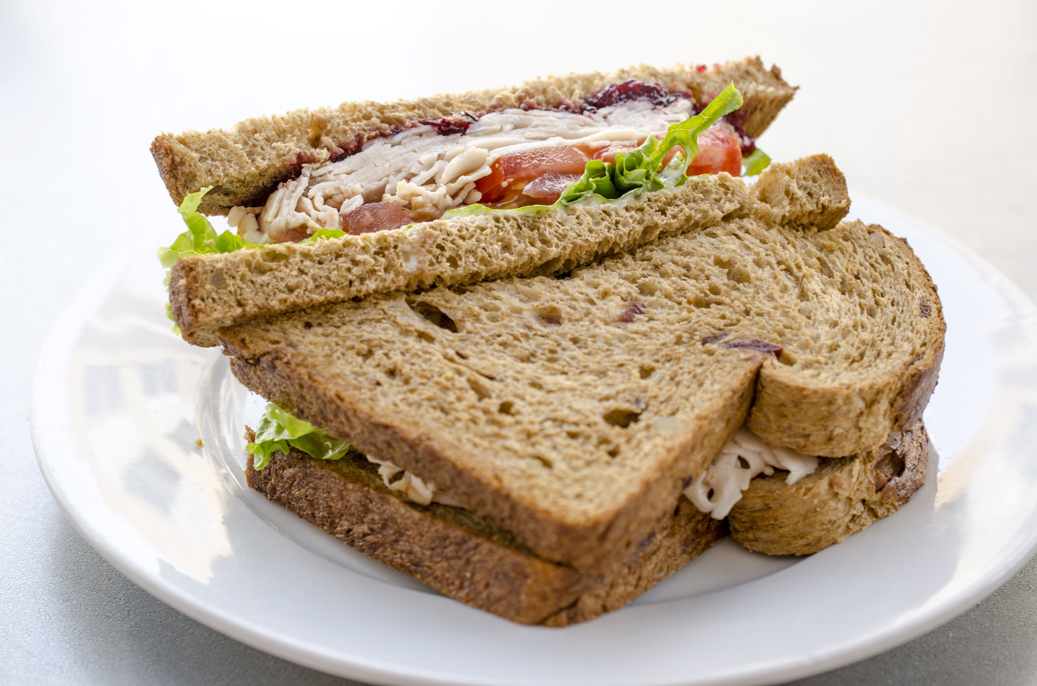
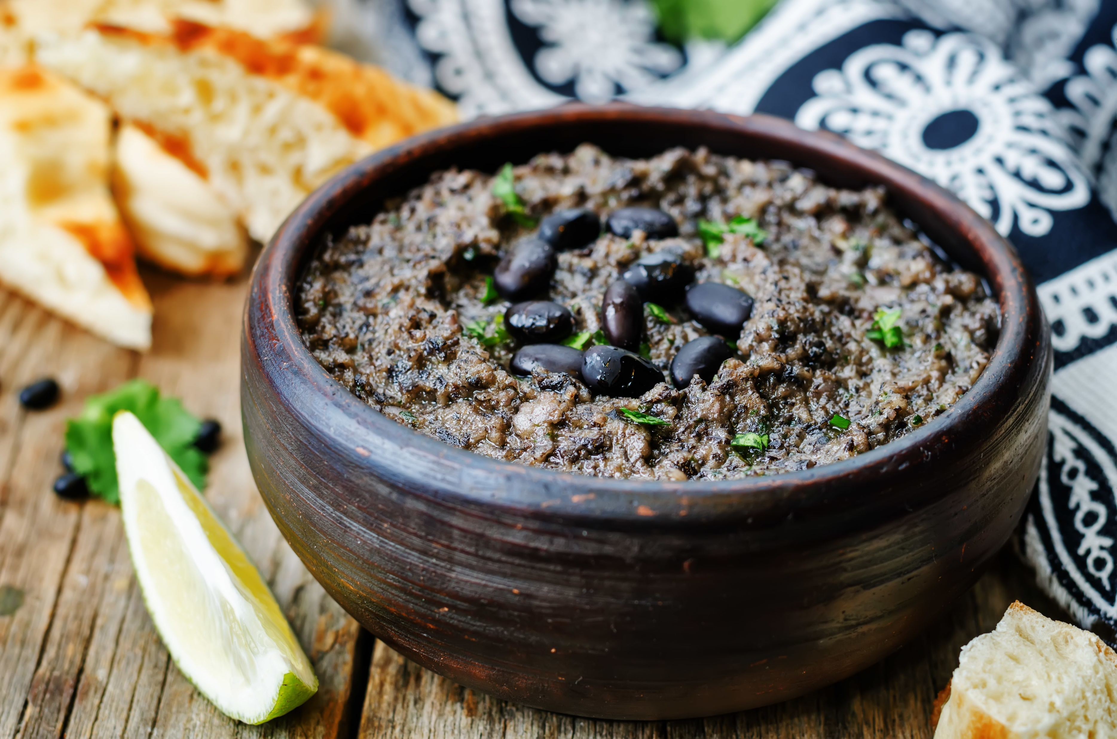
Sample Menu for Adult
 | Monday | Tuesday | Wednesday | Thursday | Friday
Breakfast | WG Pancakes w Syrup Blackberries Milk | Banana Bread Grapefruit Milk | WG English Muffin w Jam Mandarin Oranges Milk | Cream of Wheat Raisins Milk | WG Toast Fried Eggs Pears Milk
Lunch/ Supper | WG Breaded Fish Sticks w Ketchup Spinach Salad Lemon Roasted Cauliflower Milk | Turkey & Cheese WG Sandwich Carrots with Dip Cantaloupe Milk | Pork Roast Mashed Potatoes Roasted Brussels Sprouts WG Dinner Roll Milk | Lasagna Green Beans Apple Slices Milk | Turkey Hot Dog On a Bun Oven Roasted Potatoes Grapes Milk
Snack | Trail Mix with Almonds Milk | Raisins Soft Pretzel with Honey Mustard | Black Bean Hummus Corn Tortilla | Fruit Salsa Pita Triangles | WG Ready to Eat Cereal Milk
Adult participants must select 3 food items during breakfast and must have 3 of 5 food components at lunch if the meal is participating in Offer Versus Serve.
Milk is optional at Supper. Yogurt may be substituted for milk once a day when yogurt is not a meat alternate in the same meal.
For complete meal patterns please go to www.SquareMeals.org/
cacfpmealpattern
USDA Standardized Recipes can be found here: https://www.fns.usda.gov/tn/standardized-recipes-cacfp
WG= Whole Grain
TEXAS DEPARTMENT OF AGRICULTURE COMMISSIONER SID MILLER
This product was funded by USDA.
This institution is an equal opportunity provider.
Food and Nutrition Division
Child and Adult Care Food Program
Updated 02/2021
www.SquareMeals.org
Notes:
Sources for menus
Cranberry Orange Muffin
https://www.vernerearlylearning.org/uploads/1/1/4/1/114129345/cranberry-orange-muffin-v4.pdf

Slide 4
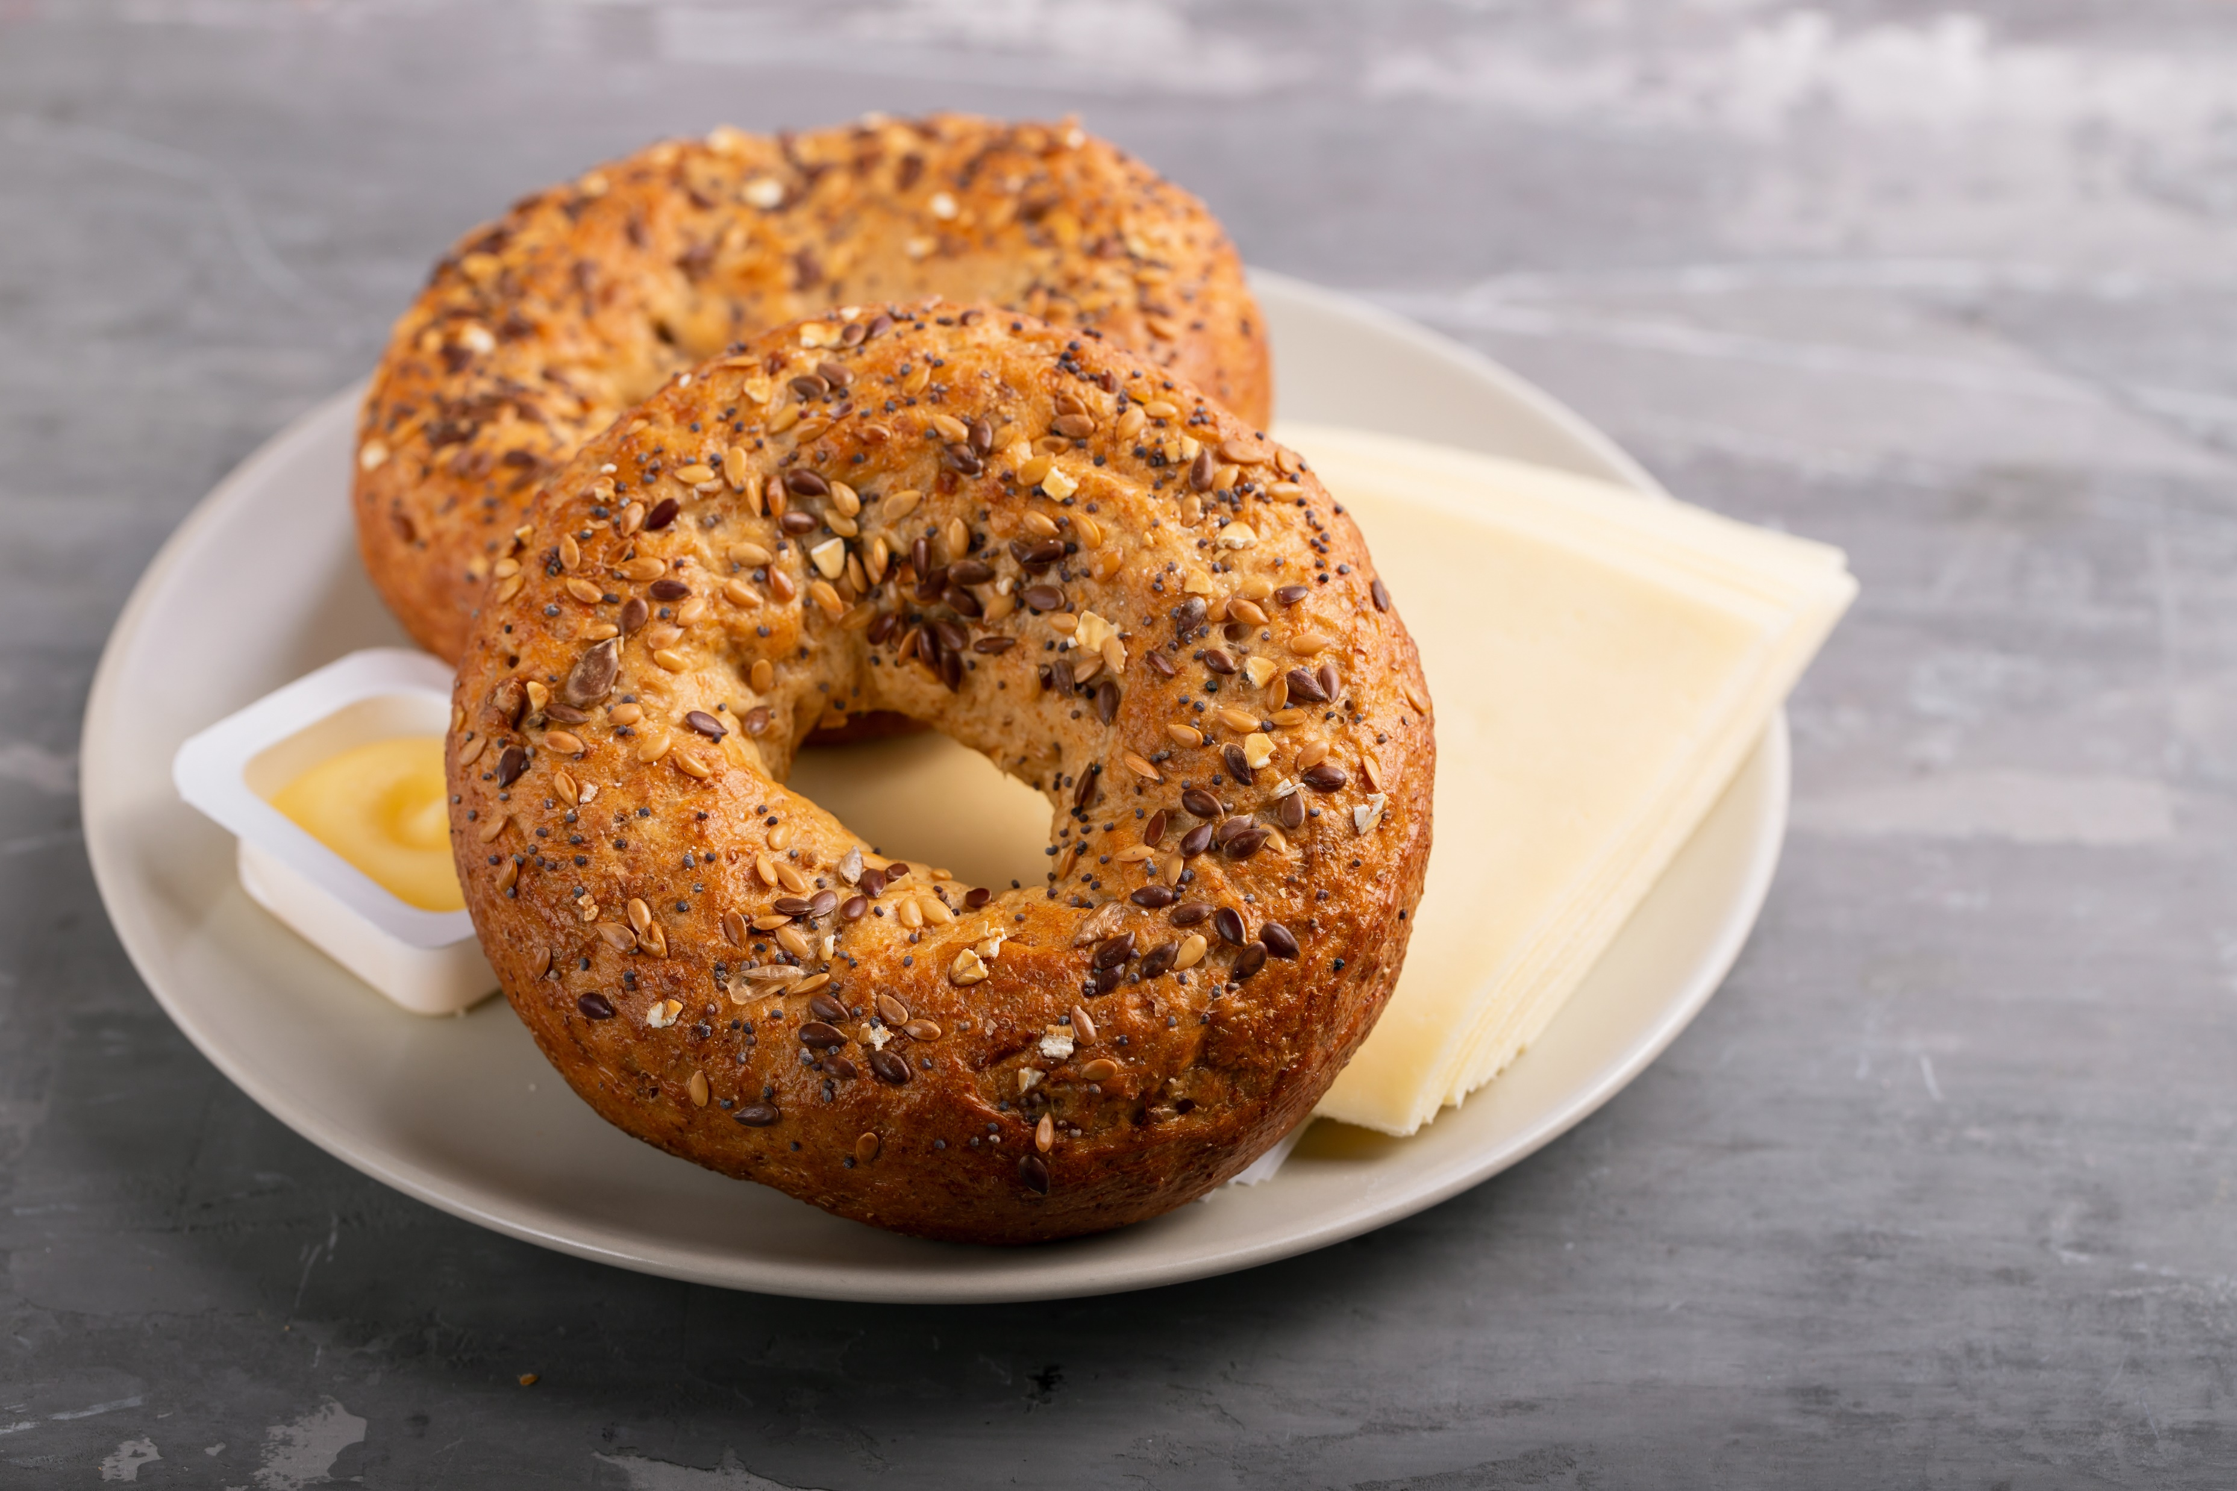
Sample Menu for Adult
 | Monday | Tuesday | Wednesday | Thursday | Friday
Breakfast | WG Bagel Cream Cheese Mixed Berries Milk | WG Blueberry Muffin Fruit Cocktail Yogurt | WG Toasted English Muffin w Jam Banana Milk | WG Ready to EAT Cereal Vegetable Juice Milk | Roasted Potatoes with Turkey Hash Pico de Gallo Fruit Cocktail Milk
Lunch/ Supper | Egg Salad WG Sandwich Dill Pickle Spears Grapes Milk | Mac & Cheese Green Beans Cantaloupe Bread Sticks Milk | Chicken Stir Fry Broccoli Brown Rice Plums Milk | Cheese Pizza Green Salad w Dressing Pears Milk | Taco Salad with WG Taco Shells Pinto Beans Peach Halves Milk
Snack | Pimento Cheese Spread WG Crackers | Animal Crackers Orange Slices | Pineapple Chunks Cottage Cheese | Peanut Butter & Jelly Sandwich Milk | Yogurt Mixed Berries
Adult participants must select 3 food items during breakfast and must have 3 of 5 food components at lunch if the meal is participating in Offer Versus Serve.
Milk is optional at Supper. Yogurt may be substituted for milk once a day when yogurt is not a meat alternate in the same meal.
For complete meal patterns please go to www.SquareMeals.org/
cacfpmealpattern
USDA Standardized Recipes can be found here: https://www.fns.usda.gov/tn/standardized-recipes-cacfp
WG= Whole Grain
TEXAS DEPARTMENT OF AGRICULTURE COMMISSIONER SID MILLER
This product was funded by USDA.
This institution is an equal opportunity provider.
Food and Nutrition Division
Child and Adult Care Food Program
Updated 02/2021
www.SquareMeals.org
Notes:
Sources for menus
Cranberry Orange Muffin
https://www.vernerearlylearning.org/uploads/1/1/4/1/114129345/cranberry-orange-muffin-v4.pdf

