Slide 1


Administrative Review (AR)
For
Contracting Entities
REVIEW FORMS
Notes:
Welcome to The Texas Department of Agriculture’s Administrative Review in TX-UNPS, specifically focusing on Review Forms.

Slide 2

ICON | FUNCTION
 | ATTACHMENT: Select this icon beside the corresponding question to upload a file as an attachment.
 | ERROR: Indicates that a question is in is error. The error process is initiated once a user selects the Validate button at the bottom of the form page. The form will remain in an error status until all required questions have been answered
 | TOOL TIP: Hovering over the icon will briefly display additional information that may aid in answering the review question. The user can also click the icon to display the information in a popup.
!
?
WORDS | DEFINITION
VIEW | View only, no changes are possible
MODIFY | Edit, make changes
DETAIL | Opens selected parts of the review
AGENCY | Contracting Entity
Notes:
The following icons are used in the Administrative review module. Please take a few moments to familiarize yourself with them.
Throughout the AR module you will often see the word ‘AGENCY’ . Agency means Contracting Entity.
ATTACHMENT: Select this icon beside the corresponding question to upload a file as an attachment
ERROR: Indicates that a question is in is error. The error process is initiated once a user selects the Validate button at the bottom of the form page. The form will remain in an error status until all required questions have been answered
TOOL TIP: Hovering over the icon will briefly display additional information that may aid in answering the review question. The user can also click the icon to display the information in a popup.
VIEW: View only, no changes are possible
MODIFY: Edit, make changes
DETAIL: Opens selected parts of the review
AGENCY: Contracting Entity

Slide 3
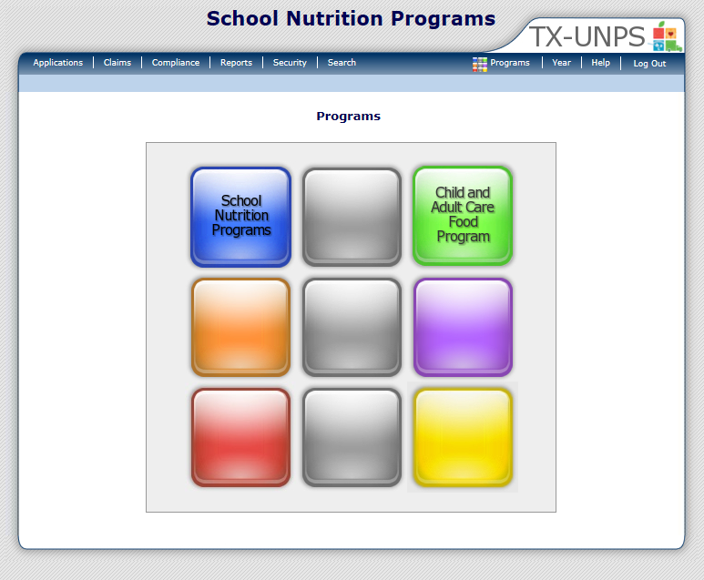
Notes:
After you have logged into the system, click on ‘COMPLIANCE ‘ on the blue navigation menu bar.

Slide 4
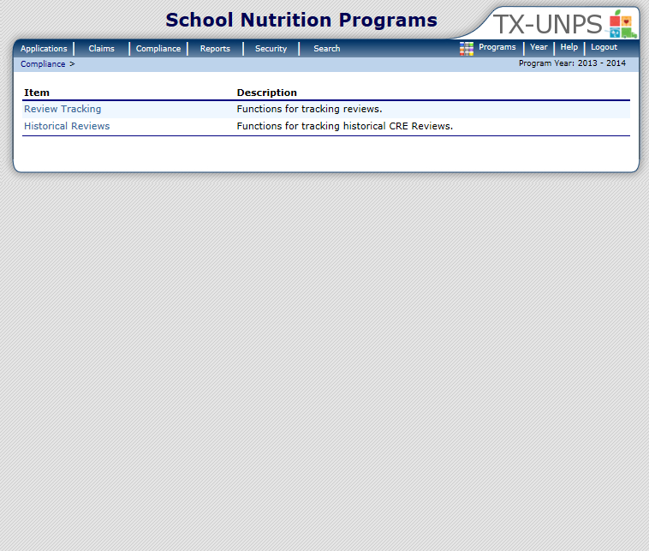
Notes:
Next, select ‘REVIEW TRACKING’.

Slide 5
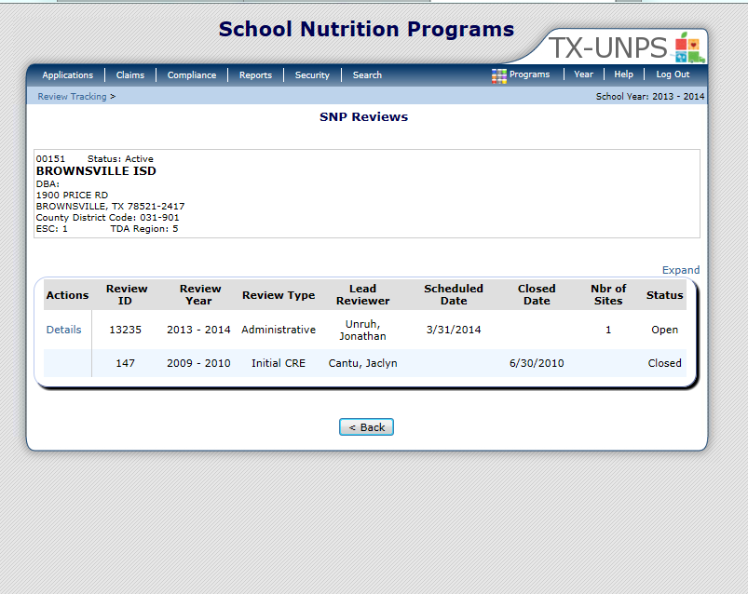
Notes:
This will open up the SNP Review screen
Only Reviews that have a status of Open are accessible. Click ‘DETAILS’

Slide 6
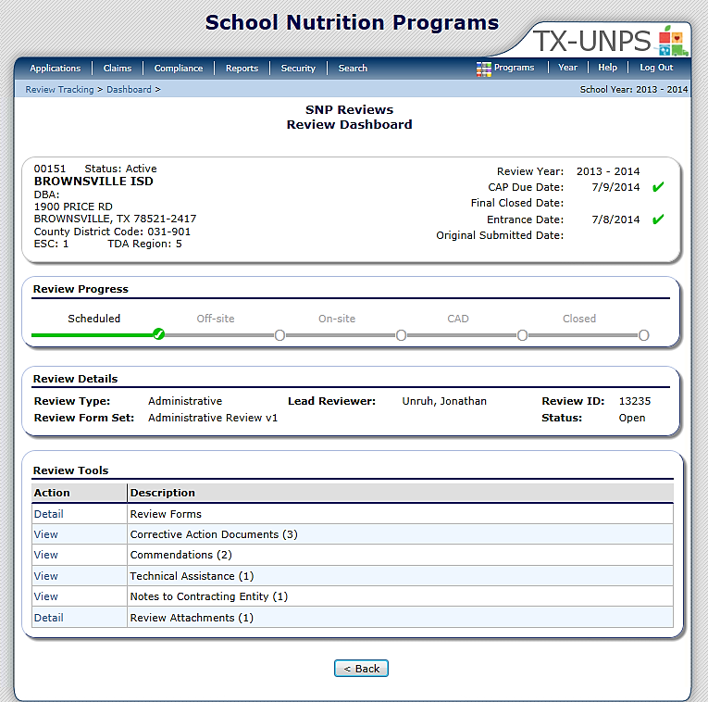
01234 Status: Active
ANYWHERE ISD
DBA:
1 Main ST
Anywhere, US 12345
County District Code : 123-456
ESC Region: 1
SCHOOL
INFORMATION:
IMPORTANT
DATES:
Notes:
The next screen is the Review Dashboard
The Review Dashboard serves as the launching point for all information pertaining to the review.
At the top of the page you will see a box that has basic information:
On the left is the school’s basic information (name, address and ESC region)
On the right are important dates (Review year, CAP due date, Final closed date, Entrance date and original submitted date).
Below this box is the REVIEW PROGRESS box. The review progress bar enables you to view the stage of the review at–a-glance. Each stage must be completed sequentially in order to progress through the review process
The last box contains the REVIEW TOOLS. This is where you will navigate to specific sections or modules of the review.

Slide 7

01234 Status: Active
ANYWHERE ISD
DBA:
1 Main ST
Anywhere, US 12345
County District Code : 123-456
ESC Region: 1
Notes:
You can access ‘REVIEW FORMS’ from the Review dashboard.
To open, select ‘DETAIL’

Slide 8
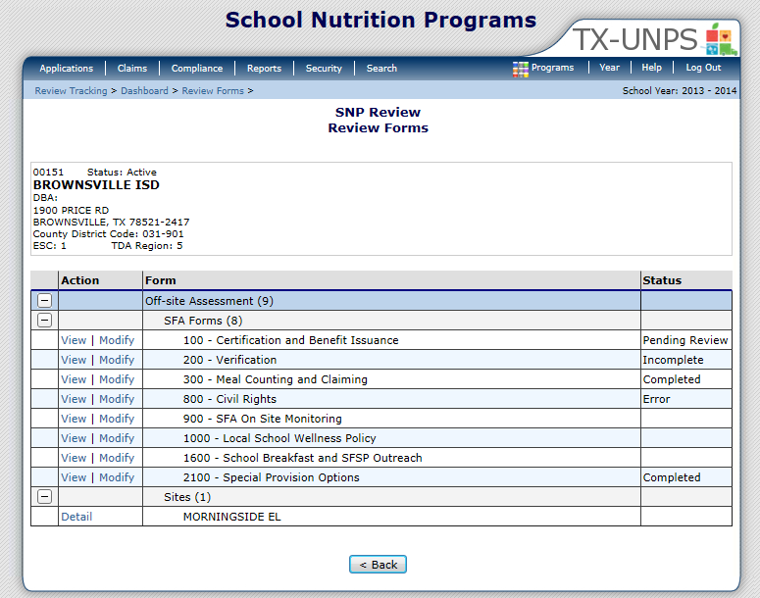
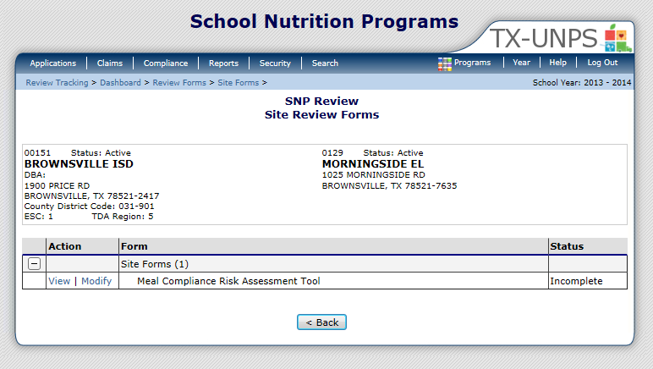
01234 Status: Active
ANYWHERE ISD
DBA:
1 Main ST
Anywhere, US 12345
County District Code : 123-456
ESC Region: 1
01234 Status: Active
ANYWHERE ISD
DBA:
1 Main ST
Anywhere, US 12345
County District Code : 123-456
ESC Region: 1
01234 Status: Active
ANYWHERE ISD
DBA:
1 Main ST
Anywhere, US 12345
County District Code : 123-456
ESC Region: 1
Not Started
Not Started
Not Started
Not Started
Not Applicable
Notes:
The Review Forms module requires the CE to open up forms contained here and answer the required questions.
Both SFA (CE) level forms and Site level forms are located here.
To see the Site level forms click on ‘Detail’ next to each site. This will expand the selected site and show you forms that you can open up for each site.
You can find the status of each form in the far right column.
Possible status include:
Not Started = CE has not started that series of questions
Not Applicable = CE does not need to answer this series of questions b/c they do not apply to their operations
Incomplete = CE has started, but has not finished a series of questions
Error = CE has not answered all the required questions in a series
Pending Review = CE has answered all questions and they are ready for TDA review
To open a SFA or site level form click on ‘MODIFY’ next to each finding.

Slide 9
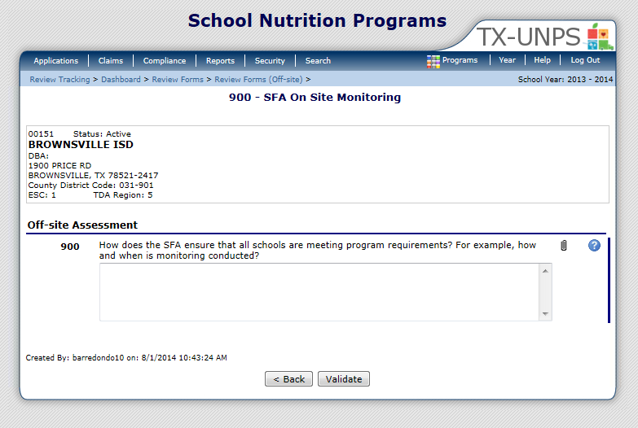

01234 Status: Active
ANYWHERE ISD
DBA:
1 Main ST
Anywhere, US 12345
County District Code : 123-456
ESC Region: 1
Notes:
Once you open a finding you must answer all required questions.
Tool tips are provided for many questions to provide additional clarification and guidance for a specific question.
You will also notice the paperclip icon which allows you to attach documents. For specific instructions on attaching documents please review the REVIEW ATTACHMENT webinar.
When you have completed this form select ‘VALIDATE’.

Slide 10
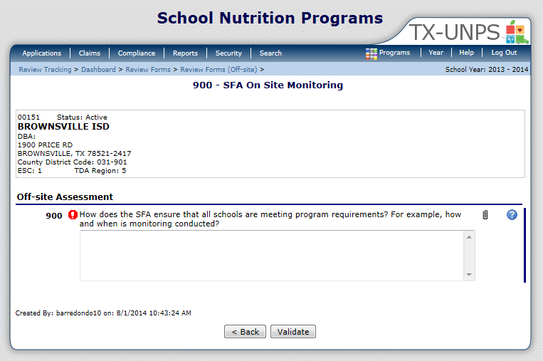
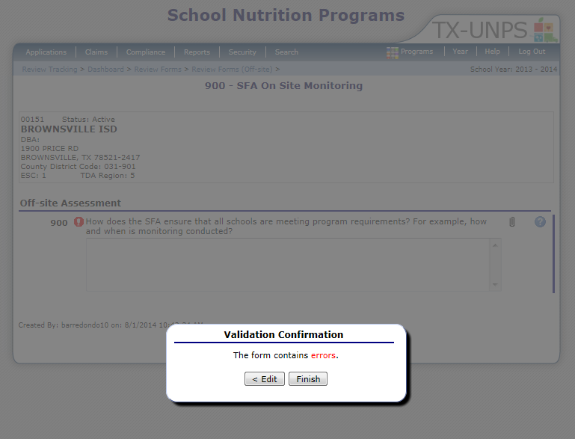
01234 Status: Active
ANYWHERE ISD
DBA:
1 Main ST
Anywhere, US 12345
County District Code : 123-456
ESC Region: 1
01234 Status: Active
ANYWHERE ISD
DBA:
1 Main ST
Anywhere, US 12345
County District Code : 123-456
ESC Region: 1
Question must be answered
All sites are monitored on a weekly basis.
Notes:
After selecting ‘Validate’ the system will check for error. If errors are found you will receive this message.
To correct the errors select edit.
This will bring you back to the previous screen.
If you hoover over the help icon you will be able to find out more information about the error.
Make the correction and select ‘VALIDATE’

Slide 11
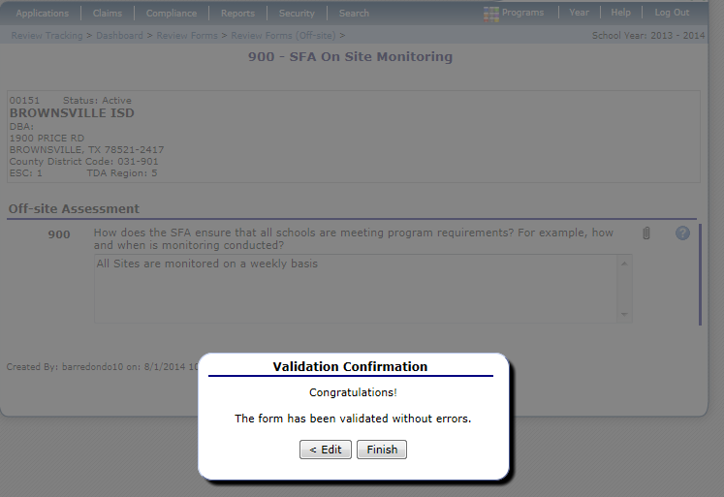
01234 Status: Active
ANYWHERE ISD
DBA:
1 Main ST
Anywhere, US 12345
County District Code : 123-456
ESC Region: 1
Notes:
If you have successfully completed all questions you will now receive a Validation Confirmation message after selecting the validate button.
Next, select ‘FINISH’

Slide 12
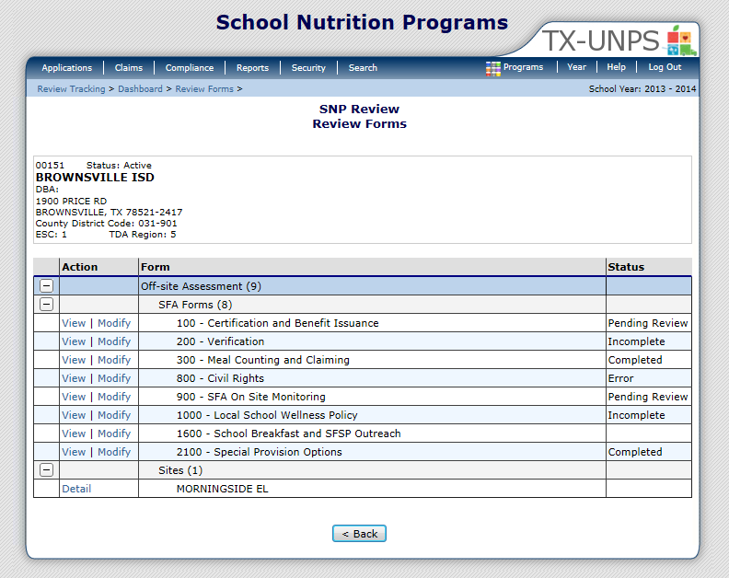
01234 Status: Active
ANYWHERE ISD
DBA:
1 Main ST
Anywhere, US 12345
County District Code : 123-456
ESC Region: 1
Notes:
After you select finish you will be brought back to the main Review Forms screen.
You should now see the status reading ‘PENDING REVIEW’.
Complete this process for both SFA (CE) level forms and Site level forms.

Slide 13


In accordance with Federal civil rights law and U.S. Department of Agriculture (USDA) civil rights regulations and policies, the USDA, its Agencies, offices, and employees, and institutions participating in or administering USDA programs are prohibited from discriminating based on race, color, national origin, sex, disability, age, or reprisal or retaliation for prior civil rights activity in any program or activity conducted or funded by USDA.
Persons with disabilities who require alternative means of communication for program information (e.g. Braille, large print, audiotape, American Sign Language, etc.), should contact the Agency (State or local) where they applied for benefits. Individuals who are deaf, hard of hearing or have speech disabilities may contact USDA through the Federal Relay Service at (800) 877-8339. Additionally, program information may be made available in languages other than English.
To file a program complaint of discrimination, complete the USDA Program Discrimination Complaint Form, (AD-3027) found online at: How to File a Complaint, and at any USDA office, or write a letter addressed to USDA and provide in the letter all of the information requested in the form. To request a copy of the complaint form, call (866) 632-9992. Submit your completed form or letter to USDA by:
mail:
U.S. Department of Agriculture
Office of the Assistant Secretary for Civil Rights
1400 Independence Avenue, SW
Washington, D.C. 20250-9410;
fax: (202) 690-7442; or email: program.intake@usda.gov.
This institution is an equal opportunity provider.
TEXAS DEPARTMENT OF AGRICULTURE
COMMISSIONER SID MILLER
Food and Nutrition Division
National School Lunch Program
This product was funded by USDA.
This institution is an equal opportunity provider.
Updated 12/22/2020
www.SquareMeals.org

