Slide 1


Administrative Review (AR)
For
Contracting Entities
COMMENDATIONS
TECHNICAL ASSISTANCE
NOTES TO CEs
Notes:
Welcome to The Texas Department of Agriculture’s Administrative Review in TX-UNPS, focusing specifically on Viewable Only modules: Commendations, Technical assistance and Notes to Ces

Slide 2

ICON | FUNCTION
 | ATTACHMENT: Select this icon beside the corresponding question to upload a file as an attachment.
 | ERROR: Indicates that a question is in is error. The error process is initiated once a user selects the Validate button at the bottom of the form page. The form will remain in an error status until all required questions have been answered
 | TOOL TIP: Hovering over the icon will briefly display additional information that may aid in answering the review question. The user can also click the icon to display the information in a popup.
!
?
WORDS | DEFINITION
VIEW | View only, no changes are possible
MODIFY | Edit, make changes
DETAIL | Opens selected parts of the review
AGENCY | Contracting Entity
Notes:
The following icons are used in the Administrative review module. Please take a few moments to familiarize yourself with them.
Throughout the AR module you will often see the word ‘AGENCY’ . Agency means Contracting Entity.
ATTACHMENT: Select this icon beside the corresponding question to upload a file as an attachment
ERROR: Indicates that a question is in is error. The error process is initiated once a user selects the Validate button at the bottom of the form page. The form will remain in an error status until all required questions have been answered
TOOL TIP: Hovering over the icon will briefly display additional information that may aid in answering the review question. The user can also click the icon to display the information in a popup.
VIEW: View only, no changes are possible
MODIFY: Edit, make changes
DETAIL: Opens selected parts of the review
AGENCY: Contracting Entity

Slide 3
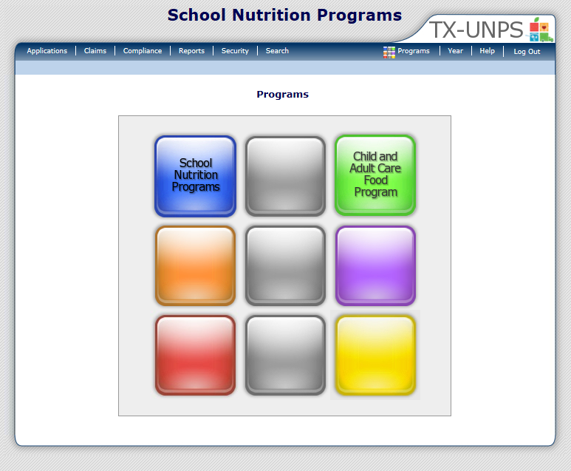
Notes:
After you have logged into the system, click on ‘COMPLIANCE ‘ on the blue navigation menu bar

Slide 4
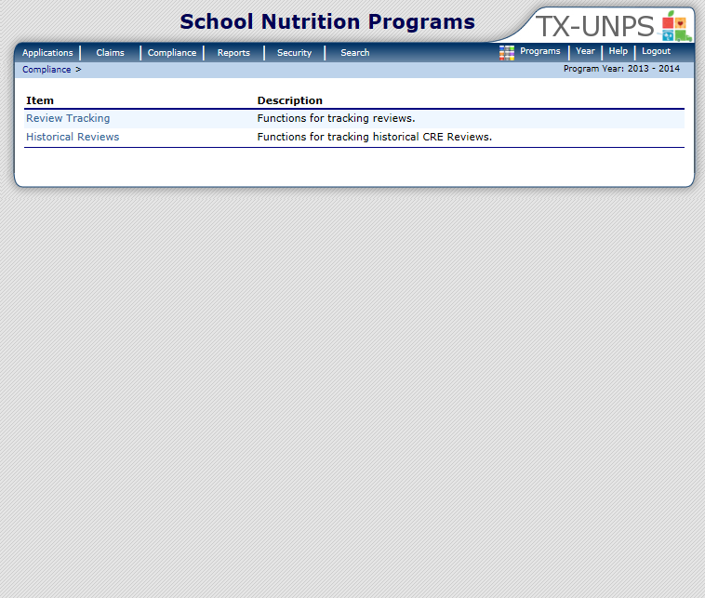
Notes:
Next, select ‘REVIEW TRACKING’

Slide 5

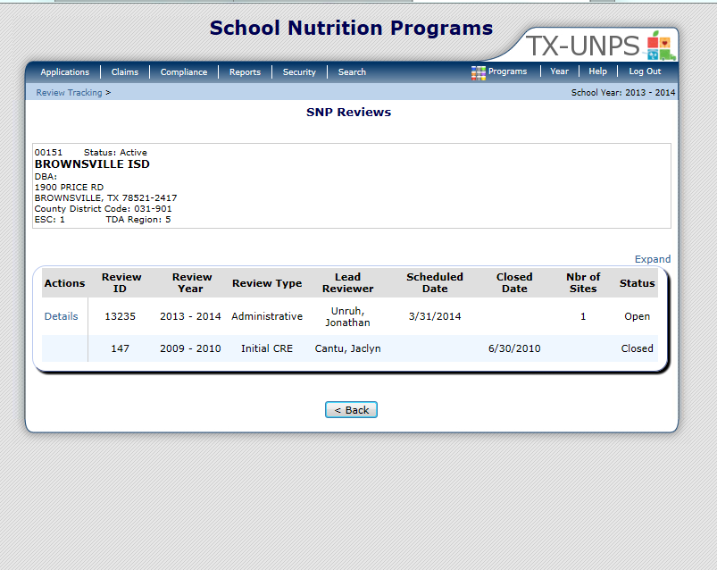
Notes:
This will open up the SNP Review screen
Only Reviews that have a status of Open are accessible. Click ‘DETAILS’

Slide 6
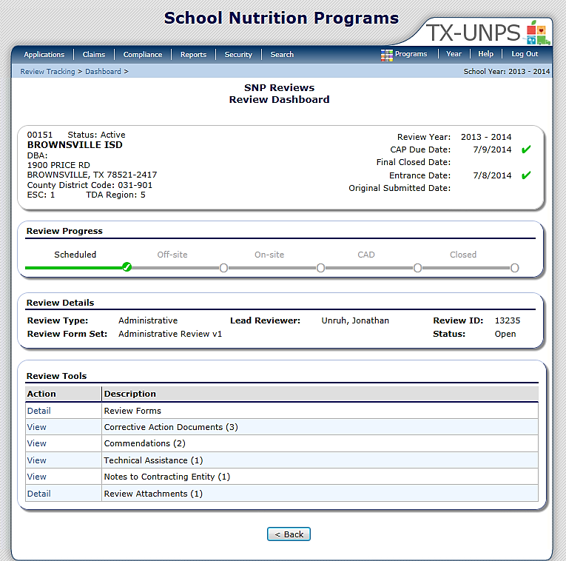
01234 Status: Active
ANYWHERE ISD
DBA:
1 Main ST
Anywhere, US 12345
County District Code : 123-456
ESC Region: 1
SCHOOL
INFORMATION:
IMPORTANT
DATES:
Notes:
The next screen is the Review Dashboard.
The Review Dashboard serves as the launching point for all information pertaining to the review.
At the top of the page you will see a box that has basic information:
On the left is the school’s basic information (name, address and ESC region)
On the right are important dates (Review year, CAP due date, Final closed date, Entrance date and original submitted date).
Below this box is the REVIEW PROGRESS box. The review progress bar enables you to view the stage of the review at–a-glance. Each stage must be completed sequentially in order to progress through the review process.
The last box contains the REVIEW TOOLS. This is where you will navigate to specific sections or modules of the review.

Slide 7

01234 Status: Active
ANYWHERE ISD
DBA:
1 Main ST
Anywhere, US 12345
County District Code : 123-456
ESC Region: 1
Notes:
You can access ‘COMMENDATIONS’ from the Review Dashboard. To open select ‘VIEW’.
The number of Commendations can be found in the ().

Slide 8
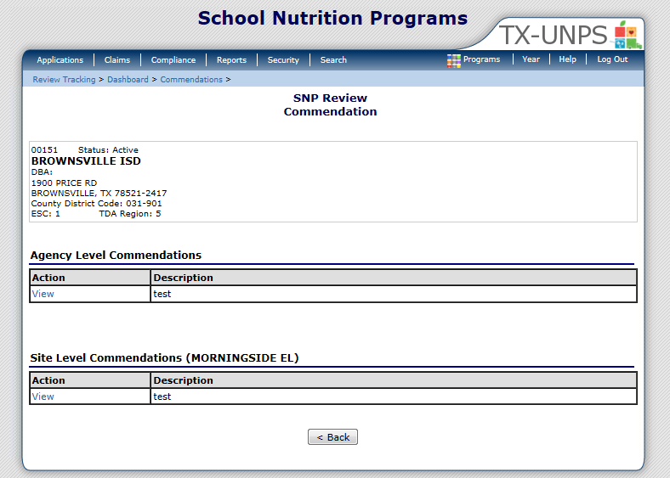
01234 Status: Active
ANYWHERE ISD
DBA:
1 Main ST
Anywhere, US 12345
County District Code : 123-456
ESC Region: 1
Notes:
To open a Contracting Agency or Site level commendation click ‘VIEW’.

Slide 9
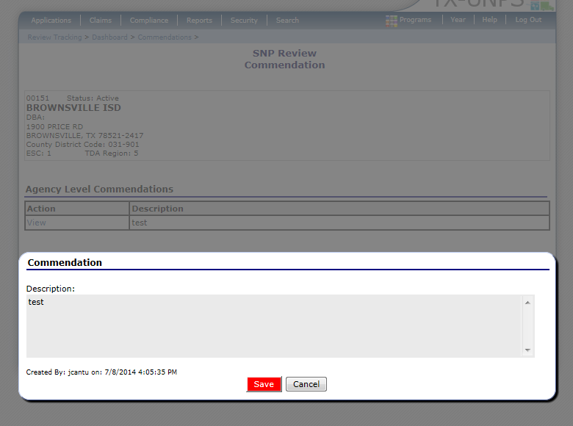
01234 Status: Active
ANYWHERE ISD
DBA:
1 Main ST
Anywhere, US 12345
County District Code : 123-456
ESC Region: 1
You did a great job!
Notes:
Here you can view any commendations that have been documented

Slide 10

01234 Status: Active
ANYWHERE ISD
DBA:
1 Main ST
Anywhere, US 12345
County District Code : 123-456
ESC Region: 1
Notes:
You can access ‘TECHNICAL ASSISTANCE’ from the Review Dashboard. To open, select ‘VIEW’.
You can see the number of TA entries listed in the ().

Slide 11
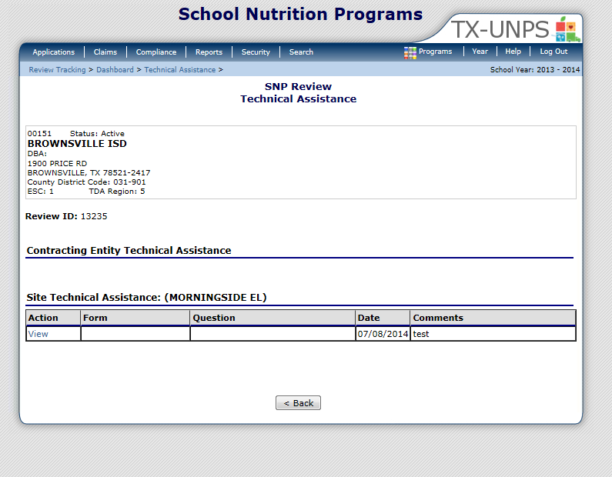
01234 Status: Active
ANYWHERE ISD
DBA:
1 Main ST
Anywhere, US 12345
County District Code : 123-456
ESC Region: 1
Notes:
After selecting ‘View” you will be brought to the Technical Assistance home screen.
Here you will find both CE Level TA and Site Level TA.
If you would like to review any Technical Assistance, Click on ‘VIEW’ next to the entry that you would like more information about.

Slide 12
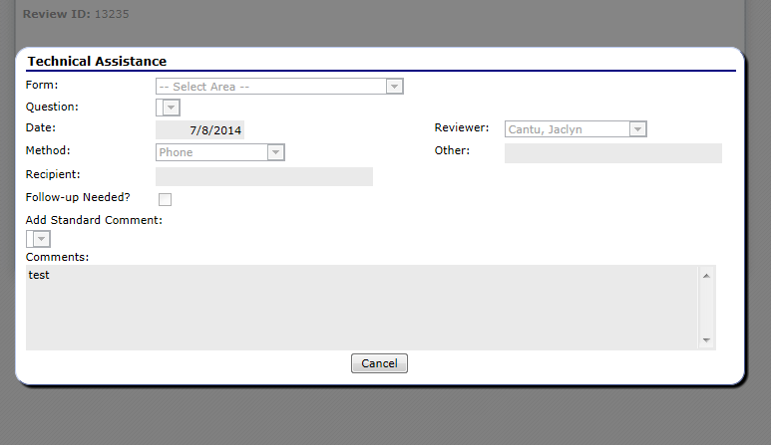
Notes:
You will now see the details for the technical assistance that you have selected.
Form: area that assistance was provided on
Question number
Date it was provided
How it was provided
Who received the assistance
If Follow-up is needed
The name of the Reviewer and
Comments

Slide 13

01234 Status: Active
ANYWHERE ISD
DBA:
1 Main ST
Anywhere, US 12345
County District Code : 123-456
ESC Region: 1
Notes:
You can access ‘NOTES TO CONTRACTING ENTITY’ from the Review Dashboard. To open, select ‘VIEW’ . The number of notes are listed in the ()

Slide 14
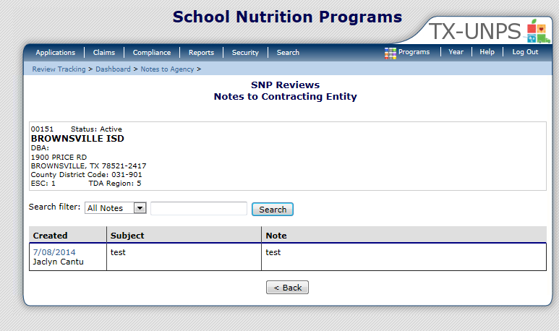
01234 Status: Active
ANYWHERE ISD
DBA:
1 Main ST
Anywhere, US 12345
County District Code : 123-456
ESC Region: 1
Notes:
Notes are shown here and provide a quick view of who created the note and when it was created, the subject and the first few lines of the note.
Notes can be filtered by ‘created by’ which will list the notes by the name of the person who wrote it. Otherwise they will be listed in date order.
You can also type in the name of the person who created the note then select ‘SEARCH’ and your results will be listed again by the name of the person who wrote it.
To open the note click the Date in the ‘CREATED’ box.

Slide 15
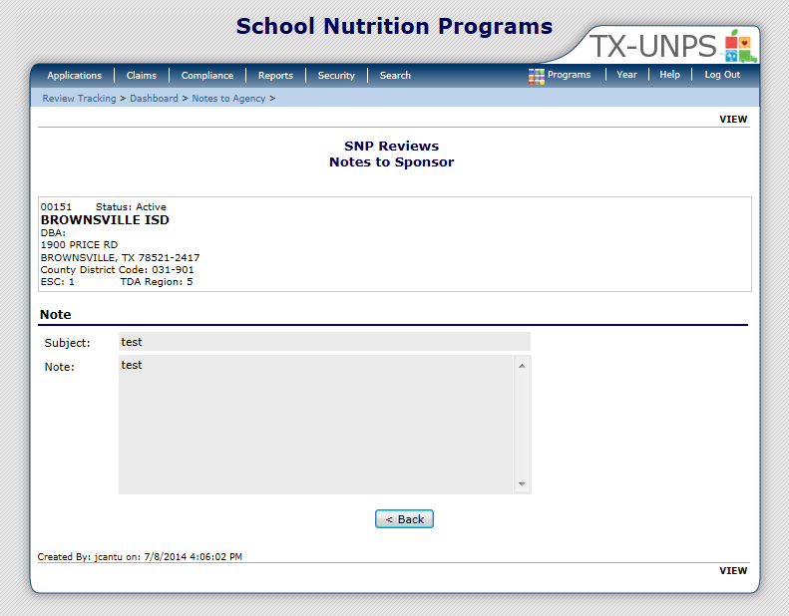
01234 Status: Active
ANYWHERE ISD
DBA:
1 Main ST
Anywhere, US 12345
County District Code : 123-456
ESC Region: 1
Notes:
This next screen is a detailed look at the full note.

Slide 16

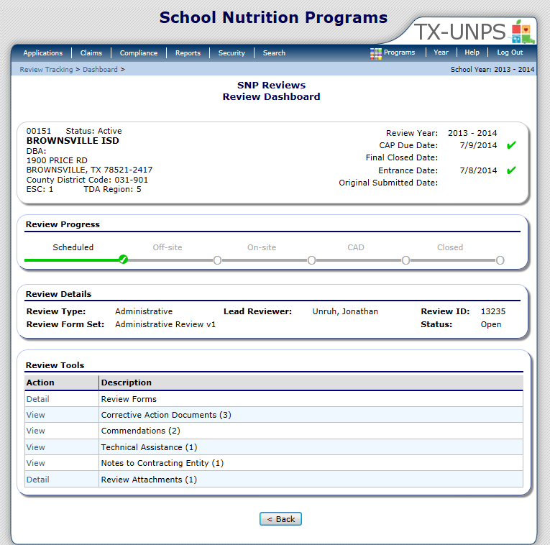
01234 Status: Active
ANYWHERE ISD
DBA:
1 Main ST
Anywhere, US 12345
County District Code : 123-456
ESC Region: 1
Notes:
Remember these 3 modules are viewable only and simply provides information for your review.

Slide 17


In accordance with Federal civil rights law and U.S. Department of Agriculture (USDA) civil rights regulations and policies, the USDA, its Agencies, offices, and employees, and institutions participating in or administering USDA programs are prohibited from discriminating based on race, color, national origin, sex, disability, age, or reprisal or retaliation for prior civil rights activity in any program or activity conducted or funded by USDA.
Persons with disabilities who require alternative means of communication for program information (e.g. Braille, large print, audiotape, American Sign Language, etc.), should contact the Agency (State or local) where they applied for benefits. Individuals who are deaf, hard of hearing or have speech disabilities may contact USDA through the Federal Relay Service at (800) 877-8339. Additionally, program information may be made available in languages other than English.
To file a program complaint of discrimination, complete the USDA Program Discrimination Complaint Form, (AD-3027) found online at: How to File a Complaint, and at any USDA office, or write a letter addressed to USDA and provide in the letter all of the information requested in the form. To request a copy of the complaint form, call (866) 632-9992. Submit your completed form or letter to USDA by:
mail:
U.S. Department of Agriculture
Office of the Assistant Secretary for Civil Rights
1400 Independence Avenue, SW
Washington, D.C. 20250-9410;
fax: (202) 690-7442; or email: program.intake@usda.gov.
This institution is an equal opportunity provider.
TEXAS DEPARTMENT OF AGRICULTURE
COMMISSIONER SID MILLER
Food and Nutrition Division
National School Lunch Program
This product was funded by USDA.
This institution is an equal opportunity provider.
Updated 12/22/2020
www.SquareMeals.org

